Slide 1

Containers in OpenShift
Best Practices & Security
Carlos López
Specialist Adoption Architect

Slide 2
Agenda
Build efficient containers
Users and Service Accounts
Root Containers and Security Context Constraints
Using Secrets and Vaults
Network Policies

Slide 3
Build efficient containers

Slide 4


Containers are created from container images
Build efficient containers
CONTAINER
IMAGE
CONTAINER
BINARY
RUNTIME
Notes:
Estos contenedores se crean a partir de imágenes, que son ficheros binarios que contienen toda la información necesaria de la aplicación que queremos desplegar

Slide 5

Container images are stored in an image registry
Build efficient containers
CONTAINER
REGISTRY
CONTAINER

Slide 6
Best Practices
Build efficient containers
When creating a container, there are some guidelines to optimize the time of creating an image, the security of it and its size.
Choose a Universal Base Image
Limit the number of layers in your images
Run as a non-root user
Use COPY instead of ADD
Do not install packages in CMD or ENTRYPOINT
Define a clear ENTRYPOINT
Exclude unnecessary files with .dockerignore
Set environment variables
Set image metadata with LABEL
Scan images for vulnerabilities
FROM registry.access.redhat.com/ubi9/ubi-micro
💡 Avoid latest tag
Notes:
https://docs.openshift.com/container-platform/4.17/openshift_images/create-images.html#images-create-guide-general_create-images

Slide 7
Red Hat Universal Base Image (UBI)
Build efficient containers
Engineered by Red Hat with an enterprise roadmap, security and performance
Trusted:
Libraries
Packaging format
Core Utilities
Security Response
Patching
Performance Response
Technical Support
More
CONTAINER
APP
LANGUAGE RUNTIMES
OS
(USER SPACE)
Notes:
https://www.redhat.com/es/blog/introducing-red-hat-universal-base-image?
https://www.redhat.com/en/blog/introducing-red-hat-universal-base-image
Imagen base para crear contenedores (?)
Red Hat proporciona imágenes base seguras, estables y certificadas, ideales para construir aplicaciones empresariales. Estas imágenes están diseñadas para trabajar en conjunto con Red Hat OpenShift y otros entornos de contenedores basados en Kubernetes, cumpliendo con estándares de seguridad y cumplimiento.
Algunos beneficios incluyen:
Seguridad: Las imágenes base de Red Hat son escaneadas regularmente para vulnerabilidades y cuentan con parches de seguridad continuos.
Soporte técnico: Red Hat brinda soporte a las imágenes certificadas dentro de su ecosistema.
Optimización para OpenShift: Las imágenes están preparadas para correr eficientemente en OpenShift o cualquier entorno basado en Kubernetes.
Red Hat puts immense effort into our operating system to provide trust and provenence for our customers. All of the time, effort, and energy we put into securing and trusting Red Hat Enterprise Linux is made available for container-based applications through the Universal Base Image. The UBI is the foundation of trust for containerized applications developed and deployed by our customers.
https://security.stackrox.com/container-security-going-beyond-image-scanning.html?Source=Website&LSource=Website
The first thing developers should be made aware of is the need to use secure base images whenever possible => Use SECURE BASED IMAGES !!!
Developments Teams should also take care to never bake in any secrets to images. Secrets include TLS certificate, cloud provider credentials, SSH private keys and database password.

Slide 8
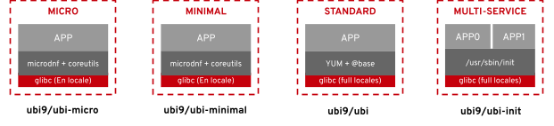
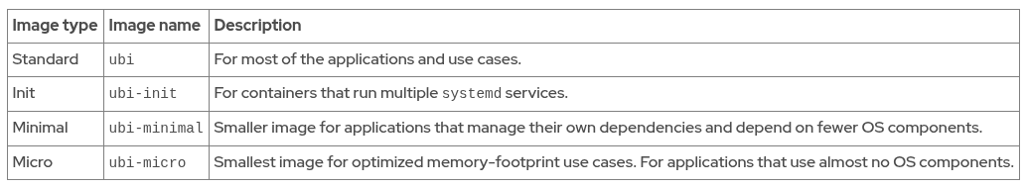
Build efficient containers
Providing the right level of content for application stability via the RHEL API/UBI
Notes:
https://www.redhat.com/es/blog/introducing-red-hat-universal-base-image?
https://catalog.redhat.com/en/software/base-images
Red Hat proporciona imágenes ligeras, como UBI (Universal Base Images), optimizadas para diferentes necesidades:
ubi9/ubi-minimal: Muy ligera, ideal para aplicaciones simples o contenedores que sólo necesitan bibliotecas básicas.
ubi9/ubi: Más completa, incluye herramientas adicionales para desarrolladores.
ubi9/ubi-init: Diseñada para casos en los que necesitas un sistema de inicio dentro del contenedor.
UBI 9 como la mejor opción para el futuro: Modernidad, seguridad, y soporte extendido.
UBI 8 como una opción de compatibilidad: Apta para entornos existentes que aún no han migrado a RHEL 9.

Slide 9
Build efficient containers
Runtime UBI Images For Developers
Red Hat provides UBI images for the following runtime languages:
OpenJDK
Node.js
Python
PHP
.NET
Go
Ruby
Notes:
https://www.redhat.com/es/blog/introducing-red-hat-universal-base-image?
https://www.redhat.com/en/blog/introducing-red-hat-universal-base-image
Red Hat proporciona imágenes ligeras, como UBI (Universal Base Images), optimizadas para diferentes necesidades:
ubi9/ubi-minimal: Muy ligera, ideal para aplicaciones simples o contenedores que sólo necesitan bibliotecas básicas.
ubi9/ubi: Más completa, incluye herramientas adicionales para desarrolladores.
ubi9/ubi-init: Diseñada para casos en los que necesitas un sistema de inicio dentro del contenedor.
UBI 9 como la mejor opción para el futuro: Modernidad, seguridad, y soporte extendido.
UBI 8 como una opción de compatibilidad: Apta para entornos existentes que aún no han migrado a RHEL 9.

Slide 10




Red Hat Registry
Build efficient containers
registry.access.redhat.com
registry.redhat.io (authentication needed)
quay.io
https://catalog.redhat.com
Certified Images
Secure Authentication
Enterprise-Grade
Red Hat registry which provides secured and certified container images
Authentication is required using podman or docker for pulling images
Recommended source for trusted, secure images for OpenShift and RHEL environments

Slide 11

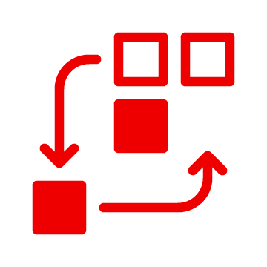

Integrated OpenShift image Registry (internal registry)
Build efficient containers
Private and secure registry
Deployment optimisation
Scalability
Integrated into the cluster user authentication and authorization system. Access to create and retrieve images is controlled by defining user permissions on the image resources
When a new image is pushed to the registry, the cluster is notified of the new image and other components can react to and consume the updated image
This registry can be scaled up or down like any other cluster workload and does not require specific infrastructure provisioning

Slide 12
Build efficient containers
Accessing the Internal Registry
Add permission to pull images
$ oc policy add-role-to-user registry-viewer <user_name>
Add permission to write or push images
$ oc policy add-role-to-user registry-editor <user_name>
Access the registry directly
$ oc debug nodes/<node_address>
sh-4.2# chroot /host
sh-4.2# oc login -u kubeadmin -p <password_from_install_log> https://api-int.<cluster_name>.<base_domain>:6443
sh-4.2# podman login -u kubeadmin -p $(oc whoami -t) image-registry.openshift-image-registry.svc:5000
Notes:
Environmental variables

Slide 13





Build efficient containers
Trusted, open source container registry platform that runs everywhere, but runs best on Red Hat OpenShift
Scalability without limits, from a developer laptop to a container host or Kubernetes, on-premise or on public cloud
Global governance and security controls, with image vulnerability scanning, access controls, geo-replication, etc.
Offered as a self-managed enterprise container registry product and as a hosted multi-tenant SaaS solution
Notes:
WHAT THIS SLIDE IS FOR: Basic key messages — highest level overview of Red Hat Quay and what it can do for a customer.
Quay in an industry-leading, trusted, and open source registry platform. It’s developed in collaboration with a broad open source, customer, and ecosystem community
Red Hat Quay runs on any infrastructure both on-prem or public cloud,and works with OCI-compliant tools, but works best with Red Hat OpenShift.
One if it’s key strengths is it’s nearly unlimited scalability. You can run Quay on your laptop or in your datacenter to serve a handful of images but you can also use it to serve billions of images to thousands of clusters and thousands of users as we do with Quay.io.
Quay is built for real enterprise use cases where content governance and security are two major focus areas. It includes a built-in vulnerability scanning, fine granular access control and multi-tenancy model and several other capabilities to federate content across your clusters, datacenters and regions.
You can run it for your own in your own datacenter or on public cloud or use our hosted SaaS offering Quay.io and we will take care of all operational aspects for you.

Slide 14
Best Practices
Build efficient containers
When creating a container, there are some guidelines to optimize the time of creating an image, the security of it and its size.
Choose a Universal Base Image
Limit the number of layers in your images
Run as a non-root user
Use COPY instead of ADD
Do not install packages in CMD or ENTRYPOINT
Define a clear ENTRYPOINT
Exclude unnecessary files with .dockerignore
Set environment variables
Set image metadata with LABEL
Scan images for vulnerabilities
FROM registry.access.redhat.com/ubi9/ubi
RUN dnf install -y httpd
RUN dnf clean all
RUN rm -rf /var/cache/dnf
❌ Too many layers
FROM registry.access.redhat.com/ubi9/ubi
RUN dnf install -y httpd && \
dnf clean all && \
rm -rf /var/cache/dnf
✅ Consolidated layers
Notes:
https://docs.openshift.com/container-platform/4.17/openshift_images/create-images.html#images-create-guide-general_create-images

Slide 15
Best Practices
Build efficient containers
When creating a container, there are some guidelines to optimize the time of creating an image, the security of it and its size.
Choose a Universal Base Image
Limit the number of layers in your images
Run as a non-root user
Use COPY instead of ADD
Do not install packages in CMD or ENTRYPOINT
Define a clear ENTRYPOINT
Exclude unnecessary files with .dockerignore
Set environment variables
Set image metadata with LABEL
Scan images for vulnerabilities
FROM registry.access.redhat.com/ubi9/ubi
RUN useradd -r -u 1001 appuser
USER 1001
✅ Avoid root usage in production
Notes:
https://docs.openshift.com/container-platform/4.17/openshift_images/create-images.html#images-create-guide-general_create-images

Slide 16
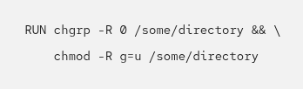
(Optional) Support arbitrary user ids
Build efficient containers
OCP ignores the USER instruction in the container image.
OCP assigns to the user in the container a UID and a supplemental GID from the identified range in the project annotations.
The GID of the user is always 0, which means that the user belongs to the root group.
Any files and directories that the container processes might write to must have read and write permissions by GID=0 and have the root group as the owner.
Although the user in the container belongs to the root group, the user is an unprivileged account.
Adding the following to your Dockerfile sets the directory and file permissions to allow users in the root group to access them in the built image:
Notes:
https://docs.redhat.com/en/documentation/openshift_container_platform/4.19/html/images/creating-images#use-uid_create-images

Slide 17
Best Practices
Build efficient containers
When creating a container, there are some guidelines to optimize the time of creating an image, the security of it and its size.
Choose a Universal Base Image
Limit the number of layers in your images
Run as a non-root user
Use COPY instead of ADD
Do not install packages in CMD or ENTRYPOINT
Define a clear ENTRYPOINT
Exclude unnecessary files with .dockerignore
Set environment variables
Set image metadata with LABEL
Scan images for vulnerabilities
ADD app.tar.gz /app/
❌ Avoid ADD
COPY app.tar.gz /app/
RUN tar -xzf /app/app.tar.gz -C /app && rm /app/app.tar.gz
✅ Use COPY as an alternative

Slide 18
Best Practices
Build efficient containers
When creating a container, there are some guidelines to optimize the time of creating an image, the security of it and its size.
Choose a Universal Base Image
Limit the number of layers in your images
Run as a non-root user
Use COPY instead of ADD
Do not install packages in CMD or ENTRYPOINT
Define a clear ENTRYPOINT
Exclude unnecessary files with .dockerignore
Set environment variables
Set image metadata with LABEL
Scan images for vulnerabilities
CMD ["dnf", "install", "-y", "nginx"]
❌ Install packages at runtime
RUN dnf install -y nginx && dnf clean all
CMD ["nginx", "-g", "daemon off;"]
✅ Use RUN to install packages

Slide 19
Best Practices
Build efficient containers
When creating a container, there are some guidelines to optimize the time of creating an image, the security of it and its size.
Choose a Universal Base Image
Limit the number of layers in your images
Run as a non-root user
Use COPY instead of ADD
Do not install packages in CMD or ENTRYPOINT
Define a clear ENTRYPOINT
Exclude unnecessary files with .dockerignore
Set environment variables
Set image metadata with LABEL
Scan images for vulnerabilities
ENTRYPOINT ["/usr/sbin/httpd", "-D", "FOREGROUND"]
✅ Recommended example
ENTRYPOINT ["/usr/sbin/httpd"]
CMD ["-D", "FOREGROUND"]
💡 Use CMD to allow users modifying predefined command

Slide 20
Best Practices
Build efficient containers
When creating a container, there are some guidelines to optimize the time of creating an image, the security of it and its size.
Choose a Universal Base Image
Limit the number of layers in your images
Run as a non-root user
Use COPY instead of ADD
Do not install packages in CMD or ENTRYPOINT
Define a clear ENTRYPOINT
Exclude unnecessary files with .dockerignore
Set environment variables
Set image metadata with LABEL
Scan images for vulnerabilities
.git
node_modules
*.log
💡 Use .dockerignore to exclude unnecessary files

Slide 21
Best Practices
Build efficient containers
When creating a container, there are some guidelines to optimize the time of creating an image, the security of it and its size.
Choose a Universal Base Image
Limit the number of layers in your images
Run as a non-root user
Use COPY instead of ADD
Do not install packages in CMD or ENTRYPOINT
Define a clear ENTRYPOINT
Exclude unnecessary files with .dockerignore
Set environment variables
Set image metadata with LABEL
Scan images for vulnerabilities
ENV DB_PASSWORD=mysecretpassword
❌ Never include secured info like credentials

Slide 22
Best Practices
Build efficient containers
When creating a container, there are some guidelines to optimize the time of creating an image, the security of it and its size.
Choose a Universal Base Image
Limit the number of layers in your images
Run as a non-root user
Use COPY instead of ADD
Do not install packages in CMD or ENTRYPOINT
Define a clear ENTRYPOINT
Exclude unnecessary files with .dockerignore
Set environment variables
Set image metadata with LABEL
Scan images for vulnerabilities
LABEL maintainer="name<email@example.com>"
LABEL version="1.0"
LABEL description="OpenShift APP"
✅ Improve administration

Slide 23
Best Practices
Build efficient containers
When creating a container, there are some guidelines to optimize the time of creating an image, the security of it and its size.
Choose a Universal Base Image
Limit the number of layers in your images
Run as a non-root user
Use COPY instead of ADD
Do not install packages in CMD or ENTRYPOINT
Define a clear ENTRYPOINT
Exclude unnecessary files with .dockerignore
Set environment variables
Set image metadata with LABEL
Scan images for vulnerabilities

Slide 24
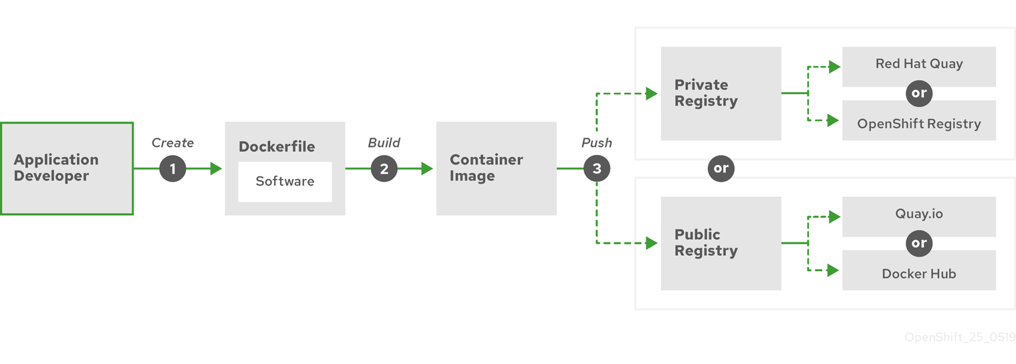
Building a simple container
Building images
Dockerfile / Containerfile
Docker / podman / buildah
Container registry
Notes:
https://docs.redhat.com/en/documentation/openshift_container_platform/4.14/html-single/architecture/index#building-simple-container
https://docs.openshift.com/container-platform/4.17/openshift_images/create-images.html#images-create-guide-general_create-images

Slide 25
Users and Service Accounts

Slide 26
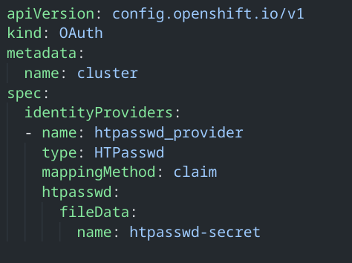
Identity Providers
Users and Service Accounts
Identity Providers:
Htpasswd
Keystone
LDAP
Basic Authentication
Request header
GitHub or GitHub Enterprise
GitLab
Google
OpenID Connect

Slide 27
RBAC
Rules
Sets of permitted verbs on a set of objects. Consist of verbs, resources and api group.
Roles
Collections of rules. You can associate, or bind, users and groups to multiple roles.
Bindings
Associations between subjects ( user, group or sa) with a role.
Users and Service Accounts
Source:
https://docs.openshift.com/container-platform/4.14/authentication/using-rbac.html
Notes:
In OpenShift we have a role based authorization component. There is a Project scope and a Cluster scope where either RoleBindings or ClusterRolebindings define the permissions a user will have once logged in. This role component matches attributes on the request like the verb on the objects for example get projects or create pods. It matches those attributes to roles which have been grated to the requesting user. If no roles match the request is denied.By default everything is denied unless the role specifically allows it. Out of the box operator and user level roles are defined and custom roles are also supported.

Slide 28
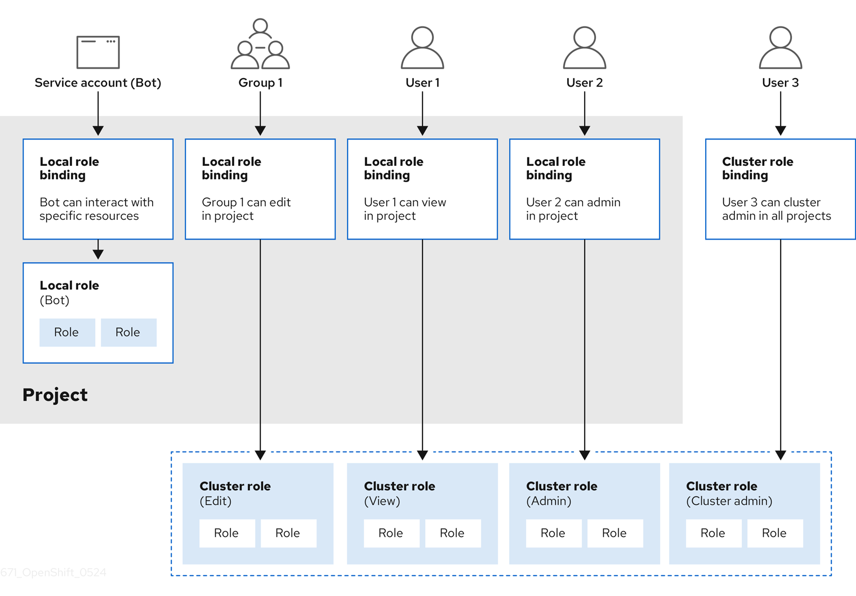
RBAC
Users and Service Accounts

Slide 29
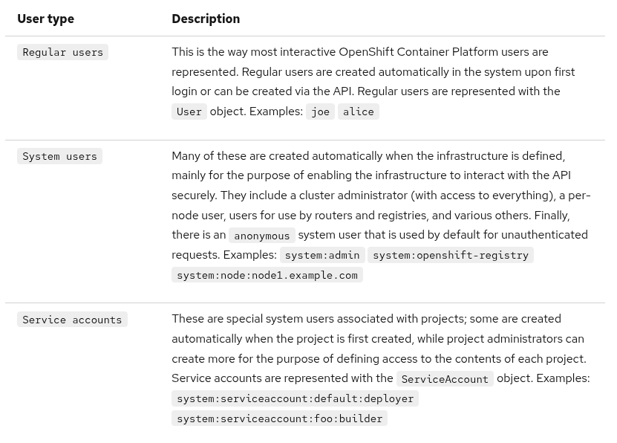
Users
Users and Service Accounts

Slide 30
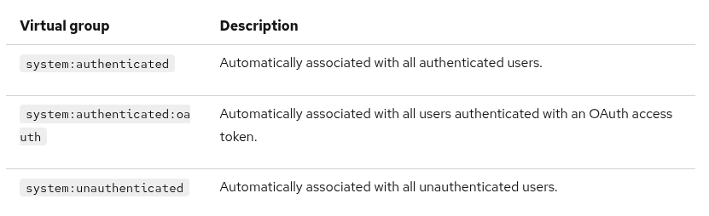
Groups
Users and Service Accounts
A user can be assigned to one or more groups
Types Of groups:
User groups
System groups (virtual groups)

Slide 31
Groups
Users and Service Accounts
# Create a group named 'dev-team' and add users
oc adm groups new dev-team
oc adm groups add-users dev-team developer user2 user3
Notes:
https://docs.openshift.com/container-platform/4.17/openshift_images/create-images.html#images-create-guide-general_create-images

Slide 32
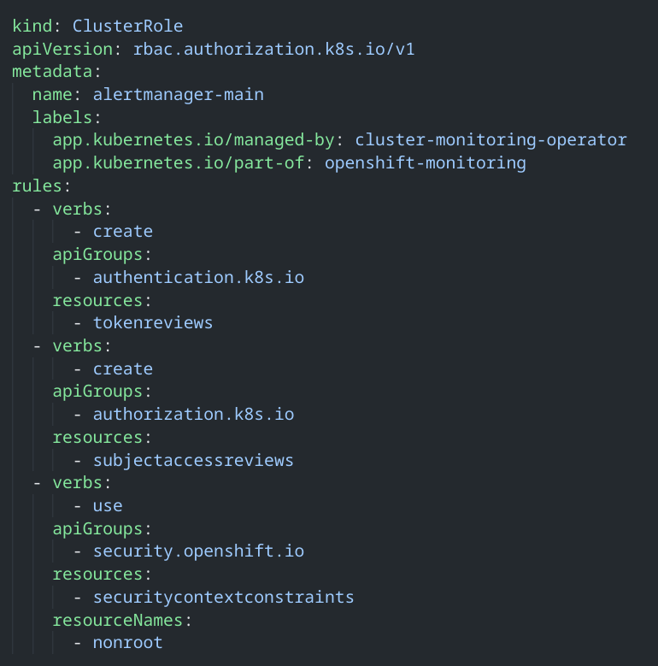
Role
Users and Service Accounts
Notes:
https://docs.openshift.com/container-platform/4.17/openshift_images/create-images.html#images-create-guide-general_create-images

Slide 33
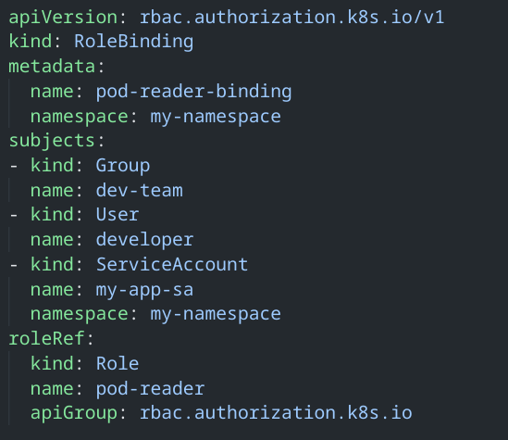
RoleBinding
Users and Service Accounts
Notes:
https://docs.openshift.com/container-platform/4.17/openshift_images/create-images.html#images-create-guide-general_create-images

Slide 34
Root Containers and Security Context Constraints

Slide 35
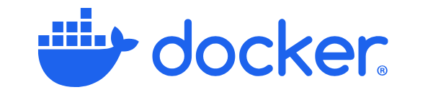


Root Containers
Root Containers
rootless context
root context
Docker Daemon
(child of init)
dockerd
containerd
runtime
RPC
RPC
fork-exec
rootless context
main PID
Podman
conmon
runtime
fork/exec
fork/exec
rootless context
OpenShift
SCC Validation
Random UID
Container

Slide 36
Security Context Constraints (SCCs)
Security Context Constraints
SCCs controls:
Whether a pod can run privileged containers
The capabilities that a container can request
The use of host directories as volumes
The SELinux context of the container
The container user ID
The use of host namespaces and networking
The allocation of an FSGroup that owns the pod’s volumes
The configuration of allowable supplemental groups
Whether a container requires the use of a read only root file system
The usage of volume types
The configuration of allowable seccomp profiles
Security mechanism that restricts access to resources, but not to operations in OpenShift.
Relaxed security context constraints to access resources that are forbidden by default,
Limit the access from a running pod in OpenShift to the host environment

Slide 37

Default SCCs
Security Context Constraints
The cluster contains nine default SCCs:
anyuid
hostaccess
hostmount-anyuid
Hostnetwork
hostnetwork-v2
node-exporter
nonroot
nonroot-v2
privileged
restricted
restricted-v2
Link to documentation for detailed discription
Do not modify the default SCCs. Customizing the default SCCs can lead to issues when some of the platform pods deploy or OpenShift Container Platform is upgraded.
During upgrades between some versions of OpenShift Container Platform, the values of the default SCCs are reset to the default values, which discards all customizations to those SCCs. Instead, create new SCCs.

Slide 38
Security Context Constraints
SCCs Management (CLI)
List the SCCs
$ oc get scc
Get additional information about a SCC
$ oc describe scc anyuid
Associate the service account with an SCC
$ oc adm policy add-scc-to-user SCC -z service-account
Identify which account can create a particular pod
$ oc get pod podname -o yaml | oc adm policy scc-subject-review -f -
Notes:
This is how to interact with the SSC from the CLI

Slide 39
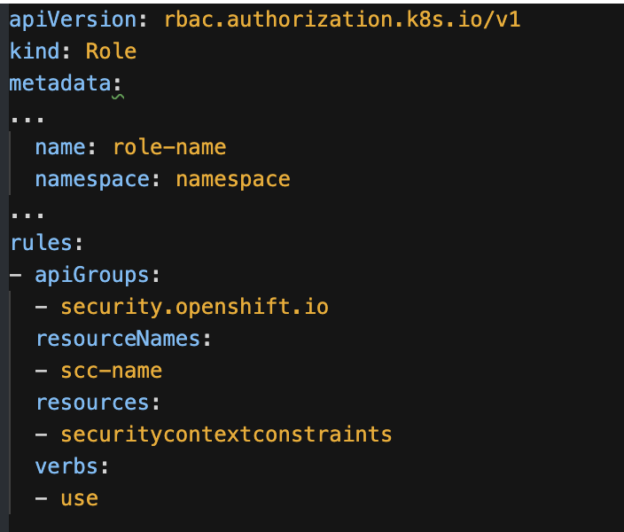

Security Context Constraints
SCCs Management (Role-based access)
Specify the SCC resource when creating a role
$ oc create role <role-name> --verb=use --resource=scc --resource-name=<scc-name> -n <namespace>
NOTE: You must have cluster-admin privileges to manage SCCs.
Automatically defined when scc is specified as a resource
Name of the scc that Subjects bounded to this role can use
Notes:
This is how to create a role from scratch, most times it’s better to make a copy of an existing role that closes matches your desired outcome and modify it from there.

Slide 40
Using Secrets and Vaults

Slide 41
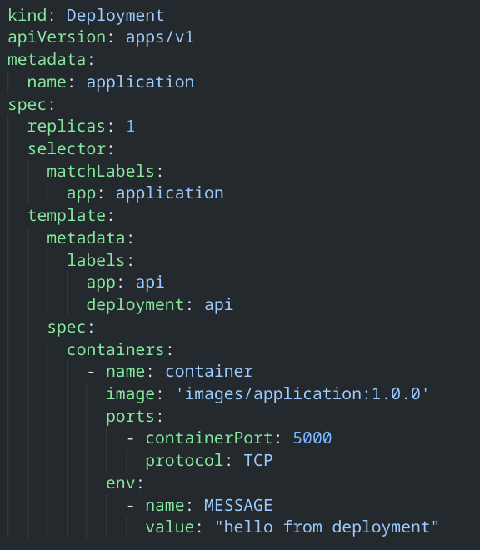
Configuring Deployments
Using Secrets and Vaults
Why is this not the best usage for configuration?:
Separation of Configuration and Code
Improved security
Simplified versioning and auditing
RBAC control
Enhanced portability

Slide 42
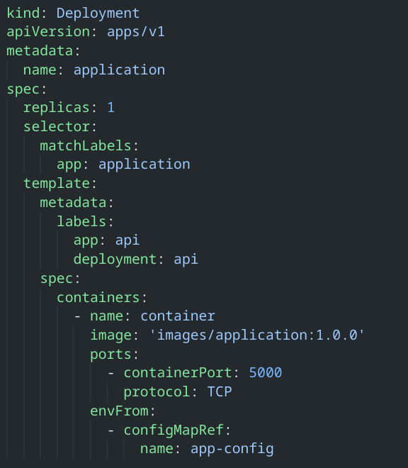
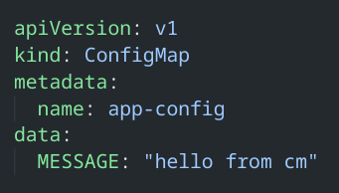
ConfigMaps
Using Secrets and Vaults

Slide 43
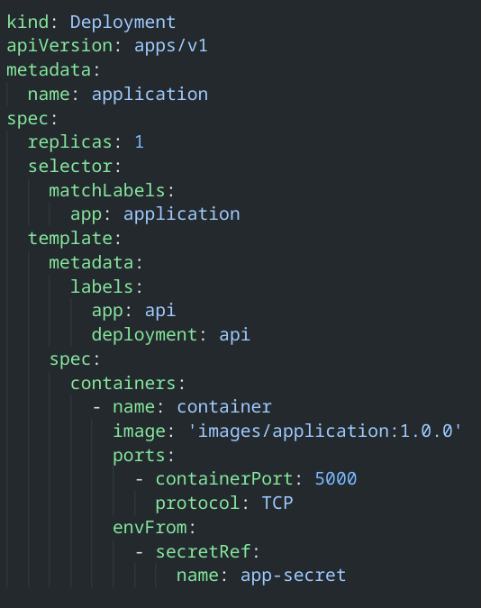
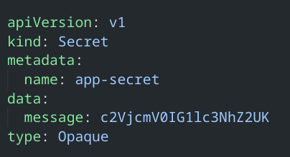
Secrets
Using Secrets and Vaults

Slide 44

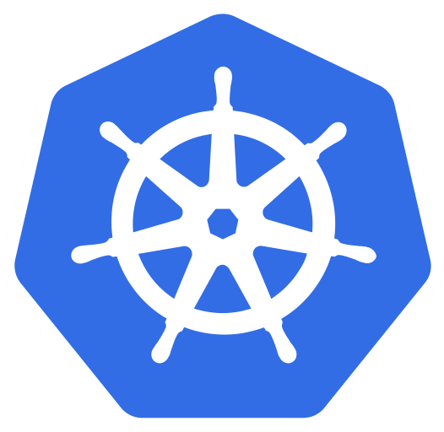
And.. with GitOps?
Using Secrets and Vaults
Git Repository as the single source of truth for system's desired state
Git
Repository
Kubernetes
❌ Secret content exposed - c2VjcmV0IG1lc3NhZ2UK

Slide 45


Vault Usage
Using Secrets and Vaults
OpenShift
Vault Service
(1) - Deploy Agent
Vault Agent
(operator/helm)
(2) - Authenticate
Organisation
(3) - Generate/Get Secrets Data
Secret 1
Vault Secret
Secret 2
…
(4) - Validate Permissions
deploy
(5) - Inject Data
policies
(pod)

Slide 46


Example Application
Using Secrets and Vaults
OpenShift
ns: public-layer
ns: app-layer
ns: data-layer
route/api
svc/backend
svc/database
svc/api
deploy/backend
deploy/database
(pod)
(pod)
deploy/api
(pod)
secret
configMap
❌

Slide 47

Example Application + BitWarden
Using Secrets and Vaults
OpenShift
ns: public-layer
ns: app-layer
ns: data-layer
route/api
svc/backend
svc/database
svc/api
deploy/backend
deploy/database
(pod)
(pod)
deploy/api
(pod)
secret
configMap
secret/token
✅ Stored in Git and managed by ArgoCD - no sensitive data
ns: sm-operator-system
secret
Auth token
sm-operator

Slide 48
Network Policies

Slide 49
Network micro-segmentation
Network Policies
PROJECT A
PROJECT B
Isolate services
Enhance security
Restrict egress traffic
Comply with security standards
POD
8080
✓
POD
5432
POD
POD
✓
POD
POD
✓
✓
POD
POD

Slide 50
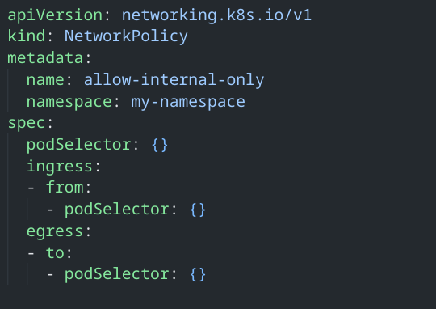
Network Policy Example
Network Policies
Allow Only Internal Traffic (No External Access)

Slide 51
Good Practices
Network Policies
Follow Zero-Trust by Default
Use Labels Consistently
Combine Multiple Policies
Test with oc Commands
Document and Review Policies Regularly
Automate with GitOps

Slide 52
Example Application - Network Policies
Network Policies
OpenShift
ns: public-layer
ns: app-layer
ns: data-layer
route/api
svc/backend
svc/database
svc/api
deploy/backend
deploy/database
(pod)
(pod)
deploy/api
(pod)
secret
configMap

Slide 53

Example Application - Network Policies
Network Policies
OpenShift
ns: public-layer
ns: app-layer
ns: data-layer
route/api
svc/backend
svc/database
svc/api
deploy/backend
deploy/database
(pod)
(pod)
deploy/api
(pod)
secret
configMap
Deny all traffic
Deny all traffic
Deny all traffic

Slide 54
Example Application - Network Policies
Network Policies
OpenShift
ns: public-layer
ns: app-layer
ns: data-layer
route/api
svc/backend
svc/database
svc/api
deploy/backend
deploy/database
(pod)
(pod)
deploy/api
(pod)
secret
configMap
Deny all traffic
Deny all traffic
Deny all traffic
Allow from Ingress

Slide 55
Example Application - Network Policies
Network Policies
OpenShift
ns: public-layer
ns: app-layer
ns: data-layer
route/api
svc/backend
svc/database
svc/api
deploy/backend
deploy/database
(pod)
(pod)
deploy/api
(pod)
secret
configMap
Deny all traffic
Deny all traffic
Deny all traffic
Allow from Ingress
Allow from public-layer ns

Slide 56
Example Application - Network Policies
Network Policies
OpenShift
ns: public-layer
ns: app-layer
ns: data-layer
route/api
svc/backend
svc/database
svc/api
deploy/backend
deploy/database
(pod)
(pod)
deploy/api
(pod)
secret
configMap
Deny all traffic
Deny all traffic
Deny all traffic
Allow backend pods on database pods (TCP/5000)
Allow from Ingress
Allow from public-layer ns

Slide 57
Demo URL + Q&A
https://github.com/clbartolome/containers_ocp

Slide 58
Thank you
Red Hat is the world’s leading provider of enterprise open source software solutions. Award-winning support, training, and consulting services make
Red Hat a trusted adviser to the Fortune 500.

