Slide 1
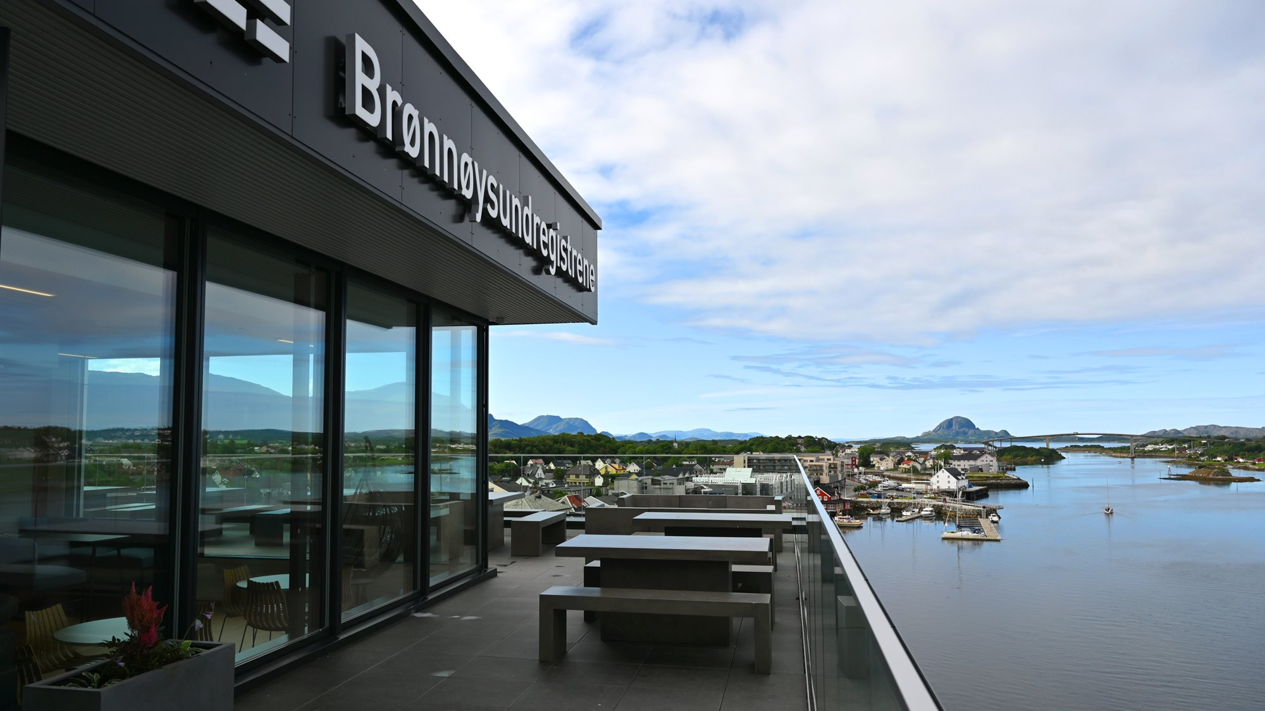
Applications and Beyond Building a Full-Stack Developer and Operations Platform for the Autonomous Teams of Tomorrow
Notes:
Hello everyone, and thank you to Red Hat and Kim for inviting me to share insights about our platform.
Today’s topic - Applications and Beyond...

Slide 2
In this talk I will share
Our technology journey
How we balance security, compliance, and operations without slowing down innovation
Tips on building a platform that scales
Lessons learned
What’s next

Slide 3
The Brønnøysund Register Centre
N
Government Agency under the Ministry of Trade, Industry and Fisheries
Provides 17 national registers/services such as:
The Central Coordinating Register for Legal Entities
The Register of Business Enterprises
The Register of Bankruptcies
The Register of Movable Property
B
We are nearly 460 co-workers, most located in Brønnøysund
Our presence includes regional offices in Narvik and Oslo as well
O
Notes:
But first, a brief introduction to BRREG
In Denmark you have Erhvervsstyrelsen

Slide 4

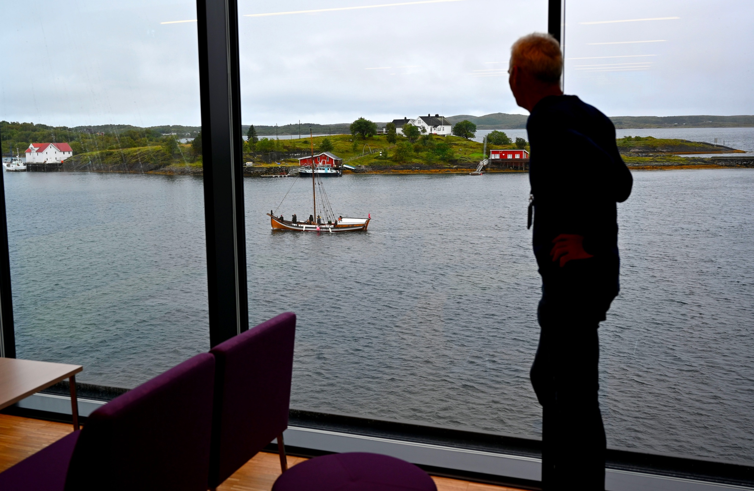

Notes:
Here you can see the view from the canteen, along with a few nearby drone shots

Slide 5
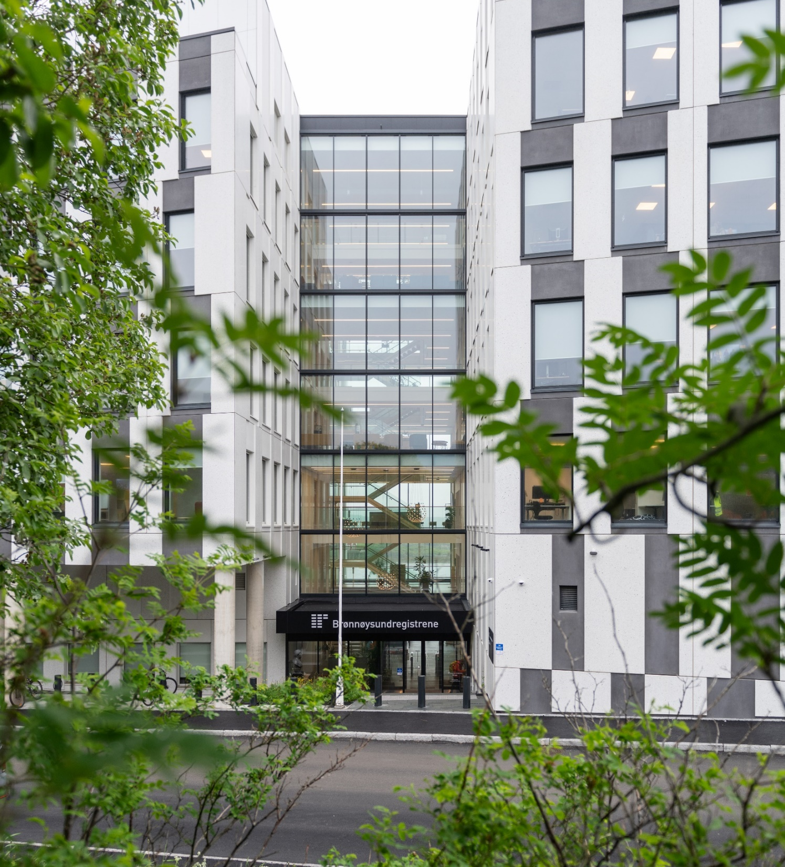
IT Department
140+ employees
4 x Development sections
1 x Operations and Security section
1 x Management and Governance section
A Platform team with 12+ platform developers

Slide 6

Our mission
We build and run our own registers and services
3.2 million cases processed in 2024
74% of them fully automated
Our most popular public service “Open data”
served more then 7 billion request last year -> ~ 220 request/s (24x7x365)
Most used programming languages and frameworks:
Java
Spring Boot
JavaScript
React
Notes:
In average 220 requests/s

Slide 7

IT Environment
Private cloud
Red Hat OpenShift in our on-prem data center
Running on bare-metal
Operating systems
Kubernetes (50)
Red Hat Enterprise Linux (1100)
Microsoft Windows (150)

Slide 8

DataCenter
Compute & Storage
Mainly Dell x86 servers
IBM Storage Ceph (block, file and object)
Operating in active/active stretch mode
Network
Cisco ACI
3 x Availability Zones
5 x Tenants
Micro segmentation
FortiGate firewalls
BIG-IP load balancers

Slide 9

Numbers
9 x OpenShift clusters (48)
4 x Ceph clusters (44)
2 x Elastic Cloud Enterprise clusters (16)
290+ Bare-metals
1000+ VMs
300+ Virtual Desktops
11 x VMware vSphere clusters (74)
4 x VMware VDI clusters (32)
In production
90 PostgreSQL clusters
25 ElasticSearch clusters
600+ ArgoCD deployments
Thousands of pods
Notes:
Some numbers

Slide 10

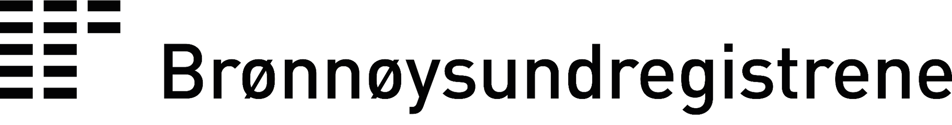


The Technology Platform
Building for the future
A Full-stack developer and operations platform
Designed for self-service
Standardized tools for build, test, and delivering value
Reducing cognitive load through abstraction, golden paths, and automation
Scalable, robust infrastructure that frees teams to innovate without operational overhead
Supporting our business needs and mission
BASE
Core Technologies
Red Hat
OpenShift
Enterprise Linux
Storage Ceph
Fusion Data Fondation
Børre Nordbakken
Lead Technology Architect | Product owner
Notes:
So to the juciy stuff
The technology platform and our product BASE

Slide 11
The Technology Platform
BASE
Our technology journey

Slide 12
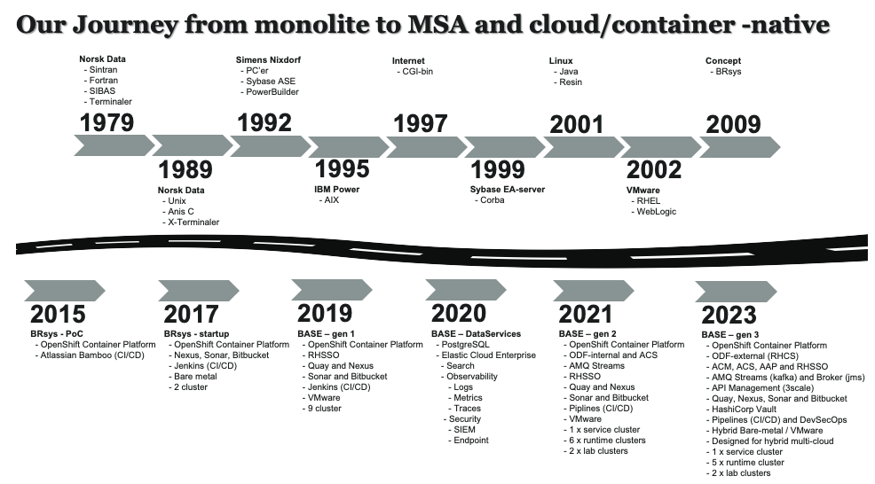
Notes:
It started in 1979 with Norsk Data
In 2009 the modernization project BRsys started

Slide 13
The real journey started in 2015
We asked ourselves:
How can we build a platform developers truly love?
It all comes together in BASE
A private cloud platform
Purpose-built to support our mission
Engineered to achieve our goals
BASE is a platform powered by OpenShift and GitOps
Keywords:
Portability – run anywhere
Automation – faster and safer delivery
Standardization – one way of building, scaling and operating
BASE empowering developer teams with
End-to-end ownership – from code to production
Security & compliance by design – trust built in
Freedom to innovate – guardrails, not roadblocks

Slide 14
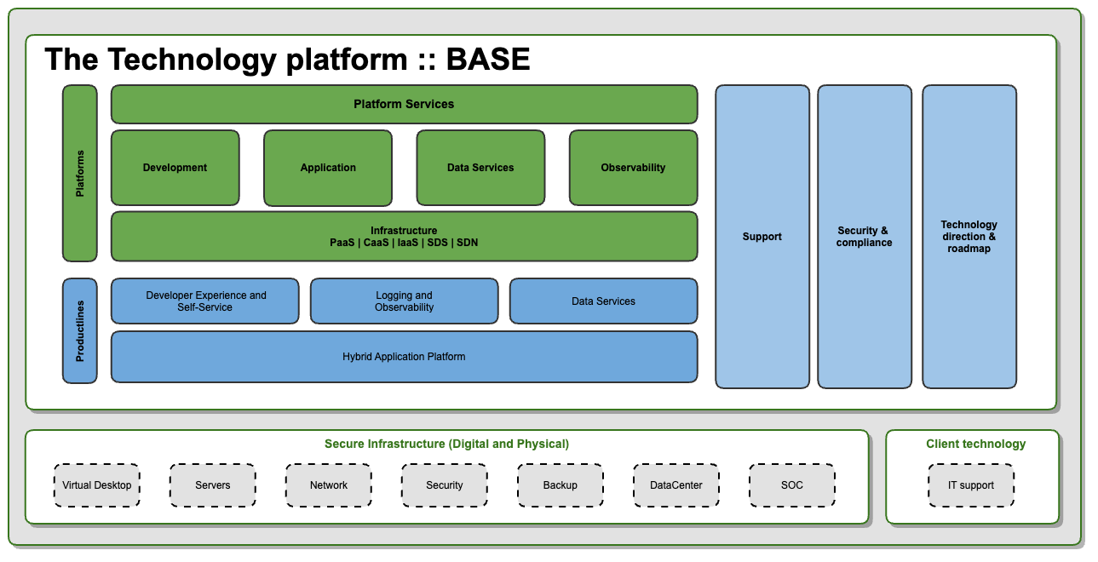
Product
BASE
Notes:
A quick look at our platform – BASE.

Slide 15
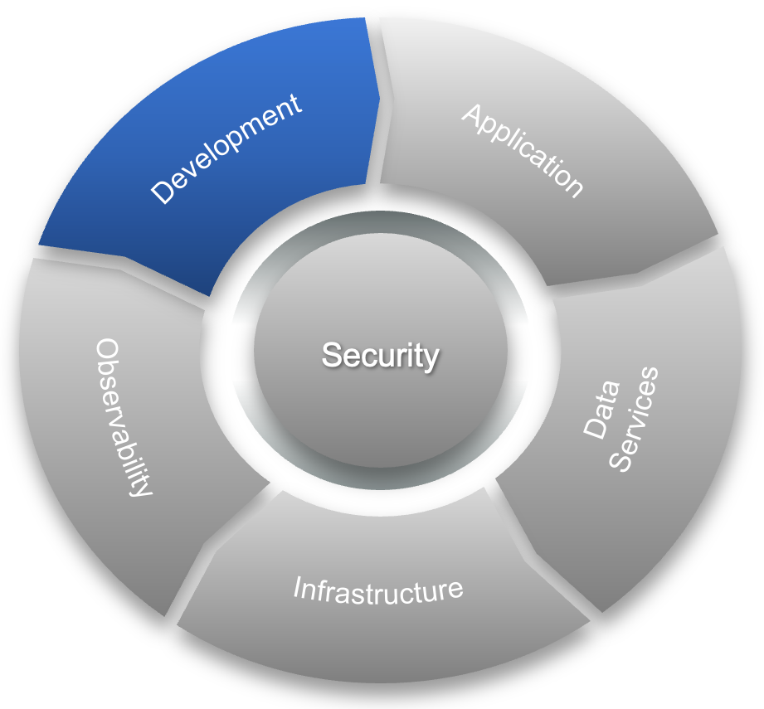
The Development Platform
Comprehensive and standardized
Providing developers with standardized tools to build, test, and deliver value.
Focused on reducing cognitive load by abstracting complexity, offering clear golden paths, and automating operational tasks.
Based on RHEL 9, provided as a Developer Desktop
BASE CLI
JetBrains tools
Microsoft Visual Code
Postman
Supported languages:
Java
JavaScript and TypeScript
Kotlin
Python
Go
C#
Development
Virtual Desktop (Omnissa Horizon) Red Hat Enterprise Linux
Notes:
BASE-CLI
- We have developed a CLI, a abstraction layer, that do all the magic when a developer interacts with the platform

Slide 16
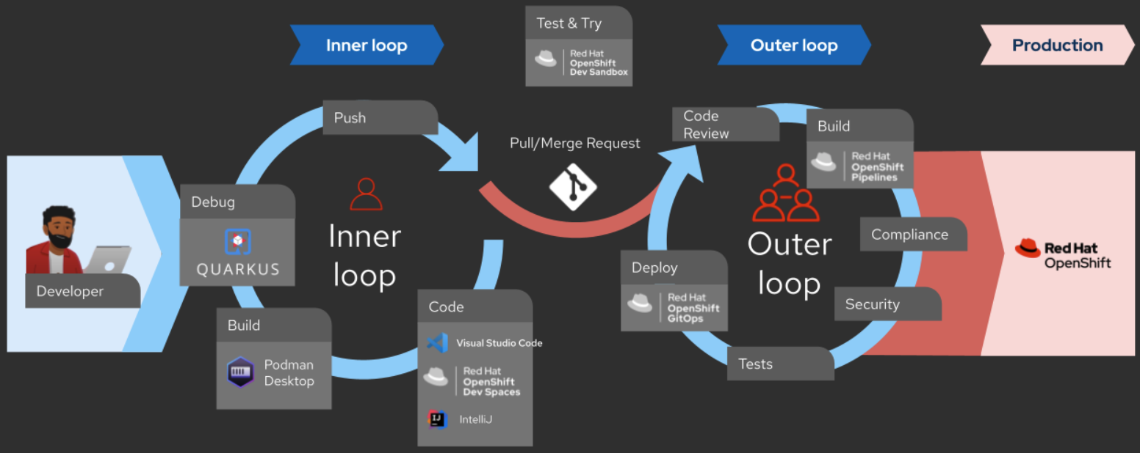
DevSecOps
We also provides a unified DevSecOps toolchain
This providing teams with a set of tools and practices to ensure quality, speed, and security throughout the software delivery lifecycle (SDLC)
Tools
Red Hat Quay and Security Scanner
Red Hat ACS and Admission Controller
HashiCorp Vault and Bitnami Sealed Secrets
Nexus Repository Manager
Snyk Code, OWASP and SonarQube
Atlassian
Jira Software and ServiceDesk
Confluence
Bitbucket
Development
Developer Flow
Notes:
We also provides A unified DevSecOps toolchain
Under you can see some of the tools in the toolchain
And how the developer flow looks like
SDLC refererer til verktøy som støtter Software Development Life Cycle

Slide 17
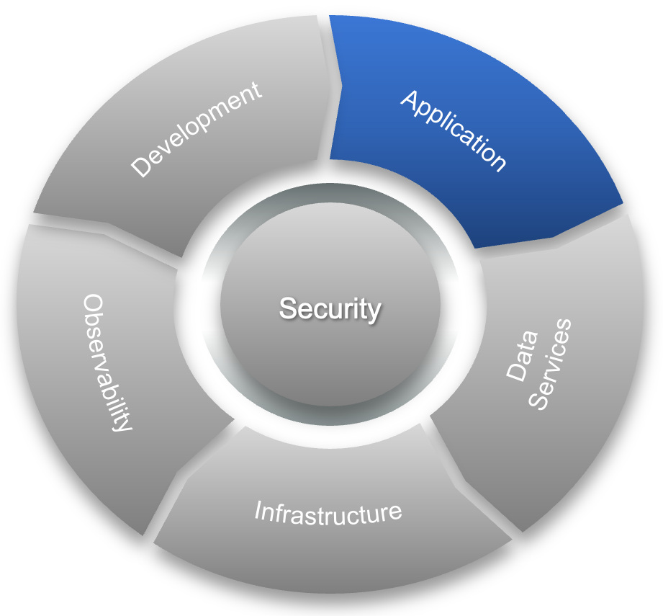


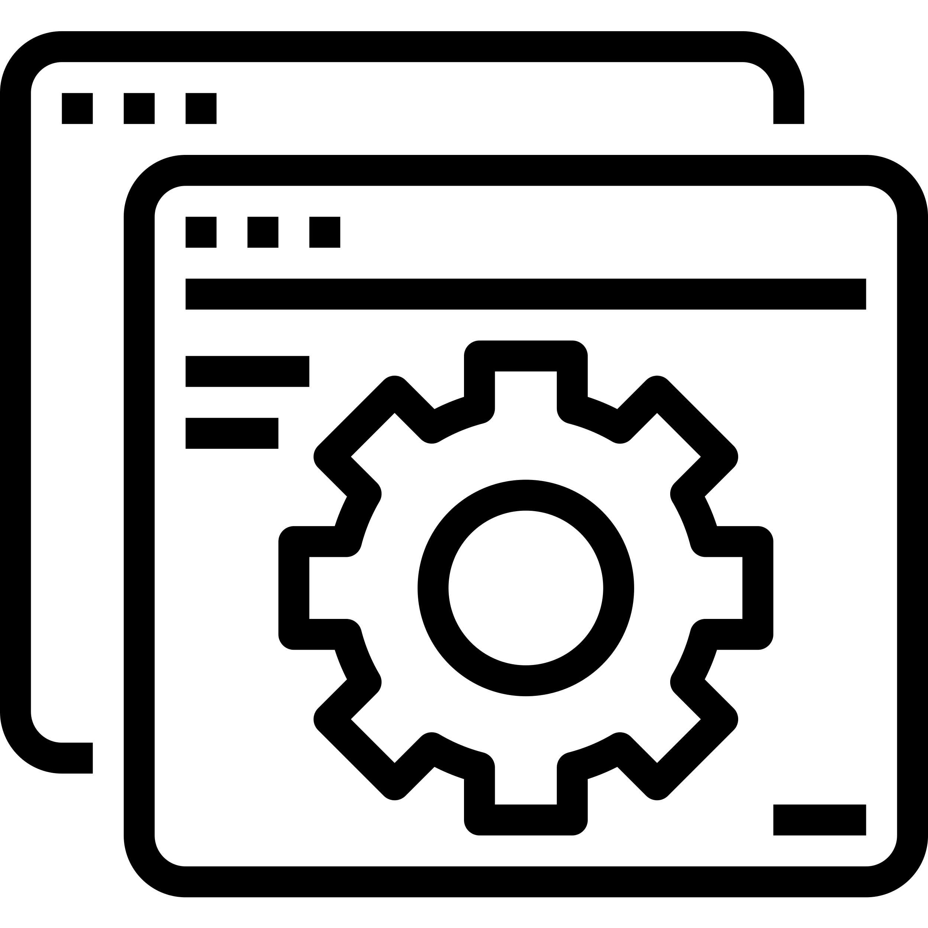
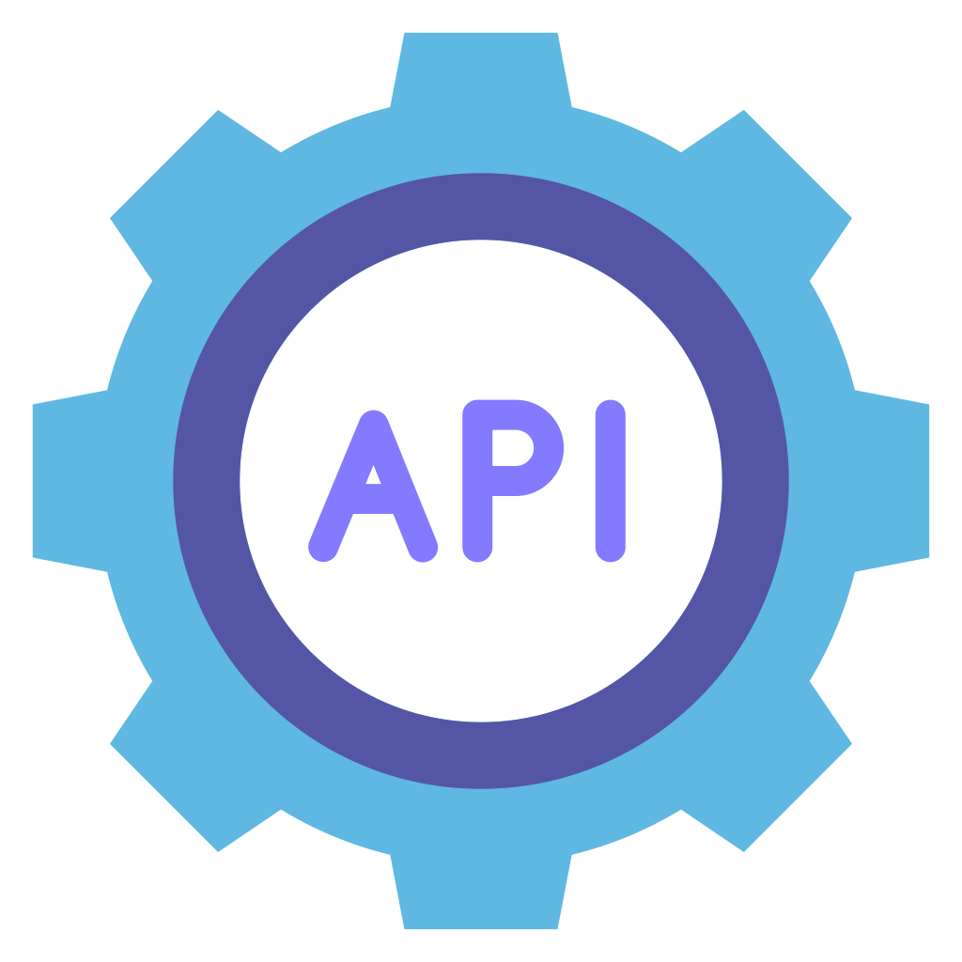
The Application Platform
Operational layer and runtime component
Cloud-Native by design
Containers as the standard deployment unit
Based on OpenShift
Application runtimes
Spring Boot (Java)
Node.JS
GitOps and Pipelines
ArgoCD
Tekton
Cloud-Native Storage
We are using IBM Storage Fusion
An abstraction and connector layer to the underlaying IBM Storage Ceph
Providing unified storage capabilities to DevOps-teams
Application
End-users
Dev Teams
Applications
Internal / External
Application Runtime
Data Services
IBM Fusion (FDF)
Observability
Platform Services
Red Hat OpenShift
Container Platform
Red Hat OpenShift
Notes:
And we are providing OpenShift GitOps for automation thru ArgoCD and Tekton
To provide cloud-native storage we are using IBM Storage Fusion

Slide 18
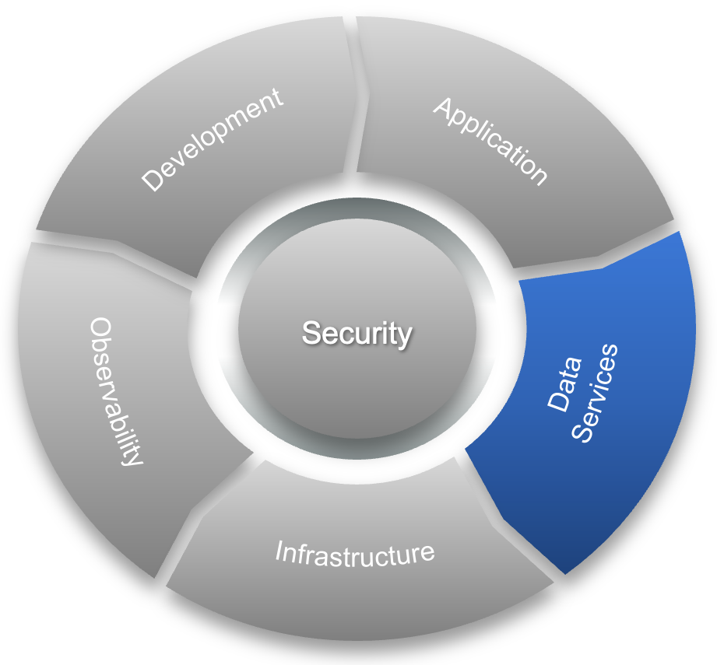
The Data Services Platform
Here we store, manage, and keep data in motion
Data Services
PostgreSQL
ElasticSearch
ActiveMQ
Kafka
Redis
Storage
IBM Storage
Ceph
Fusion
Data Services
Dev Teams
Data Scientists
Applications
Application Runtime
Data Services
IBM Fusion (FDF)
IBM Storage Ceph
Block, File, Object
Observability
Platform Services
Red Hat OpenShift
Container Platform
IBM Storage Ceph

Slide 19
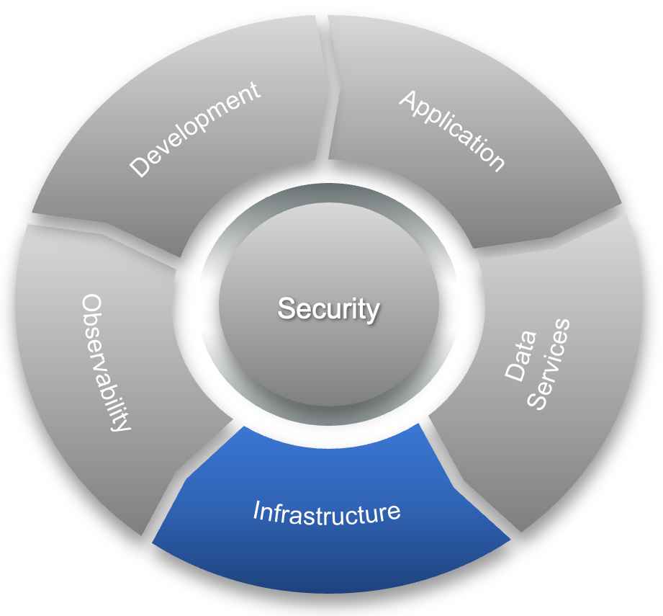
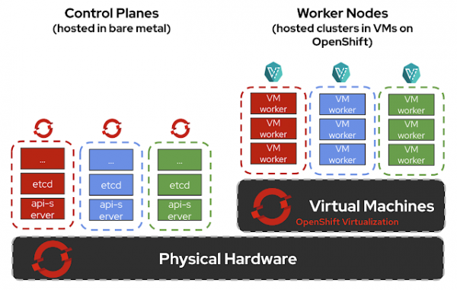
The Infrastructure Platform
Provides the compute, storage and network resources the rest of the platforms builds upon
Cloud-Native
Container based
Portable
Core components
Red Hat OpenShift Container Platform
Red Hat OpenShift Observability
Red Hat Ansible Automation Platform
Red Hat Enterprise Linux
IBM Storage Ceph
Cisco ACI
BIG-IP loadbalancers
Fortigate firewalls
Infrastructure
PaaS | IaaS | SDS | SDN

Slide 20
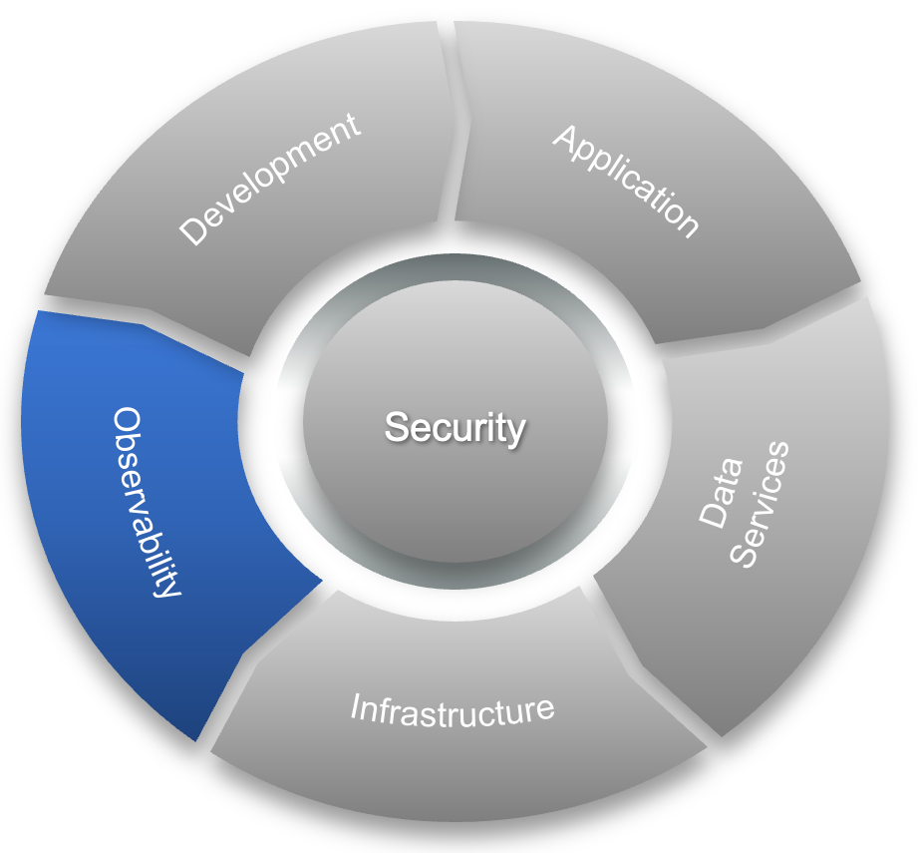
The Observability Platform
Here we gain visibility and understanding of the system, enabling proactive monitoring and troubleshooting
Sentralized logging and monitoring
Based on Elastic Stack
Generative AI and Machine Learning
intelligent automation
predictive insights
adaptive decision-making
Supporting the Service Level Objectiv (SLO) concept
A SLO is a clearly defined, measurable target that describes the expected reliability or performance of a service
External Security Operations Center (SOC)
Our SIEM provides
Logs
Metrics
Traces
Visability
Agents / Forwarders
Beats
Logstash
Vector
Observability
Kibana SIEM
Producer
Ingest
pipelines
SOC
Insight
Notes:
We have build a Sentralized loggging and monitoring for that
SOC = Security Operations Center
SIEM = Security Information and Event Management

Slide 21
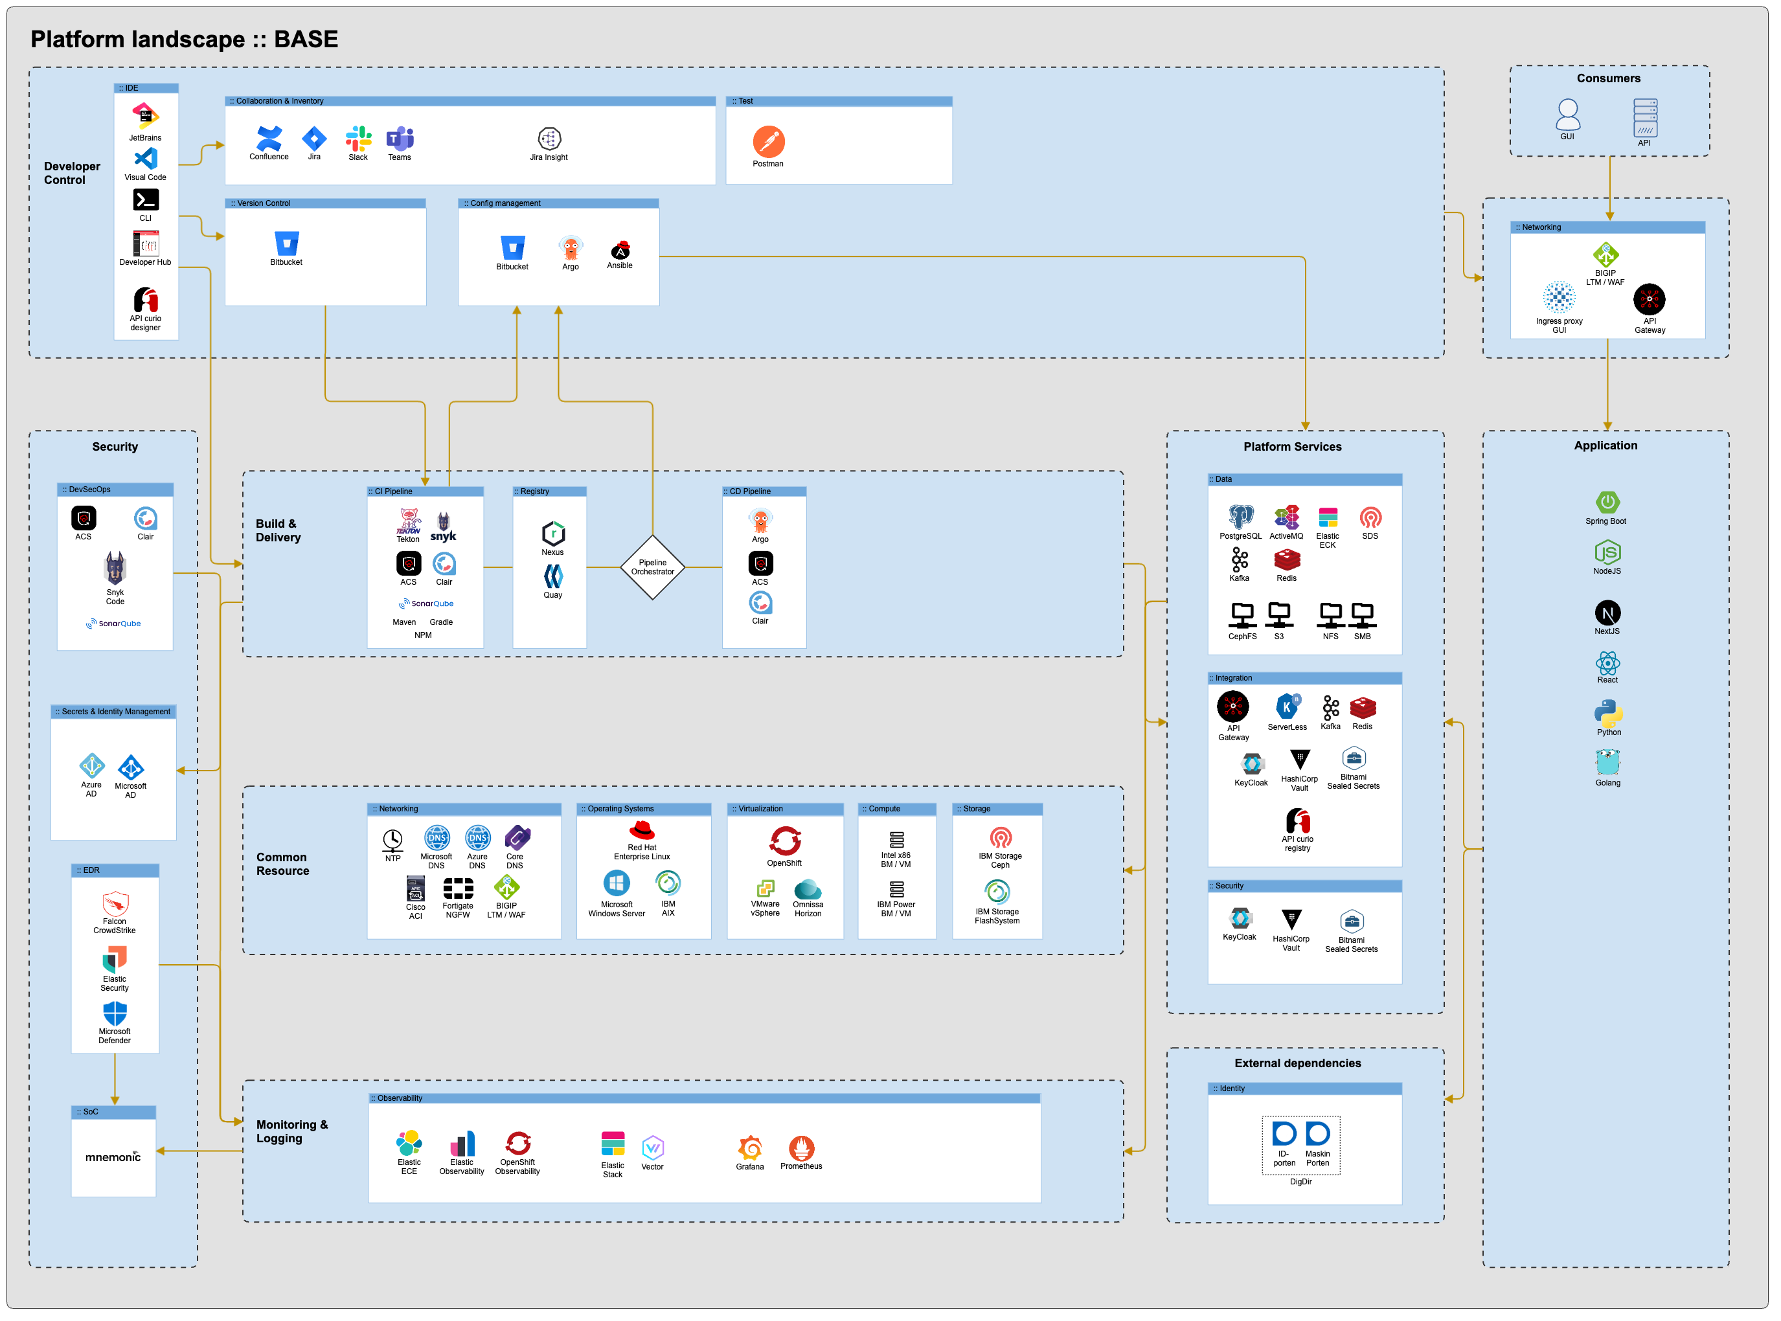

Slide 22
The Technology Platform
BASE
Lessons learned

Slide 23
Focus on the business needs
Develop an ecosystem and iterate based on feedback
If it can run in a container, run it on OpenShift
Providing
Portability
Segregation
And it’s easier to align with DevOps
A minimum viable platform has to be big enough to support the business needs
Choose proven technology that scales
Establish good relations with partners
The value of supported open-source software is often underestimated
Storage is easy – the real value lies in achieving the potential
Ownership to the product and direction is important
A strong platform team
Close collaboration with infrastructure and cybersecurity teams
Lessons learned
Notes:
Focus on the business needs
👉 Teknologivalg og plattformutforming må alltid styres av de faktiske behovene i virksomheten. Dersom man tar utgangspunkt i teknologi alene, risikerer man løsninger som er komplekse, dyre og lite relevante. Ved å prioritere forretningsbehov sikrer man at plattformen leverer reell verdi, muliggjør innovasjon og støtter strategiske mål.
1. Develop an ecosystem
👉 Et økosystem av tjenester, integrasjoner og samarbeid gir fleksibilitet og skalerbarhet. Det gjør at virksomheten kan utvide eller endre seg uten å være låst til enkeltkomponenter eller leverandører. Et godt økosystem reduserer siloer, fremmer gjenbruk og muliggjør raskere leveranser.
2. If it can run in a container, run it on OpenShift
👉 Standardisering på containere og OpenShift gir enhetlig drift, enklere livssyklus-håndtering og bedre portabilitet. Det reduserer kompleksiteten ved å kjøre applikasjoner på tvers av miljøer og sikrer at både utvikling og drift har et felles rammeverk. Dette gir forutsigbarhet, bedre ressursutnyttelse og lavere driftskostnader.
3. A Minimal viable platform has to be big enough to support the business needs
👉 En minimal plattform kan ikke være så liten at den blir ubrukelig. Den må ha tilstrekkelig funksjonalitet til å støtte sentrale forretningskrav, ellers mister den legitimitet og adopsjon. En “viable” plattform balanserer enkelhet og kostnadskontroll med evnen til å faktisk levere verdi i praksis.
Choose proven technology that can scale
👉 Valg av teknologi bør redusere risiko og sikre at løsningen kan vokse med virksomhetens behov. Modne og utprøvde teknologier har dokumentert robusthet, et aktivt økosystem og kompetanse tilgjengelig i markedet, noe som gir forutsigbarhet og lavere total eierkostnad.
1. Establish good relations with partners
👉 Ingen plattform eller organisasjon er selvforsynt. Gode relasjoner til partnere gir tilgang til ekspertise, raskere problemløsning og innovasjon gjennom samarbeid. Det styrker leveranseevnen, gir fleksibilitet og reduserer risiko ved å ha et bredere støtteapparat.
2. The value of supported open-source software is often underestimated
👉 Å bruke støttet open source gir både innovasjonskraft og trygghet. Man får fordelene av åpenhet, fleksibilitet og lavere lisenskostnader, samtidig som man sikrer profesjonell support og vedlikehold. Dette kombinerer det beste fra åpen teknologi og kommersiell kvalitetssikring.
3. Storage can be difficult, but also easy
👉 Lagring kan fremstå som trivielt, men har ofte skjulte kompleksiteter knyttet til ytelse, skalerbarhet, sikkerhet og kostnader. Riktig tilnærming og teknologi kan imidlertid gjøre lagring til en enkel og robust tjeneste. God forståelse og planlegging reduserer risiko og gjør at lagring oppleves som “lett” i praksis

Slide 24
The Technology Platform
BASE
How we balance security, compliance and operations without slowing down innovation

Slide 25
A comprehensive and standardized developer platform:
A platform designed for self-service
Providing developers with standardized tools and golden paths to reduce cognitive load and accelerate delivery.
Development teams needs flexible pipeline options:
They can use and contribute to platform-maintained, open source–based pipelines
They can also create custom pipelines in staging environments when needed
It’s important that a platform team provides guidance and support on demand
Direct collaboration – short distance between development teams and the platform team
Open Slack channels – for quick questions and knowledge sharing
Demos – showcasing features, best practices, and improvements
Forums – structured discussions and knowledge exchange
Onboarding – guidance and support for new teams and members
How we balance security, compliance and operations
without slowing down innovation

Slide 26
The Technology Platform
BASE
Tips on building a platform that scales

Slide 27
Strong ownership supported by executive leadership
Develop an ecosystem
Offer a comprehensive and standardized developer platform as a BASE for developers
Hyperscaler capabilities - tailored to your needs
A unified platform - accessible to everyone
Portability at the core
Invest in self-services
Use automation like Ansible, Terraform and ArgoCD
Infrastructure as Code
Building a platform is a never-ending story
Tips on building a platform that scales
Notes:
1. Clear ownership rooted in top leadership
👉 Plattformen er en strategisk satsing som krever tydelig ansvar og prioritering. Når eierskap forankres i toppledelsen, sikres nødvendig mandat, ressurser og langsiktig forpliktelse. Dette skaper retning, legitimitet og gjør det enklere å løse kryssfunksjonelle utfordringer.
2. A unified platform accessible to everyone
👉 En felles plattform reduserer fragmentering, fremmer samarbeid og gir en konsistent brukeropplevelse. Når den er tilgjengelig for alle relevante aktører, øker produktiviteten, gjenbruket og kvaliteten, samtidig som barrierer mellom team og avdelinger fjernes.
3. Offer a comprehensive and standardized developer platform as a BASE for developers
👉 Utviklere trenger et solid fundament for å levere verdi raskt og sikkert. En standardisert og komplett utviklerplattform gir forutsigbare rammer, øker hastigheten på leveranser og reduserer risiko for feil. Den frigjør utviklerne fra operasjonelle detaljer slik at de kan fokusere på forretningslogikk.
4. Hyperscaler capabilities, tailored to your needs
👉 Hyperscalere gir enorme muligheter for skala, innovasjon og tilgjengelighet. Men ukritisk bruk kan bli dyrt og komplekst. Ved å tilpasse hyperscaler-funksjonalitet til faktiske behov får virksomheten de beste fordelene, uten å miste kontroll eller kostnadseffektivitet.
5. Have portability in mind
👉 Hvorfor: Portabilitet beskytter virksomheten mot leverandørlåsing og gjør det mulig å flytte løsninger mellom miljøer og plattformer. Dette gir fleksibilitet, forhandlingsstyrke og trygghet for at investeringene kan tilpasses endrede behov over tid.
6. Invest in self-services
👉 Hvorfor: Selvtjenester gir utviklere og team mulighet til å levere raskere uten å vente på manuelle prosesser. Det øker produktivitet, reduserer flaskehalser og styrker eierskap. Samtidig frigjør det driftsressurser til mer strategisk arbeid.
7. Use automation like Ansible, Terraform, ArgoCD and GitOps
👉 Automatisering reduserer manuelle feil, øker konsistens og gir raskere leveranser. Ved å bruke etablerte verktøy og GitOps-prinsipper får man sporbarhet, reproduserbarhet og høyere kvalitet i endringer. Dette gir både trygghet og fart.
8. Infrastructure as Code
👉 Å behandle infrastruktur som kode gjør at man kan versjonere, gjenbruke og automatisere alt fra konfigurasjon til utrulling. Dette skaper forutsigbarhet, reduserer feil og gir større kontroll over komplekse miljøer. Det muliggjør moderne DevOps-praksis.
9. Building a platform is a never-ending story
👉 En plattform må kontinuerlig videreutvikles for å møte nye forretningskrav, teknologiske trender og sikkerhetsbehov. Det er ikke et engangsprosjekt, men en langsiktig reise som krever vedlikehold, forbedring og innovasjon. Å erkjenne dette gir riktige forventninger og bærekraftig investering.

Slide 28
The Technology Platform
BASE
What’s next

Slide 29
Connectivity Link / Kuadrant
Ingress controller
API-gateway
Developer Hub / Backstage
Establish a single, unified entry point that simplifies access for developers
Trusted Software Supply Chain
Deliver integrity, compliance, and confidence by securing and analyzing every artifact.
Hosted Control Plane
Provide PaaS as a Services
OpenShift on OpenShift
Increase the bare-metal node utilization
It is challenging to fully utilize today’s modern hardware without virtualization
VMs on OpenShift
Containerize classic VM workload
What’s next

Slide 30
Adapt AI into the platform
Explore the use of local LLMs
Enhance developer productivity
Safely embed AI into the development process
Leverage locally trained LLMs
Use Bitbucket & Confluence data for context
Provide intelligent, contextual code assistance
Investigate generative AI agents
Explore solutions like Lightspeed
Enhance development, operations & troubleshooting
Apply in context: OpenShift, RHEL, AAP
Explore the use of AI in a case handling context
Explore the potential of Ceph in a datalake context
enabling organizations to unify, scale, and optimize data storage
supporting advanced analytics and AI workloads
What’s next
AI

Slide 31
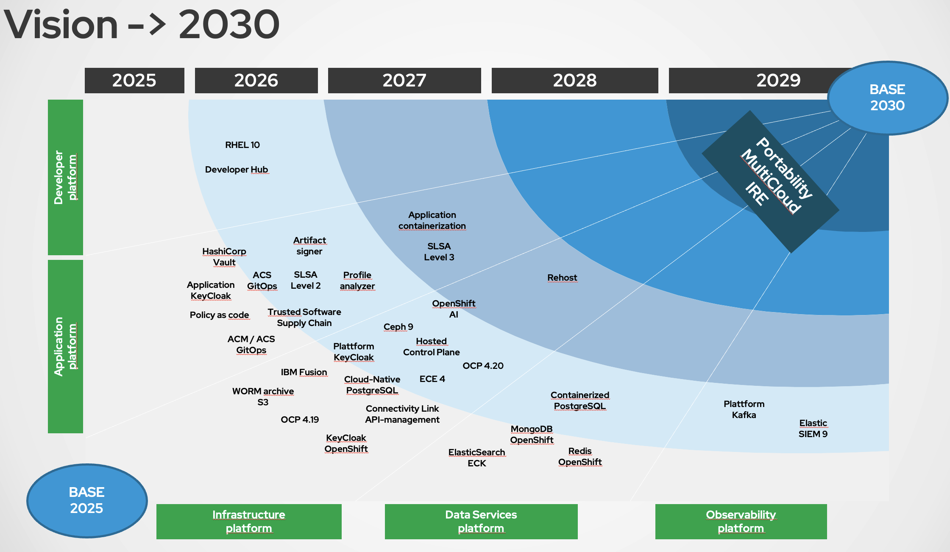
Notes:
A snapshot of the current vision

Slide 32

Thanks for letting me share our journey
Børre Nordbakken LinkedIn

