Slide 1
Advancing AI, Virtualization and Platform Security
EMEA Red Hat Summit Connect: 2025
Joachim Ærtebjerg Head of ISV Partnerships, EMEA
Intel Corporation
Notes:
>>>> Red Hat speaker welcome on stage the Intel speaker <<<<

Slide 2

Notes:
RED HAT: thank you so much for joining us today. Intel has always been an incredible partner for us; I think we've actually passed the 25-year mark at this point. A lot has changed over the years, but one thing that has remained strong and consistent is our partnership, that is still bringing huge value to our customers and ecosystem. Would you mind to tell us more about it?
INTEL: in these 25 years we have come a long way together, focusing our efforts in bringing the Platform of Choice to the Industry. Everyday Engineers from both companies work closely together to ensure the new features of Intel’s latest platforms, and features and capabilities of Red Hat’s Portfolio of solutions are designed, supported and optimized, in this way our customers gain first-rate cloud architecture, workload-optimized containers, and integrated solutions. Now, our commitment together with Red Hat is to help organizations develop and unlock the full potential of scalable and more secure AI systems based on open ecosystems and standards.
Intel contributes to more than 100 different open-source projects, from the Linux kernel to cloud orchestration and plugins for Kubernetes.

Slide 3



Evolution of AI Applications in Enterprise Use Cases
Mature
Emerging
AI Agents
Generative AI
Computer Vision
Natural Language Processing
Evolution of Artificial Intelligence
Machine Learning
Statistical Data Analytics
1980
1990
2000
2010
2020
2024
2030
Notes:
RED HAT: that’s sound really good so let’s keep this collaboration working for another round of 25 years! One point that is very important to me is how we intensified our joint effort to bringing non-proprietary AI solutions to the market, allowing developers to build AI applications the way they want on an open foundation. Now let's look ahead, what should people expect in the AI space?
INTEL: we are still in the early days of AI, the journey ahead of us is exciting as well as challenging, new updates coming every week, new models released very often, I am sure you heard a lot about agentic AI and looking at this year and the years ahead Agentic AI is the clear focus. What are those AI agents? Well, it is a system capable of reasoning through complex problems, creating actionable plans and executing them while will add tremendous value by increasing productivity, reducing cost or minimizing the time to execution, among others.

Slide 4

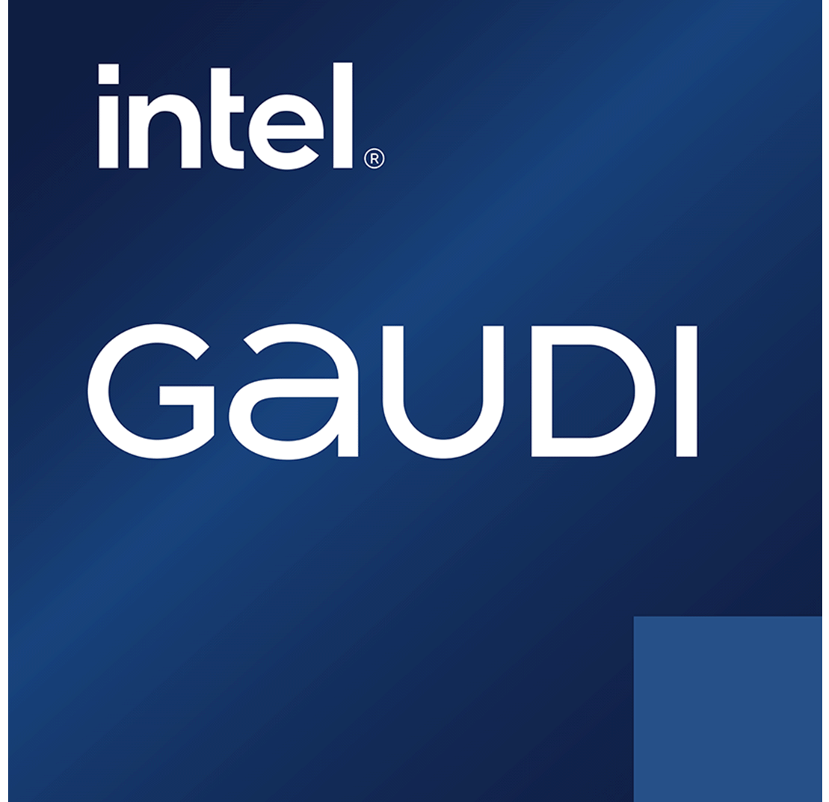
The AI Hierarchy: Mapping ML, DL, and GenAI with Intel
Discover how Intel® processors fuel AI workloads across inference, training, and next-generation GenAI applications.
30-year history of ML on CPUs
AI
Regression
Classification
Clustering
Decision trees
Data generation
Machine learning
Meet customer service-level agreements (SLAs) with general-purpose hardware
Deep learning
Image processing
Computer vision
Natural language processing (NLP)
Recommender systems
Inference
Inference and Fine- Tunning
GenAI
<20B parameters
Small to large-sized LLMs
Subset of AI that focuses on creating new, original content
4
Notes:
RED HAT: that sounds promising, and you just displayed on the chart an interesting timeline about the evolution of AI applications, so, before jumping into more details about Agentic AI, can you help us make some clarity about how AI workloads have evolved? And which role is Intel playing here?
INTEL: AI has evolved from machine learning to deep learning, and now generative AI. CPUs like Xeon are well-suited for ML and some DL tasks, but less for training large generative models like ChatGPT. However, GenAI is also segmenting smaller language models and domain-specific models (DSMs) are becoming more common and cost-effective, while larger models grow in complexity.
So, when assessing GenAI deployments, let’s consider factors like model size, latency, precision, token I/O, and user concurrency (simultaneous users): under the right conditions, Xeon can be a great fit for models under 20B parameters.

Slide 5


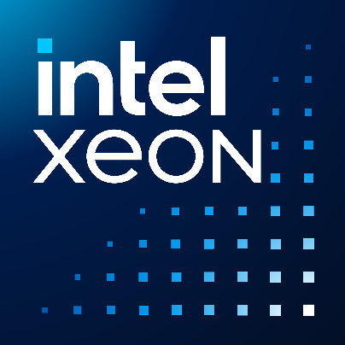
Why Intel Xeon 6 for Virtualization?
Intel® Xeon® 6 Processor
1.9x
2.5x
5.5x
higher performance per watt at a typical 40% server utilization vs. prior generation
higher HPC performance
vs. prior generation
higher AI Inferencing performance
vs. AMD EPYC
Designed for
Efficiency
Significant Performance Leaps
Unmatched
Performance
See [9G2, 9H9, 9A3] at intel.com/processorclaims: Intel Xeon 6. Results may vary
Notes:
RED HAT: a very comprehensive approach and this will surely help customers to face the challenge of the AI adoption. But talking about challenges and Data Center Modernization, our customers are also looking for support for virtualization environments: can CPU help here in the same way?
INTEL: we know that Virtualization has kept growing during the past months, here Red Hat OpenShift Virtualization with Intel Xeon 6 brings the best performance per cost option for your current Virtualization needs. This is what Xeon 6 brings to typical workloads as you can experience more than 2 times the increase of performance on your current workloads or up to 5 times better AI inferencing in comparison to competition.

Slide 6




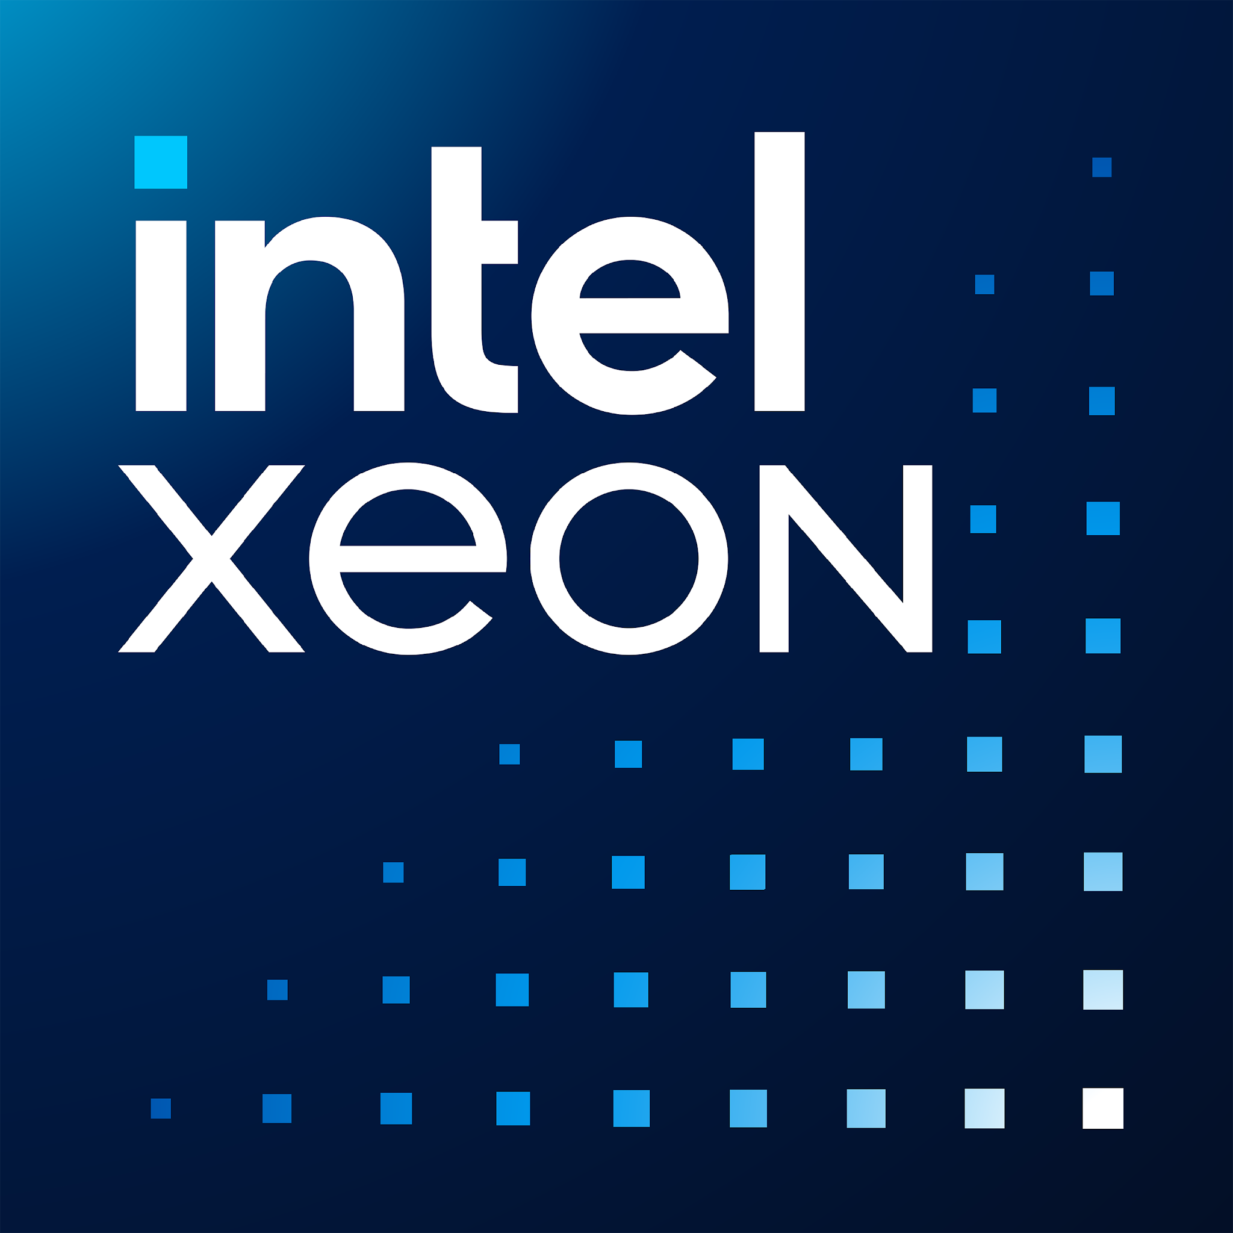
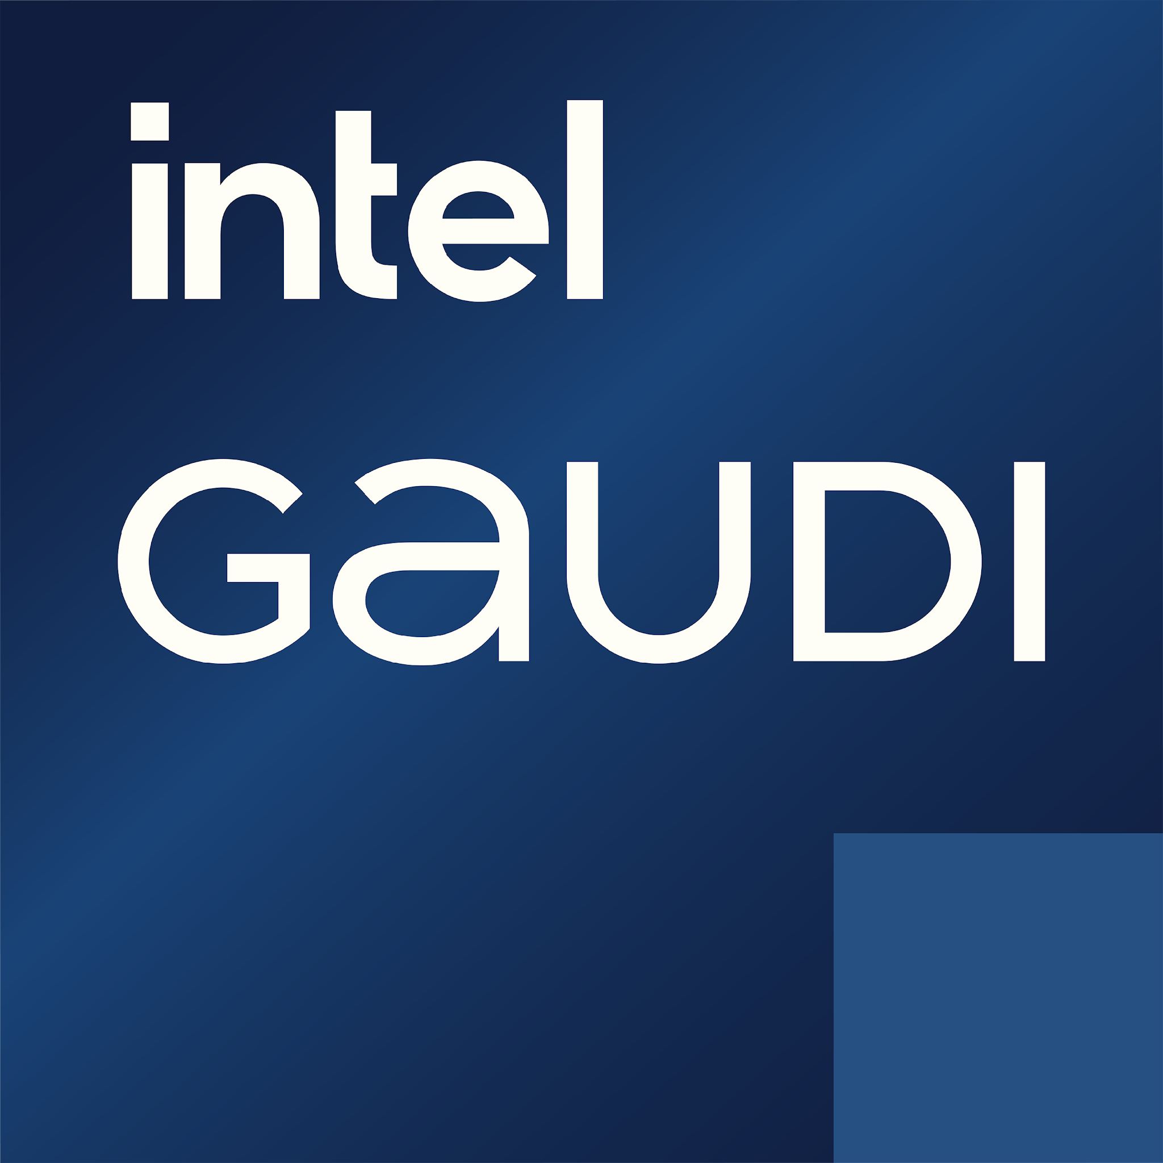
Intel x Red Hat: Core Pillars
AI
Virtualization
Security
Intel’s entire AI portfolio (SW/HW) is integrated into Red Hat OpenShift AI providing users an Open/Scalable AI experience
Explore alternative Red Hat on Intel virtualization options for Containers and/or VMs
Red Hat Enterprise Linux and Red Hat OpenShift adds support for SGX, TDX and Post Quantum Cryptography
Enterprise Linux
Notes:
Agentic AI is becoming the fastest-growing AI technology, driven by real-time inferencing. Intel, through its Xeon 6 CPUs and Gaudi 3 accelerators, uniquely enables the heterogeneous compute this technology demands—delivering a compelling TCO advantage. Combined with the Red Hat AI portfolio, it offers a powerful, open, and cost-efficient foundation for building and scaling agentic AI workloads.
Intel Xeon 6 delivers industry-leading performance per dollar across virtualized, containerized, and AI inferencing workloads for small and medium LLMs. When combined with Red Hat OpenShift Virtualization, organizations gain a unified, Kubernetes-native platform that supports VMs and containers side by side, enabling workload consolidation, operational efficiency, and a future-ready AI infrastructure.
Confidential Computing (e.g., Intel SGX, TDX) helps meet EMEA sovereignty guidelines by protecting sensitive data even during processing. Combined with open-source platforms like Red Hat OpenShift, it ensures data control across hybrid and public clouds, enabling portability, privacy, and regulatory flexibility without vendor lock-in required to adapt to future regulations and sovereign requirements.

Slide 7

Apply for a free Gaudi 3 Proof of Concept in 30 seconds
Choose your GenAI or Virtualization PoC:
Building Inference, RAG, AgenticAI, Model-as-a-Service, and other AI Use Cases with Intel Gaudi and Xeon
Optimize finetuning with Intel Gaudi
Why work with Intel + Red Hat?:
Benefit from access to free highly qualified experts from Red Hat and Intel and free access to the latest hardware to build your AI use case / application.
If selected, a Intel / Red Hat representative will contact you via email.
Notes:
RED HAT: awesome, before wrapping up, how can customers get started with these exciting new technologies?
INTEL: customers can apply for a free GenAI or Virt PoC based on Gaudi 3 technology, just take a picture of this QR Code!
Then we have a session and a booth, let’s meet there for further conversations!

