Slide 1



Local Development
in the AI Era
Kevin Dubois
Sr Principal Developer Advocate
IBM

Slide 2
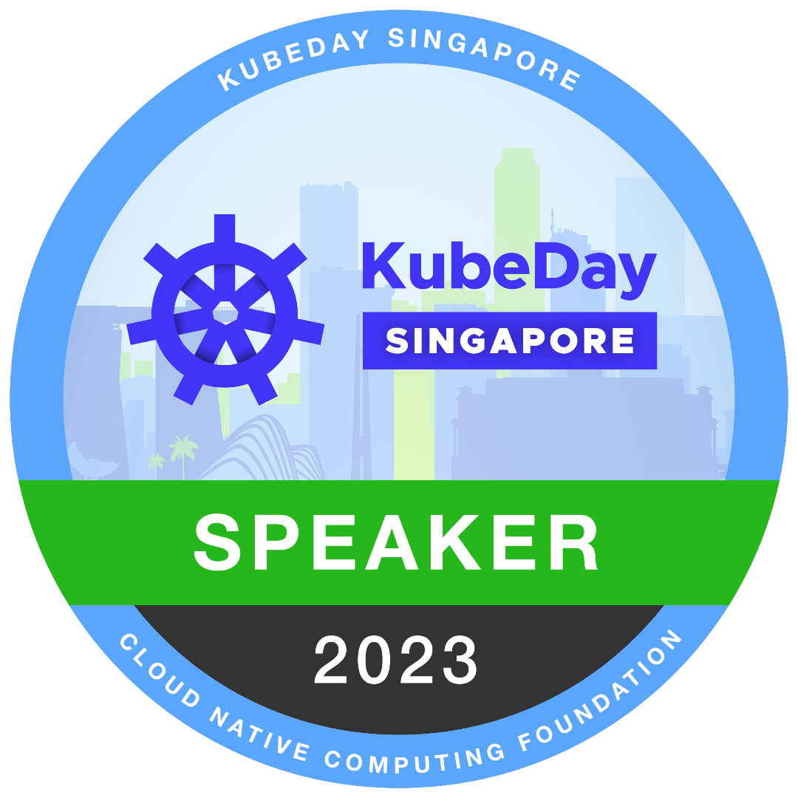



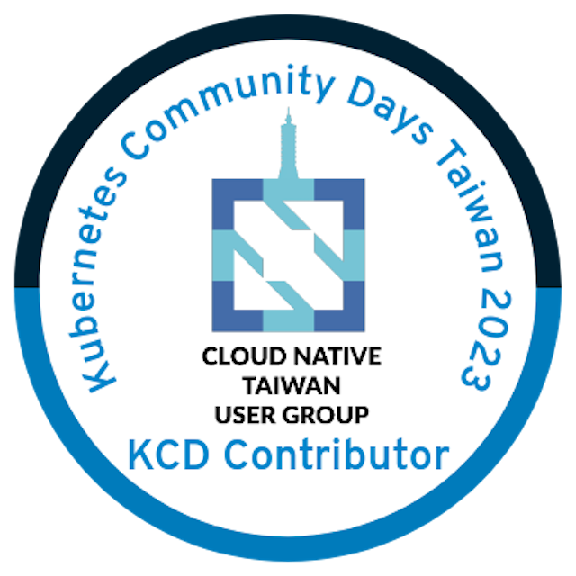

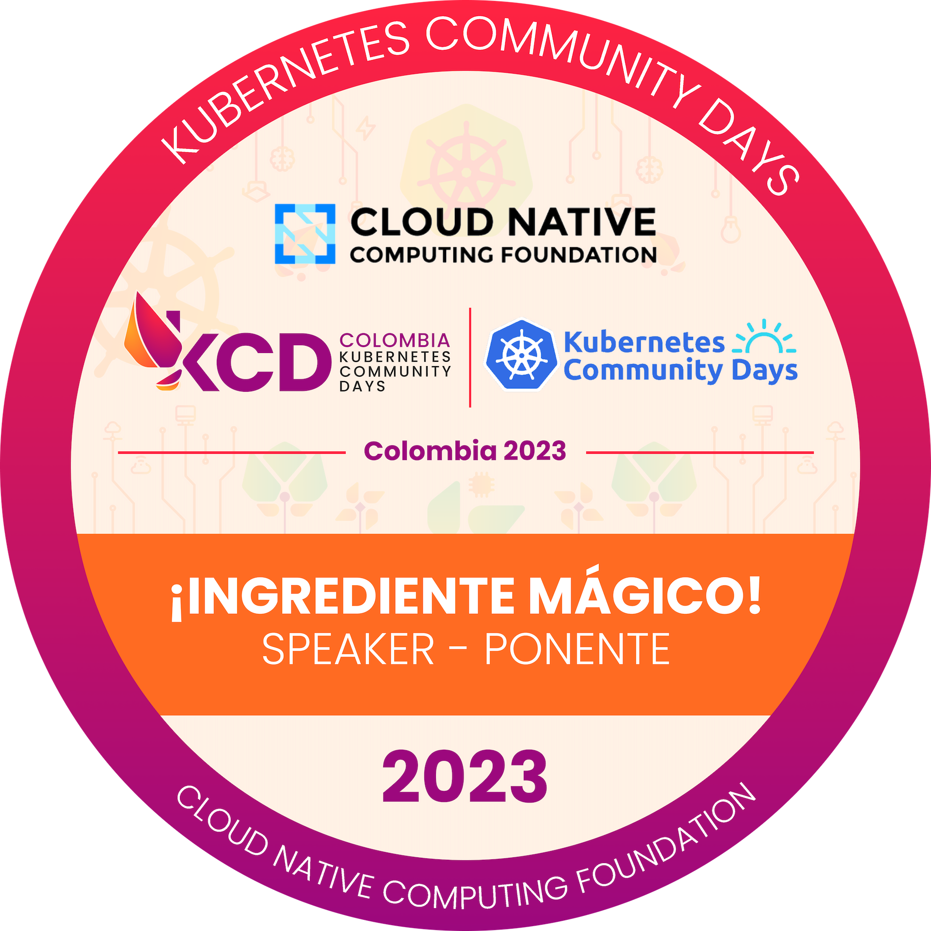





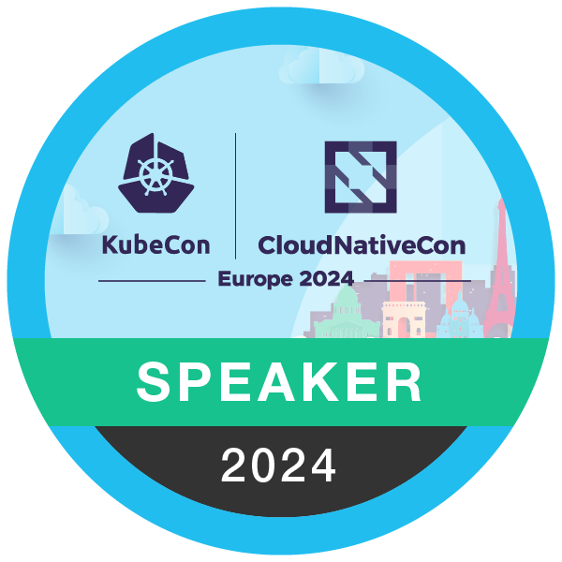


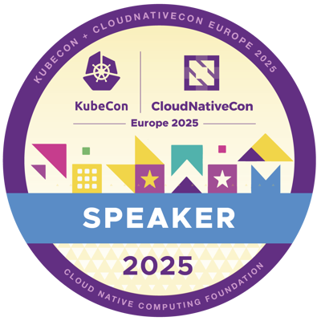




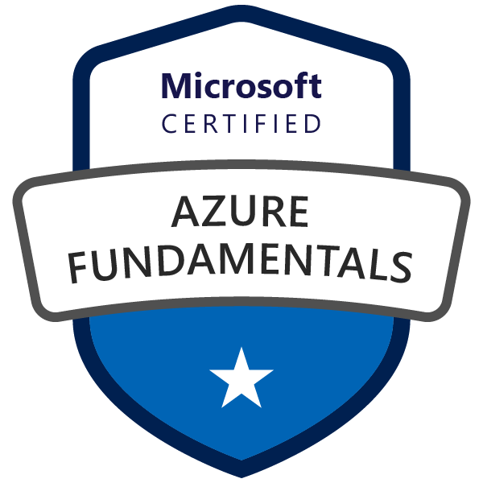
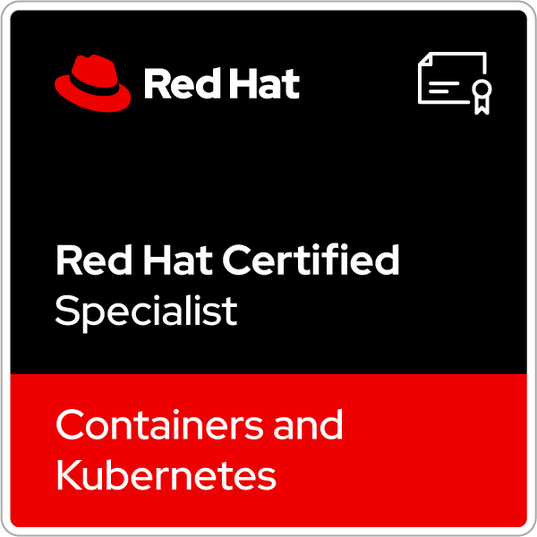


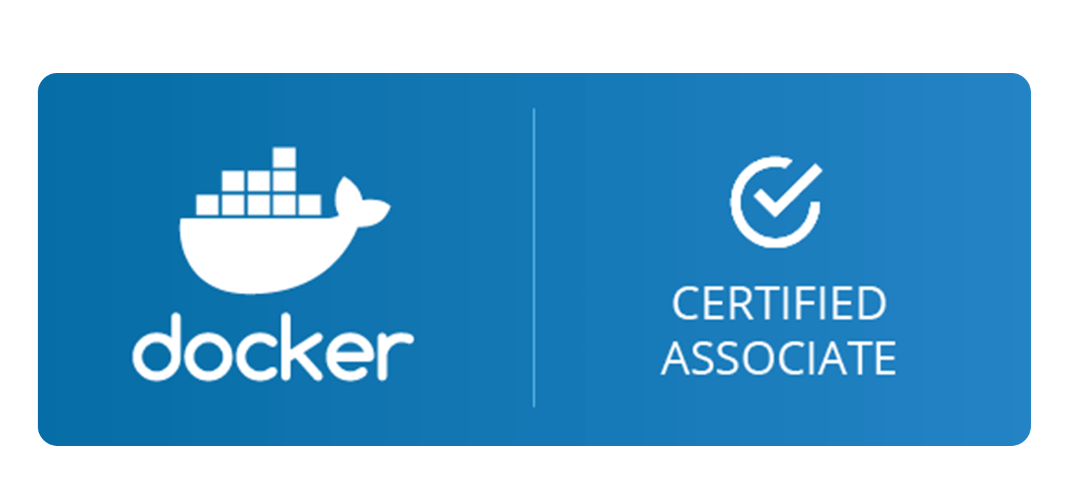
Kevin Dubois
Sr. Principal Developer Advocate at
Java Champion
Technical Lead, CNCF DevEx TAG
From Belgium 🇧🇪 / Live in Switzerland🇨🇭
🗣 English, Dutch, French, Italian
@kevindubois.com
youtube.com/@thekevindubois
linkedin.com/in/kevindubois
github.com/kdubois

Slide 3
Running and working with models… locally?

Slide 4
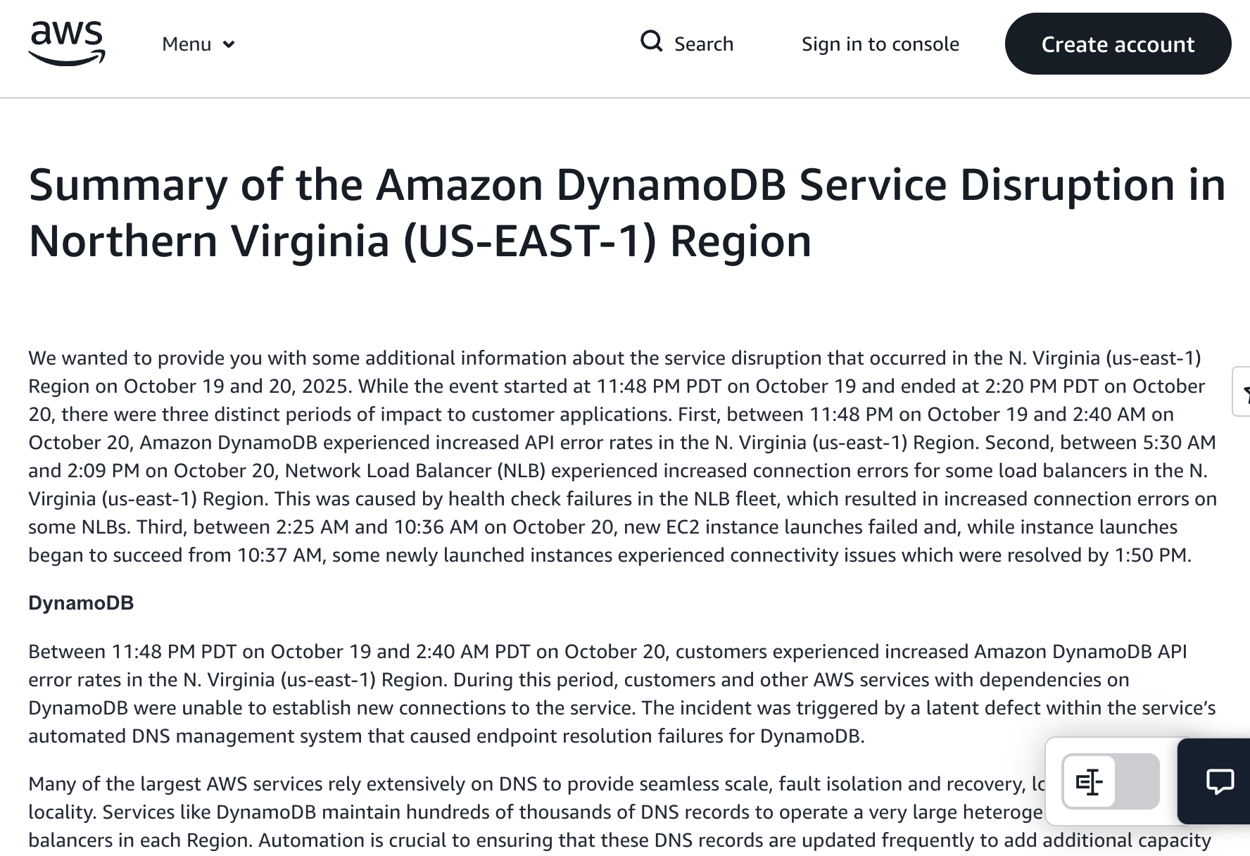
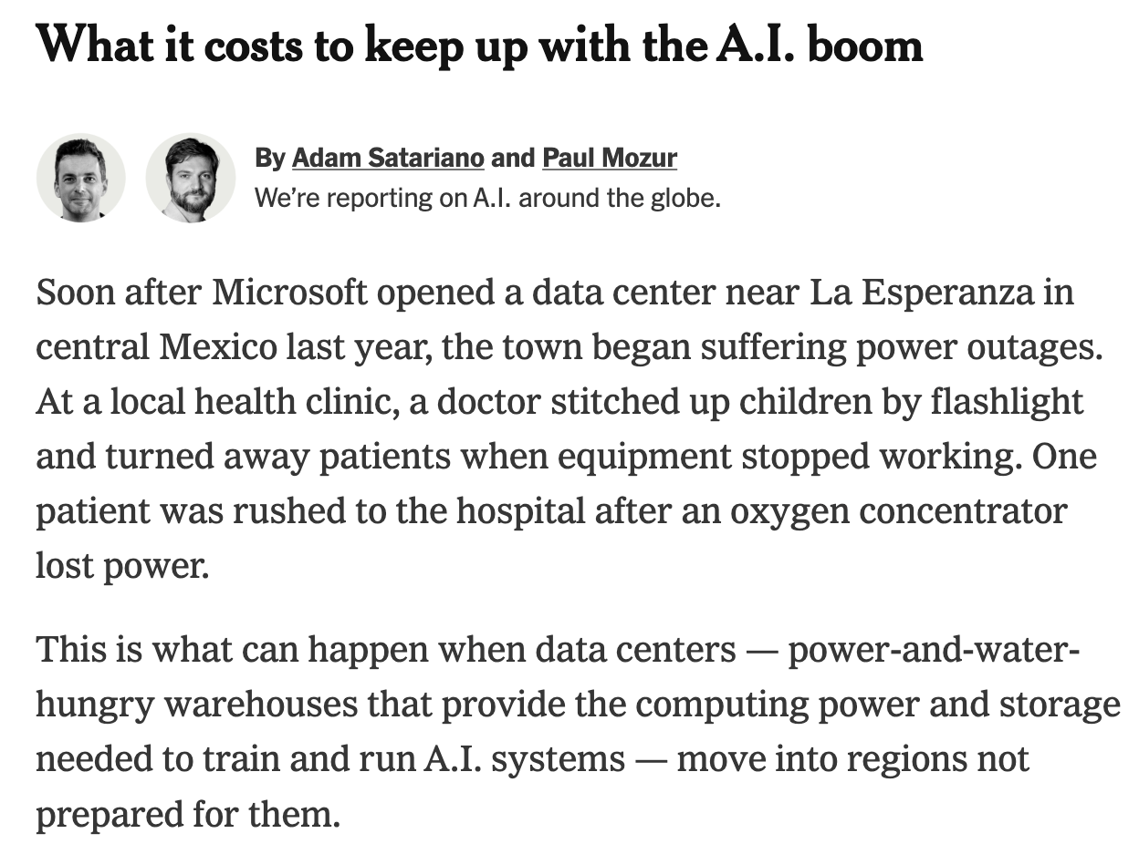
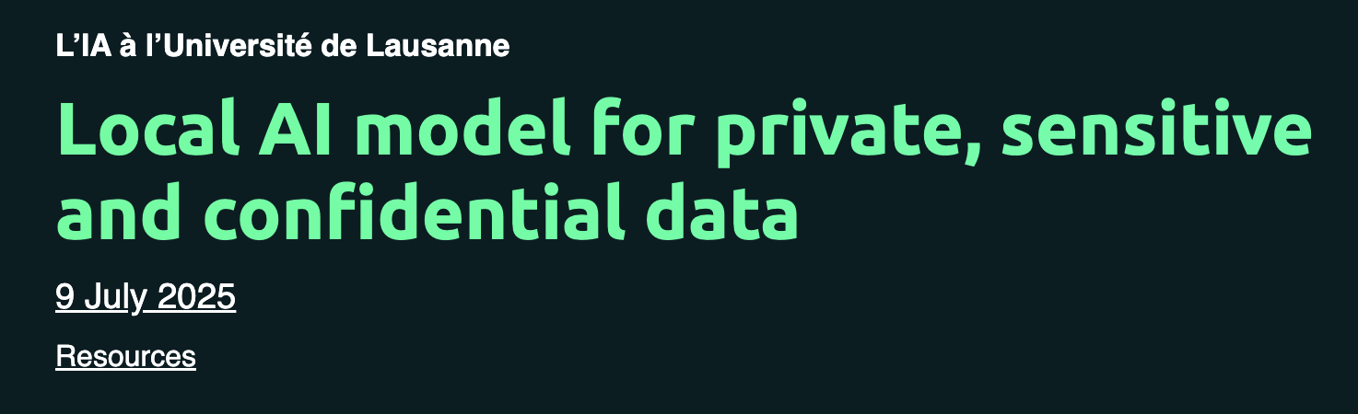
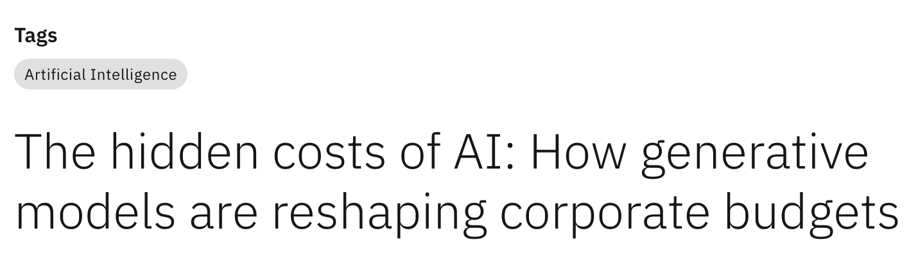

Slide 5

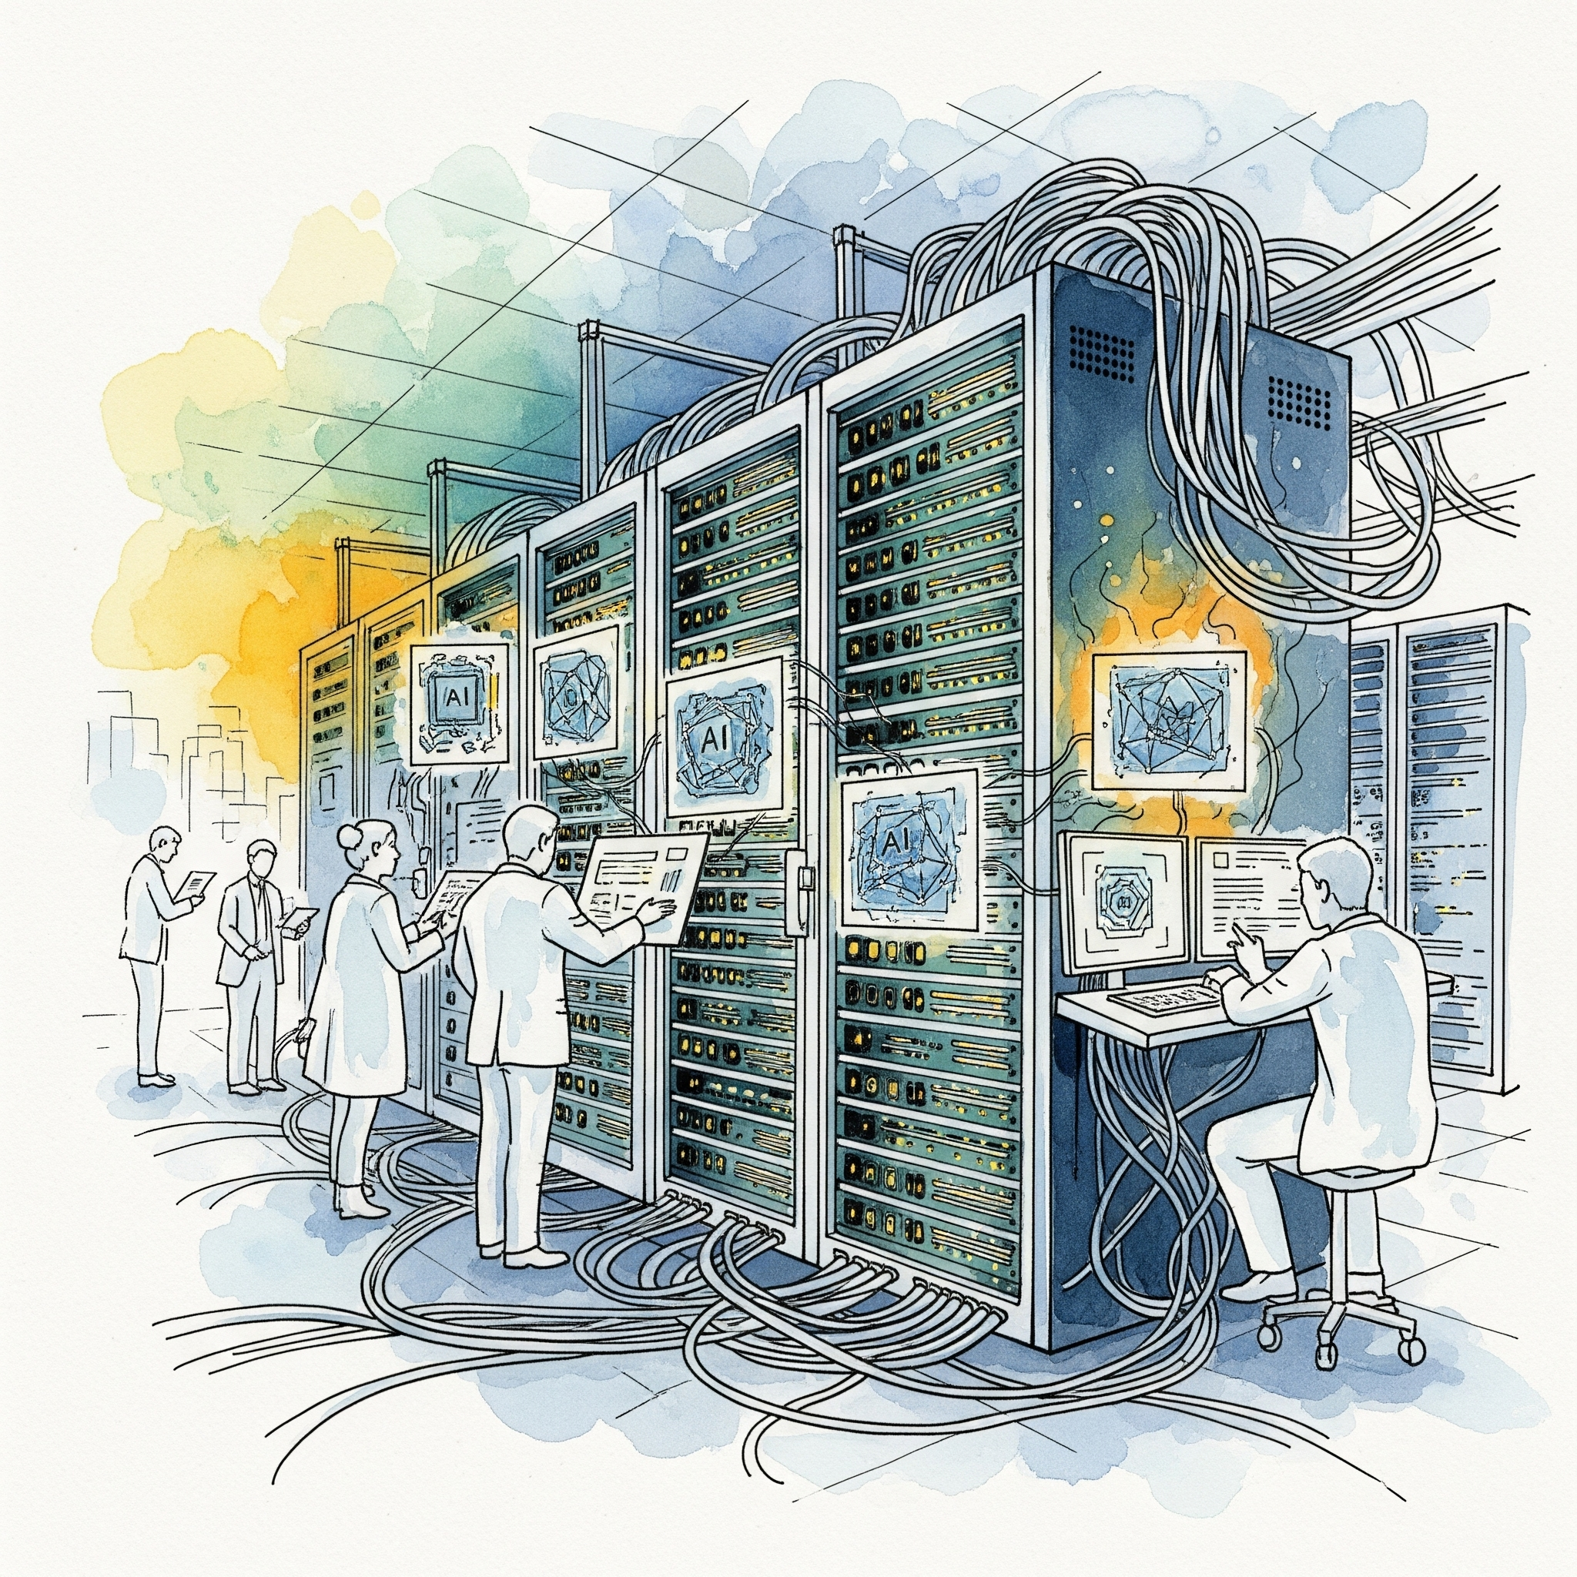
Why run a model locally?
For Developers
For Organizations
Convenience & Simplicity
Direct Access to Hardware
Data Privacy and Security
Familiarity with the Development Environment and adherence of the developers to their “local developer experience” in particular for testing and debugging
Data is the fuel for AI, and a differentiator factor (quality, quantity, qualification). Keeping data on-premises ensures sensitive information doesn’t leave the local environment → crucial for privacy-sensitive applications
Ease of Integration
Cost Control
Simplify the integration of the model with existing systems and applications that are already running locally.
While there is an initial investment in hardware and setup, running locally can potentially reduce ongoing costs of cloud computing services and alleviate the vendor-locking played by Amazon, MSFT, Google
Customization & Control
Regulatory Compliance
Easily train or fine-tune your own model, from the convenience of the developer’s local machine.
Some industries have strict regulations about where and how data is processed

Slide 6
What open source tech can help us run LLMs locally?

Slide 7







Fortunately, there’s a lot… for every use case!

Slide 8
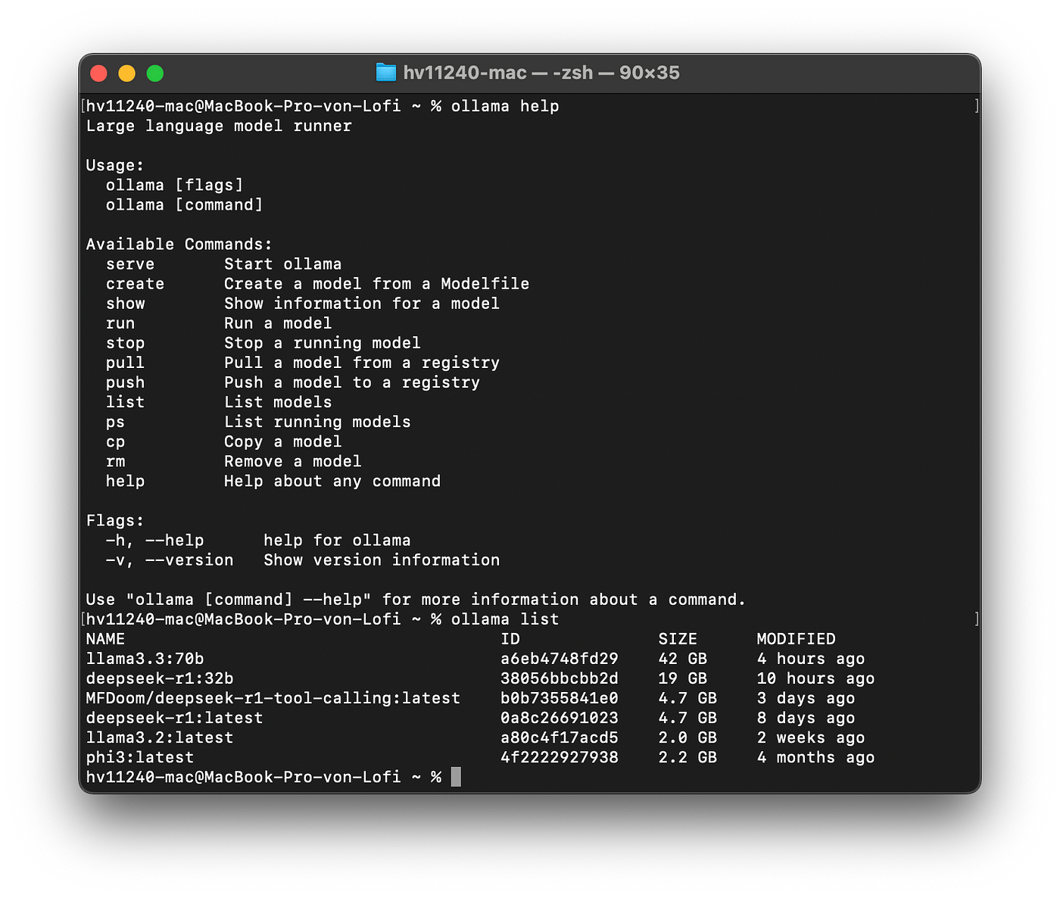

Tool #1: Ollama
Simple CLI: “Docker” style tool for running LLMs locally, offline, and privately
Extensible: Basic model customization (Modelfile) and importing of fine-tuned LLMs
Lightweight: Efficient and resource-friendly.
Easy API: API for both inferencing and Ollama itself (ex. download models)
https://ollama.com

Slide 9
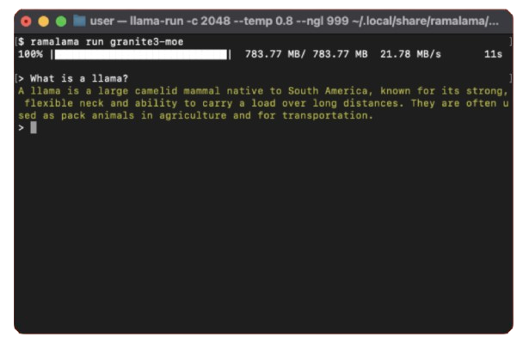
Tool #2: Ramalama
AI in Containers: Run models with Podman/Docker with no config needed.
Registry Agnostic: Freedom to pull models from Hugging Face, Ollama, or OCI registries.
GPU Optimized: Auto-detect & accelerate performance.
Flexible: Supports llama.cpp, vLLM, whisper.cpp & more.
https://ramalama.ai/

Slide 10
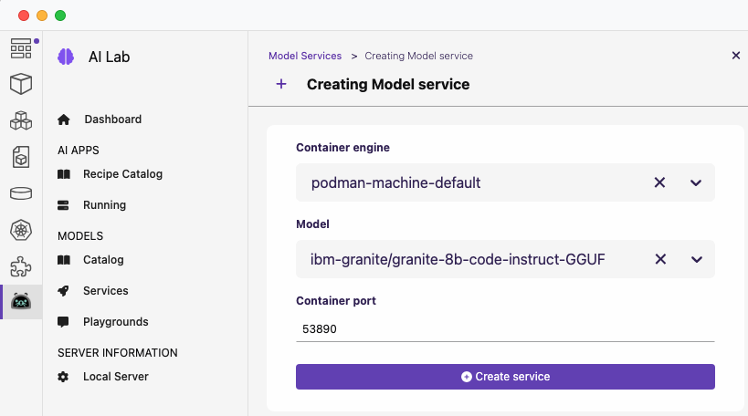
Tool #3: Podman AI Lab
For App Builders: Choose from various recipes like RAG, Agentic, Summarizers
Curated Models: Easily access Apache 2.0 open-source options.
Container Native: Easy app integration and movement from local to production.
Interactive Playgrounds: Test & optimize models with your custom prompts and data.
https://podman-desktop.io/docs/ai-lab

Slide 11
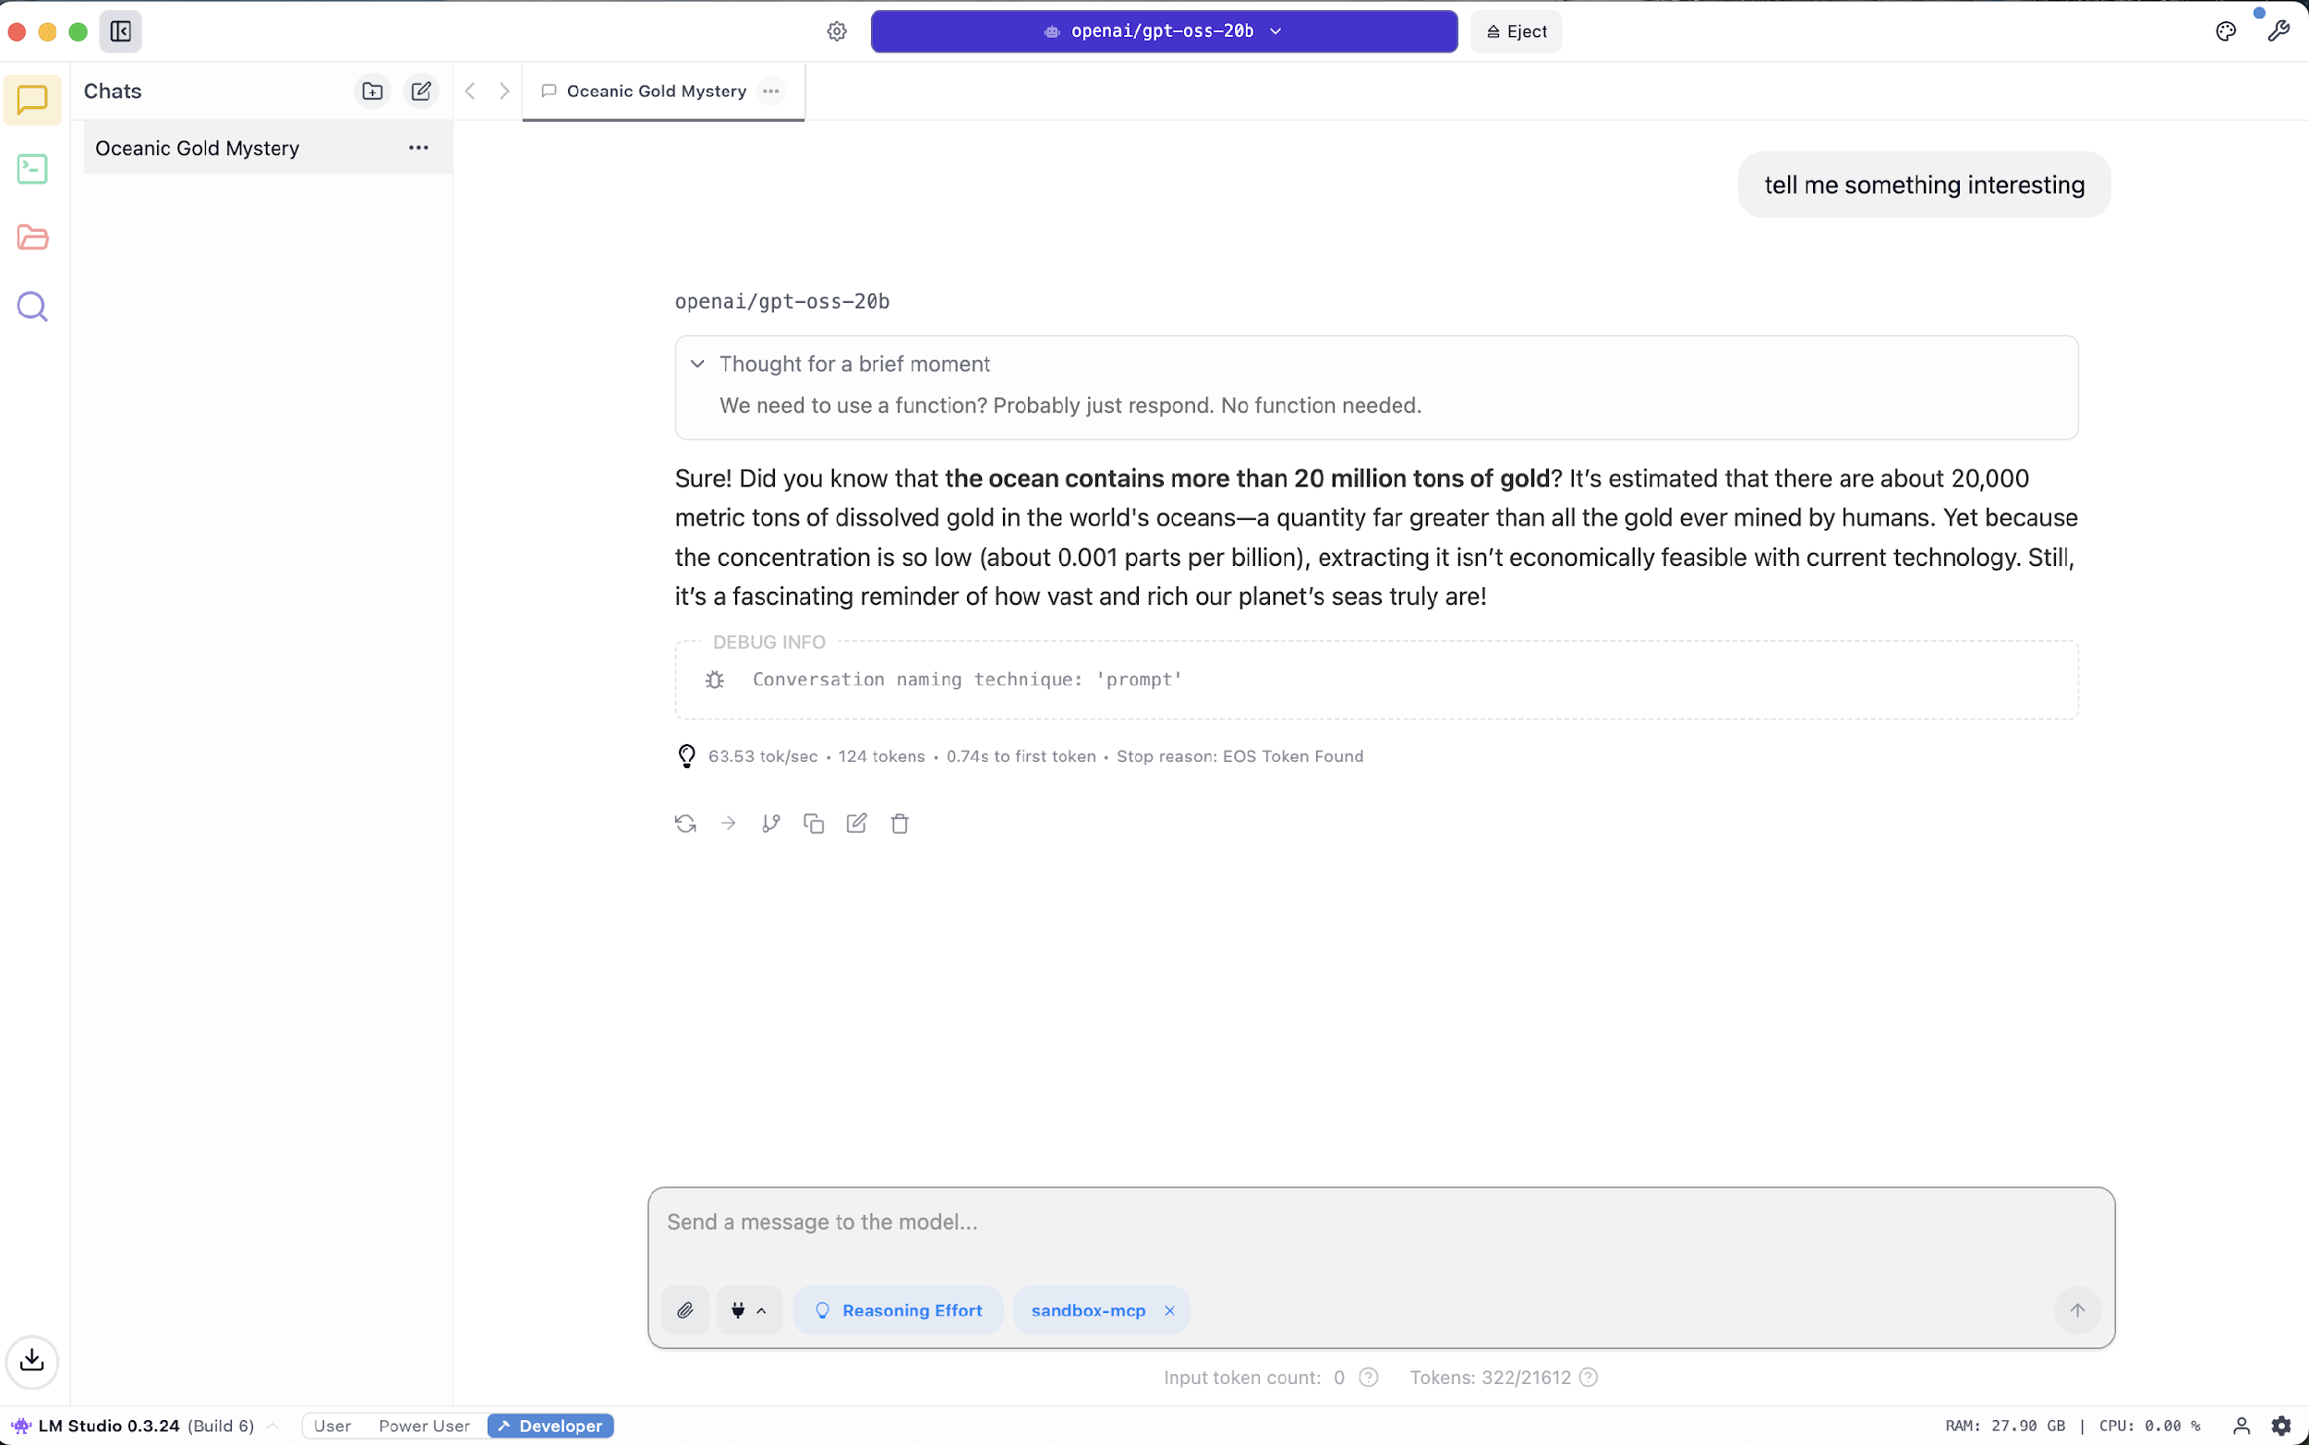
Tool #4: LM Studio
User Friendly
Easy way to find and serve models
Debug Mode: See what’s happening in the background
Ability to customize runtime for best performance
NOT Open Source ☹
https://lmstudio.ai/

Slide 12
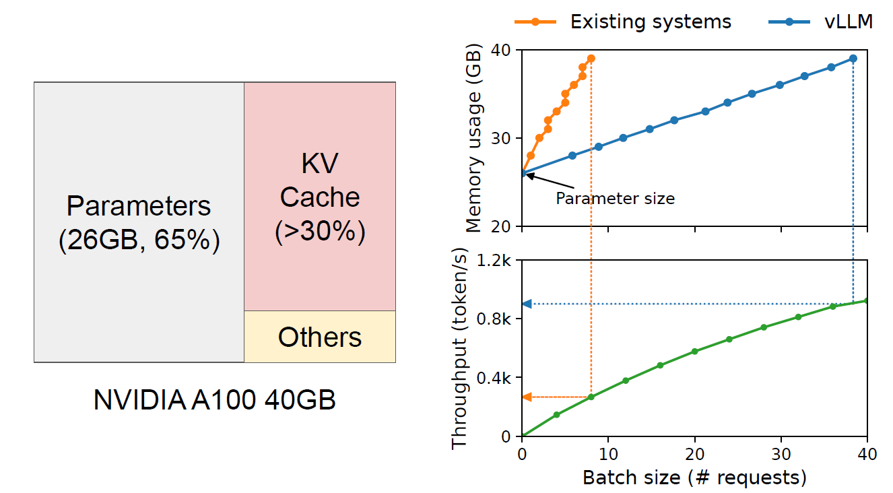
Tool #5: vLLM
Research-Based: UC Berkeley project to improve model speeds and GPU consumption
Standardized: Works with Hugging Face & OpenAI API.
Versatile: Supports NVIDIA, AMD, Intel, TPUs & more.
Scalable: Manages multiple requests efficiently, ex. with Kubernetes as an LLM runtime
https://docs.vllm.ai/

Slide 13
Ok! But, what specific model should I be using, and where do find them?

Slide 14
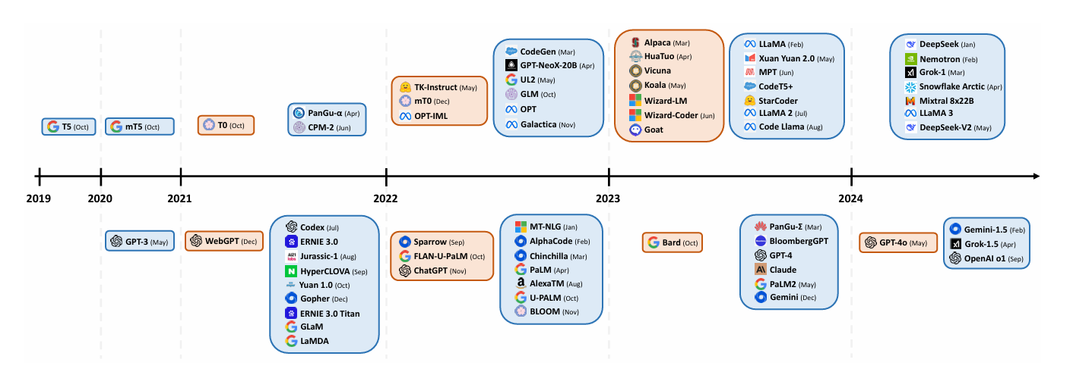
There are plenty of “open”, and closed model choices!

Slide 15
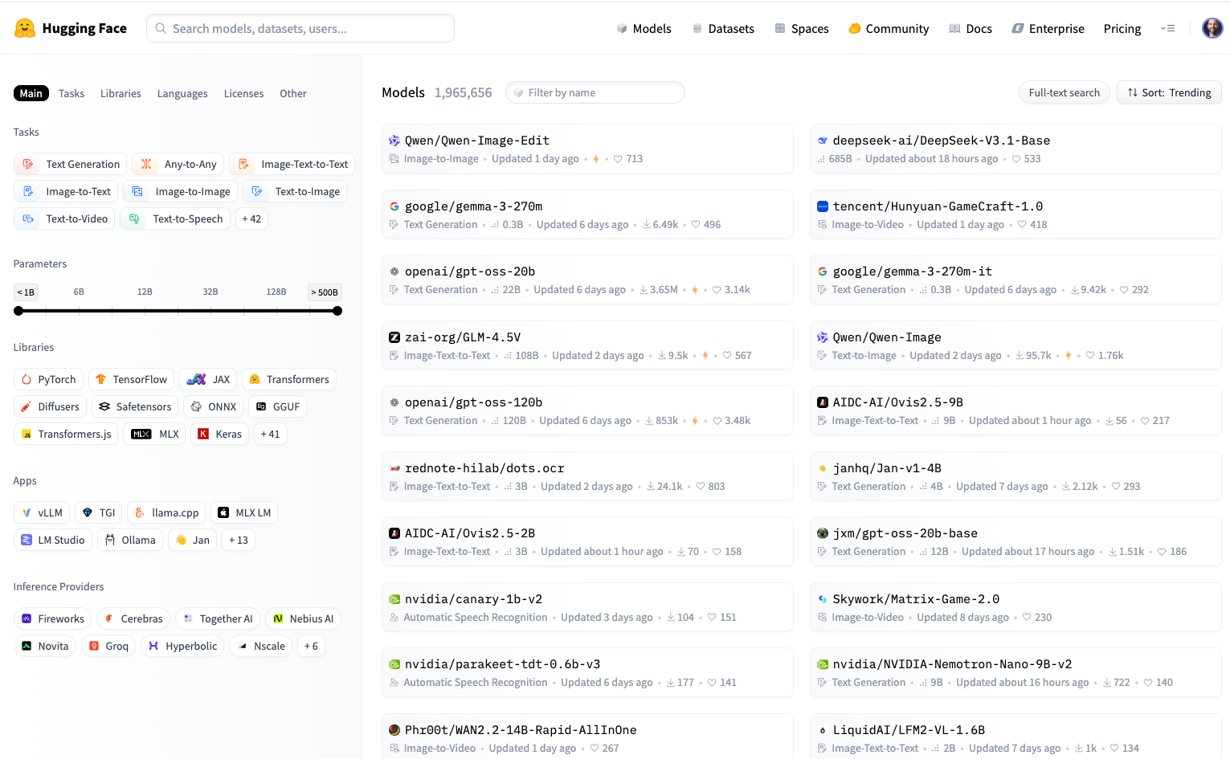
Find “Open Source” models on Hugging Face

Slide 16
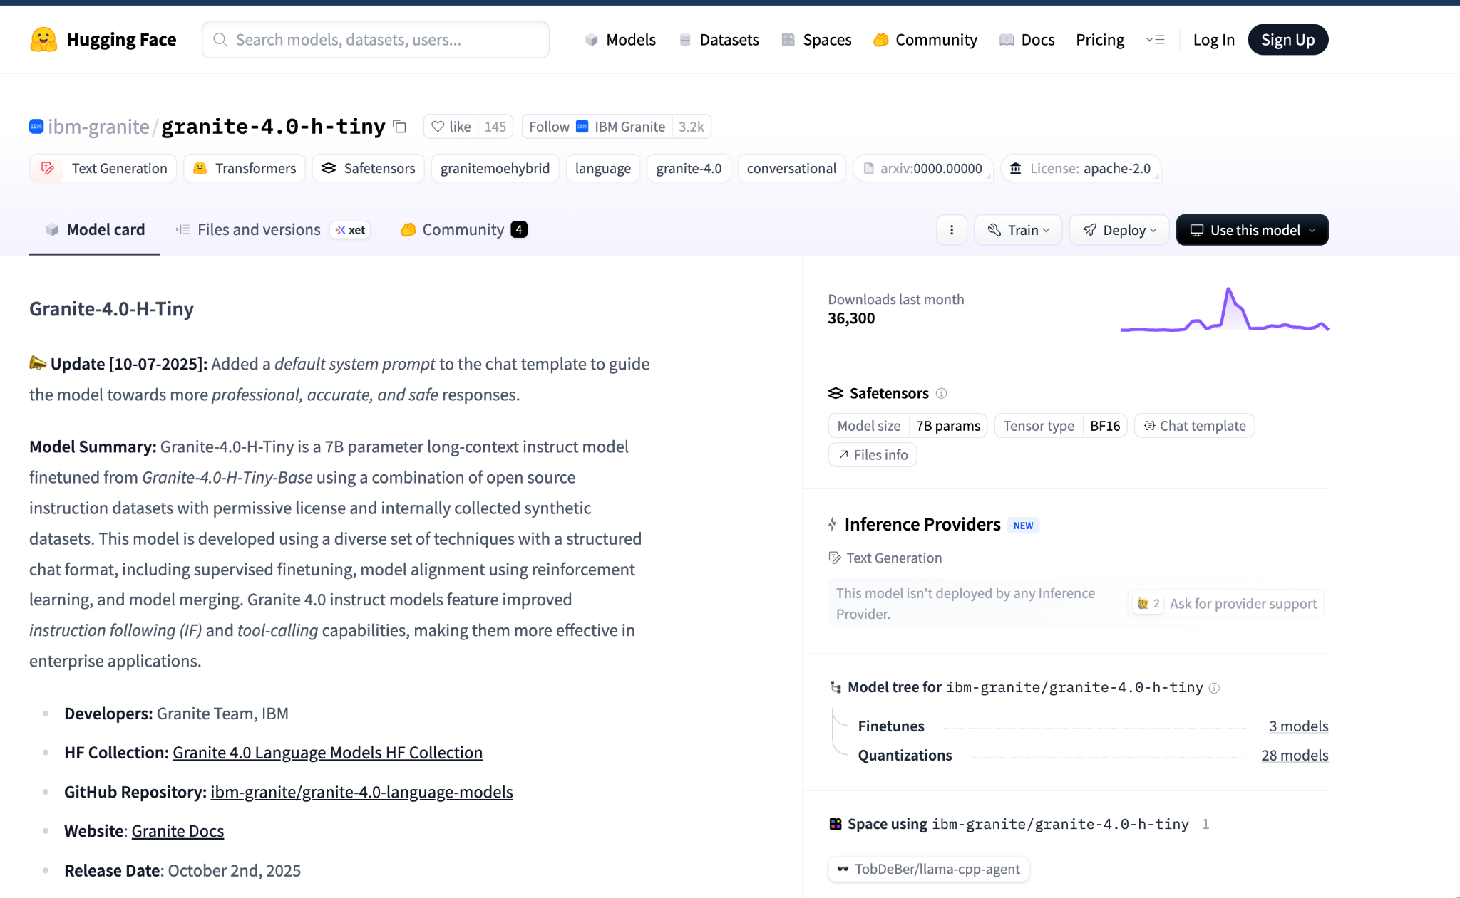

Slide 17
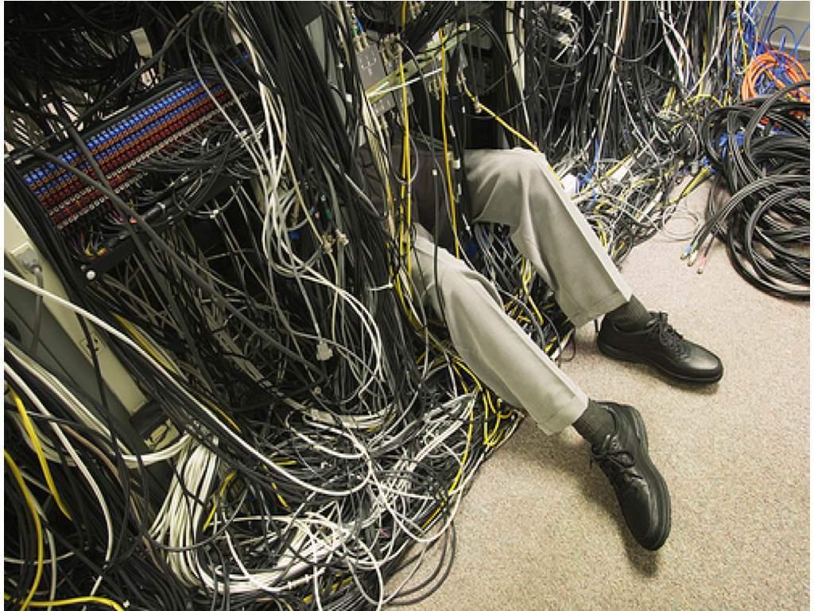

Slide 18
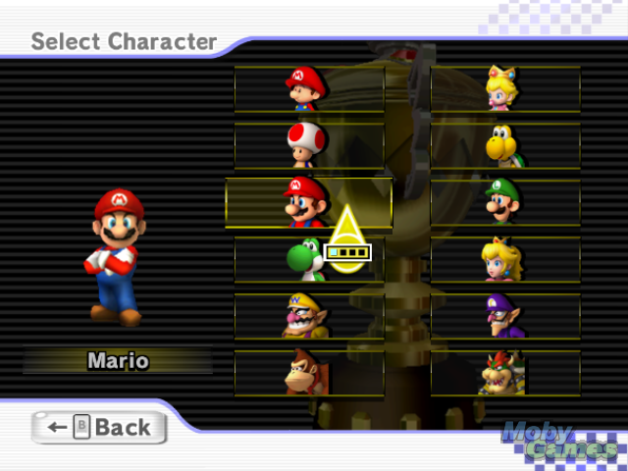

Slide 19


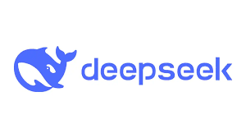
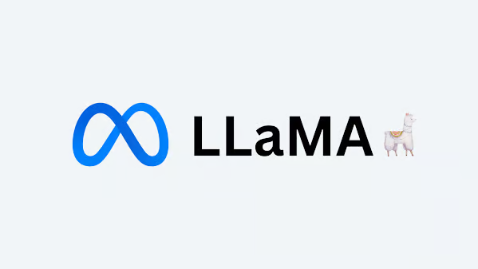



Gemma

Slide 20
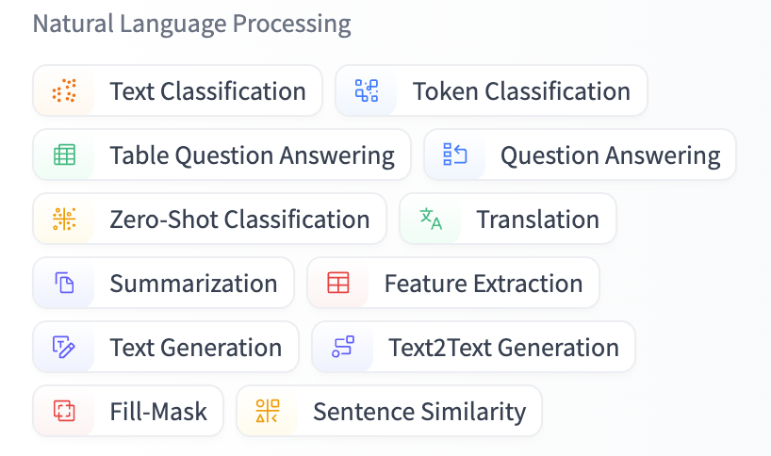
So, which local model should you select?
It depends on the use case that you want to tackle & how ”Open Source” it should be.
DeepSeek or the new gpt-oss models excel in reasoning tasks and complex problem-solving.
Qwen have strong coding assistant models.
Mixtral and LLaMA are particularly strong in summarization and sentiment analysis.
IBM’s Granite models are great for general tasks using minimal resources

Slide 21
Not all models are the same!
Text
OR
Image
Text
Image
Audio
Video
Unimodal
Single data input
Less resources
Single modality
Limited depth and accuracy
Multimodal
Multiple data inputs
More resources
Multiple modality
Better understanding and accuracy
text-to-image
text-to-code
text-to-text
any-to-any
image-to-text
image-to-image

Slide 22
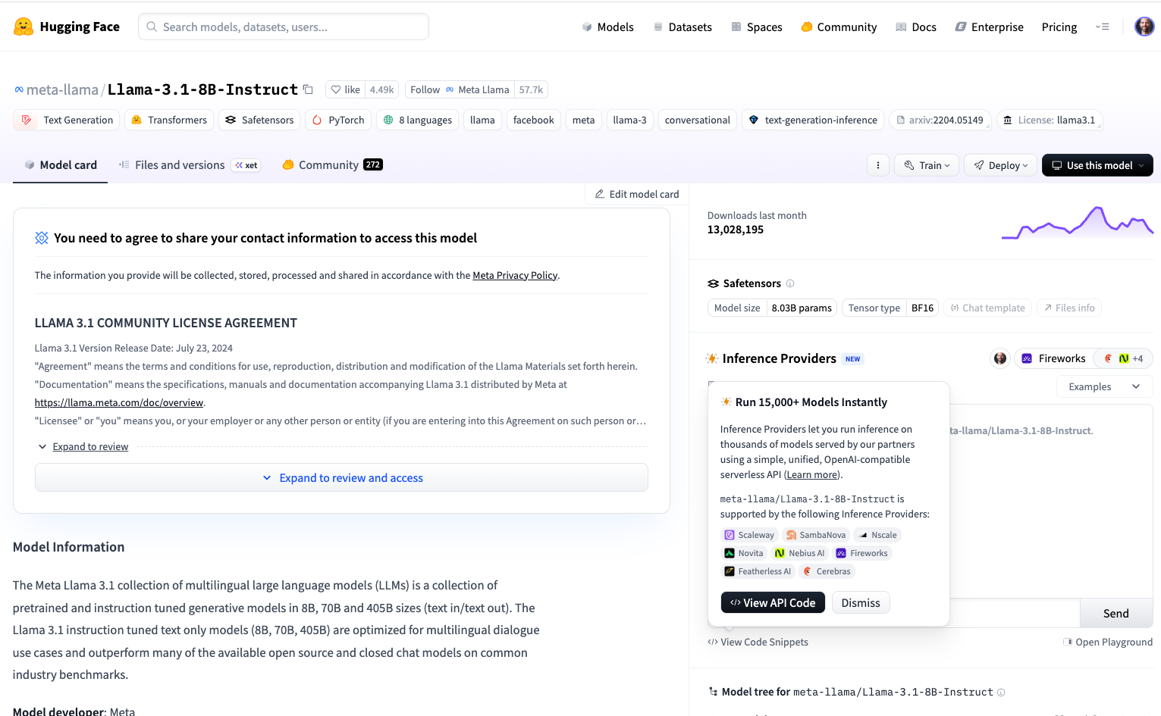
”Open Source”

Slide 23
Also! There’s a naming convention
Kind of like how our apps are compiled for various architectures!
ibm-granite/granite-4.0-8b-base
Model fine-tuned to be a baseline
Family name
Model architecture and version
Number of parameters
Mixtral-8x7B-Instruct-v0.1
Model version
Family name
Number of parameters
Model fine-tuned for instructive tasks
Architecture type

Slide 24
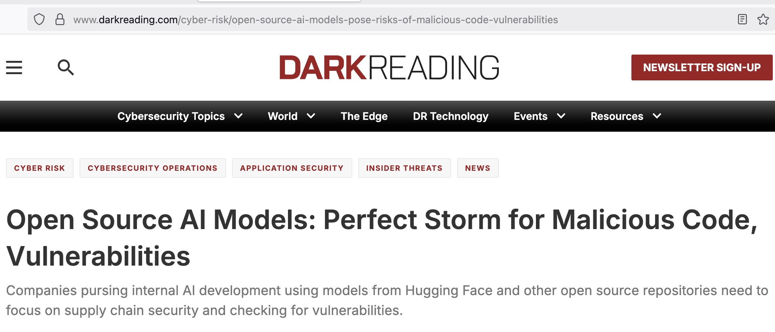
Local models mean there’s no security risk, right!?
https://www.darkreading.com/cyber-risk/open-source-ai-models-pose-risks-of-malicious-code-vulnerabilities

Slide 25

What about model size?

Slide 26
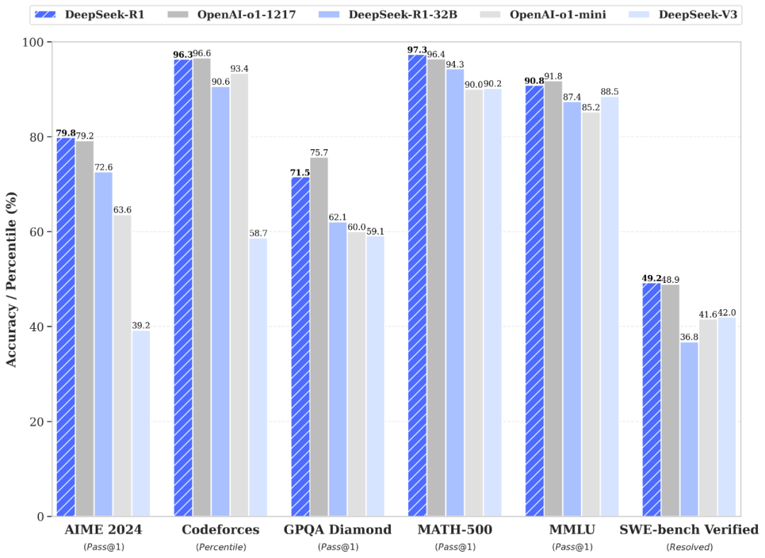

How to deploy a larger model?
Let’s say you want the best benchmarks with a frontier model

Slide 27
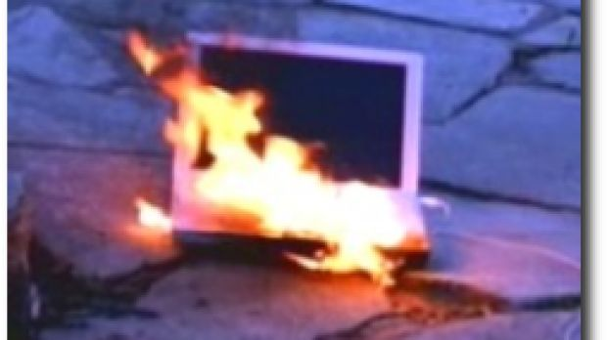
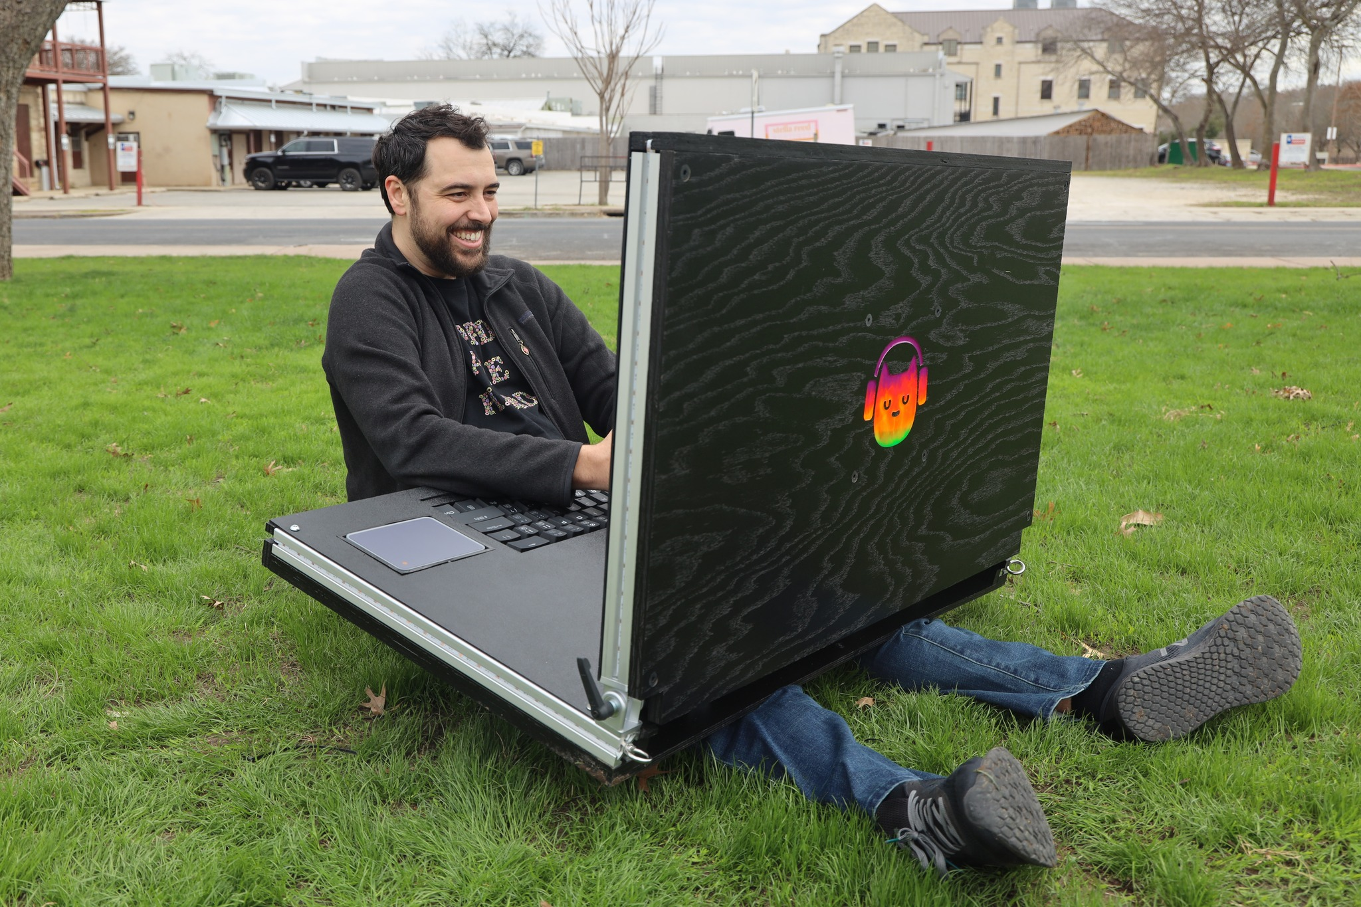
Neither of these situations is ideal :)

Slide 28
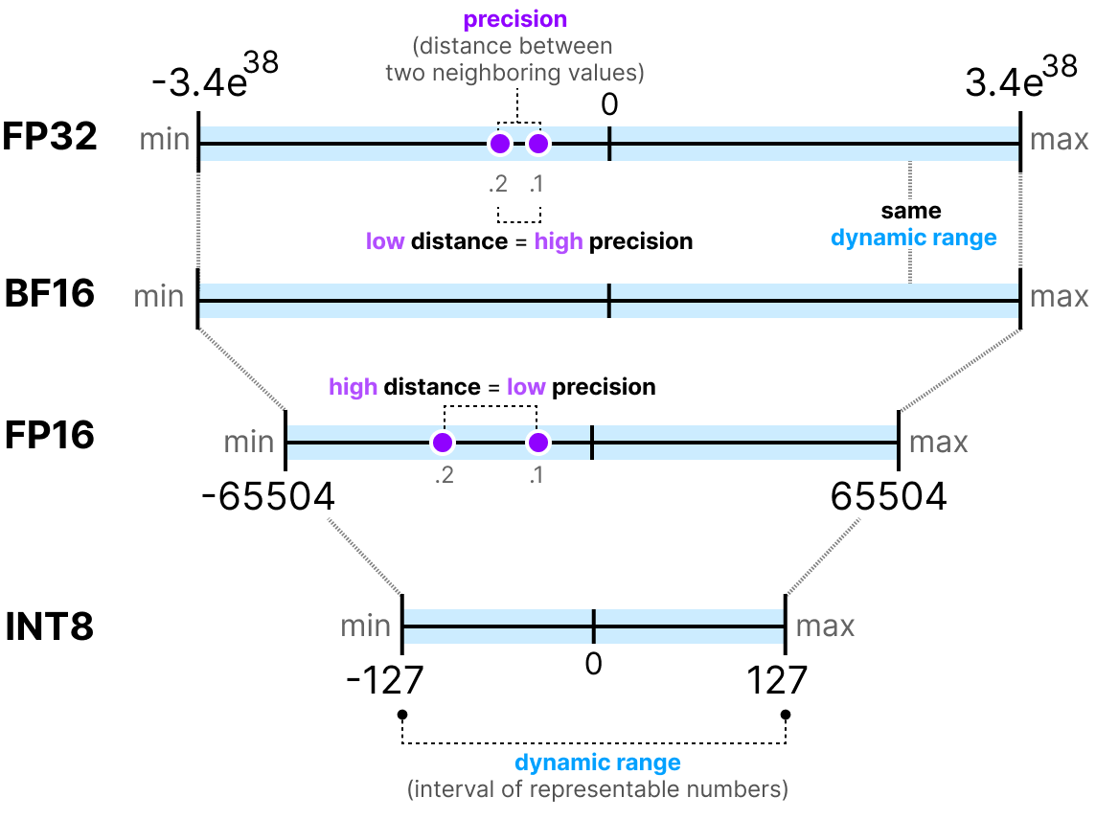

Most models for local usage are quantized!
It’s a way to compress models, think like a .zip or .tar
Quantization: A technique to compress LLMs by reducing numerical precision.
Converts high-precision weights (FP32) into lower-bit formats (FP16, INT8, INT4).
Reduces size and memory footprint, making models easier to deploy.

Slide 29

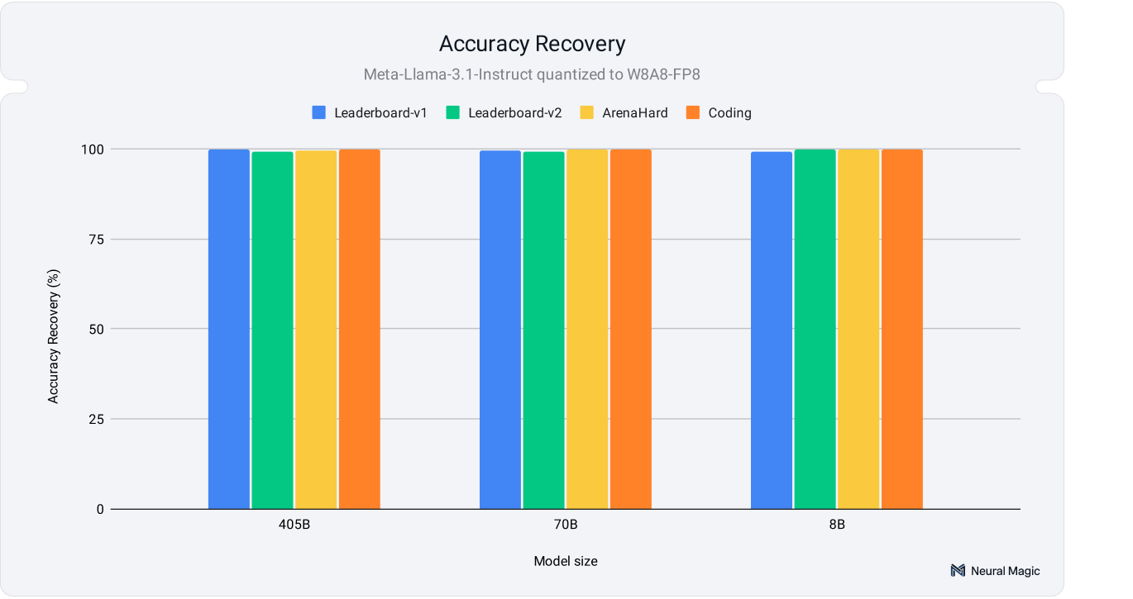
The Benefit? Run LLMs on “any” device, not just your local machine but IoT & Edge too
Results in faster and lighter models that still maintain reasonable accuracy
  Testing with Llama 3.1, for W4A16-INT resulted in 2.4x performance speedup and 3.5x model size compression
Works on GPUs & CPUs!
Source:
https://neuralmagic.com/blog/we-ran-over-half-a-million-evaluations-on-quantized-llms-heres-what-we-found

Slide 30
AI Engine? Check ✔
AI Model? Check ✔
Let’s start using these models!

Slide 31
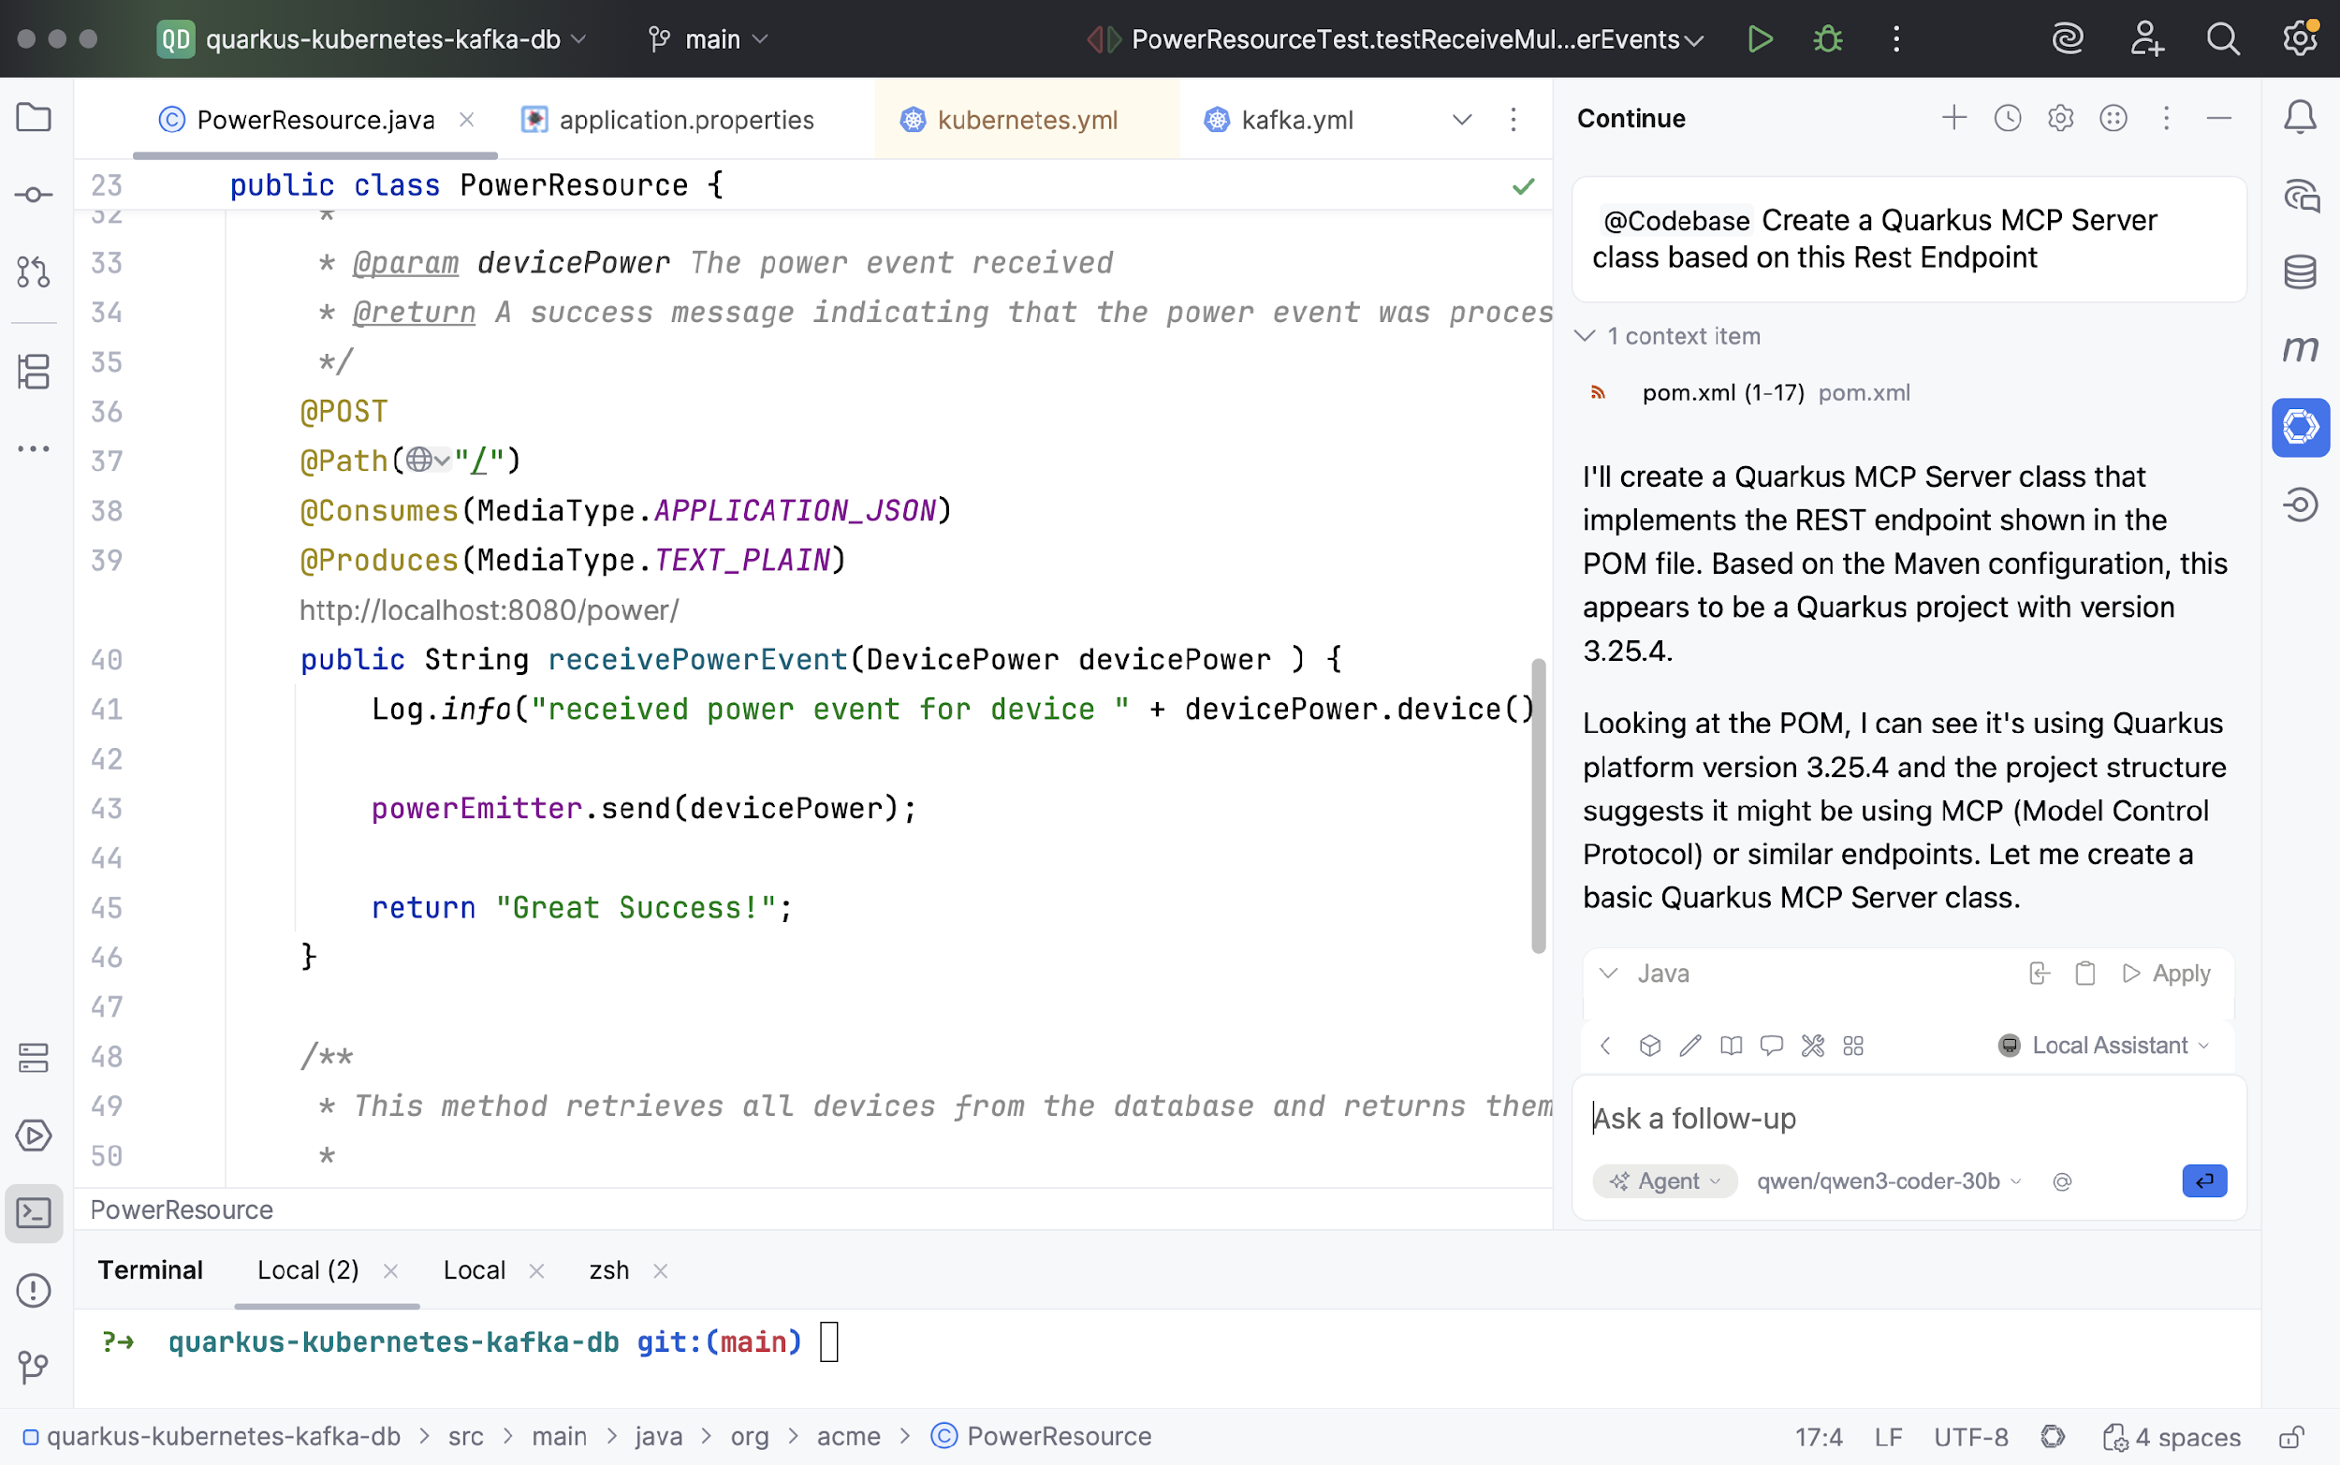

How to use local, disconnected (?) code assistants
Fortunately, many tools exist for this too!
Code
Assistance
Use a local model as a pair programmer, to generate and explain your codebase.
Tools: Continue, Roo Code, Cline, Devoxx Genie …

Slide 33
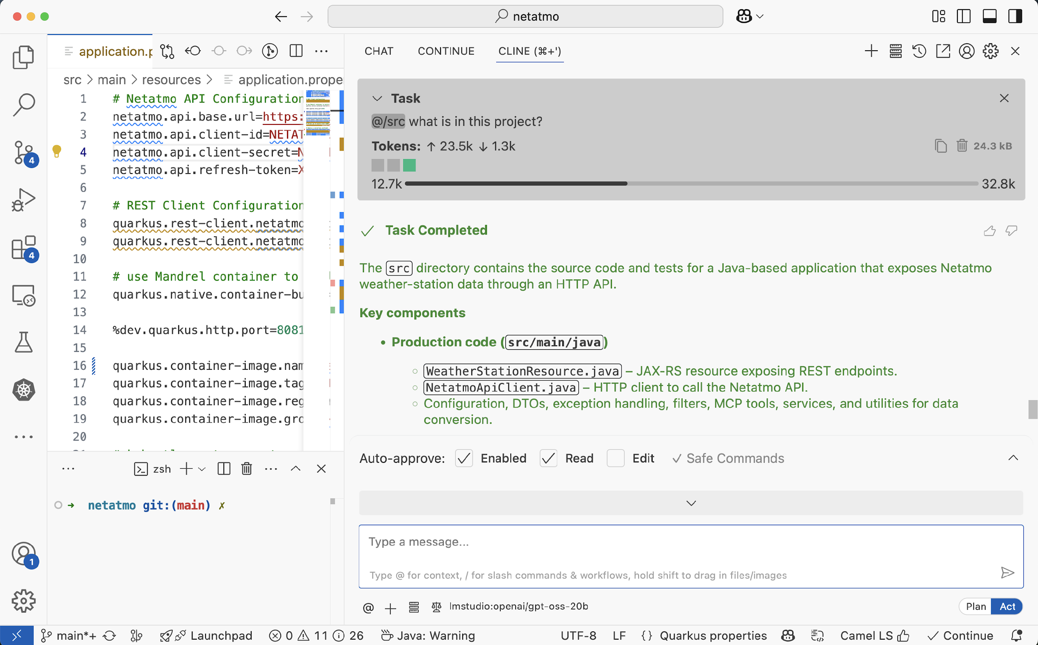

Slide 34
Building & running local, network optional,
Agentic Java AI Apps

Slide 35
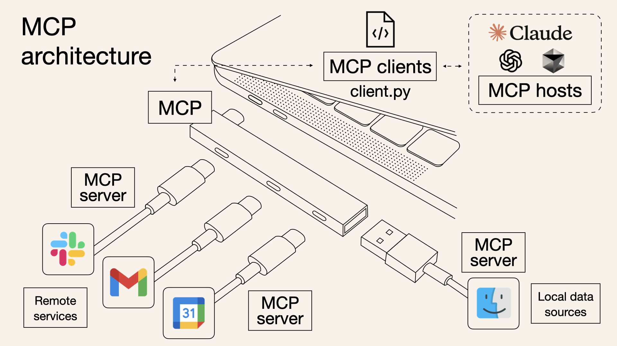

Model Context Protocol (MCP)
LangChain4j MCP Client

Slide 36
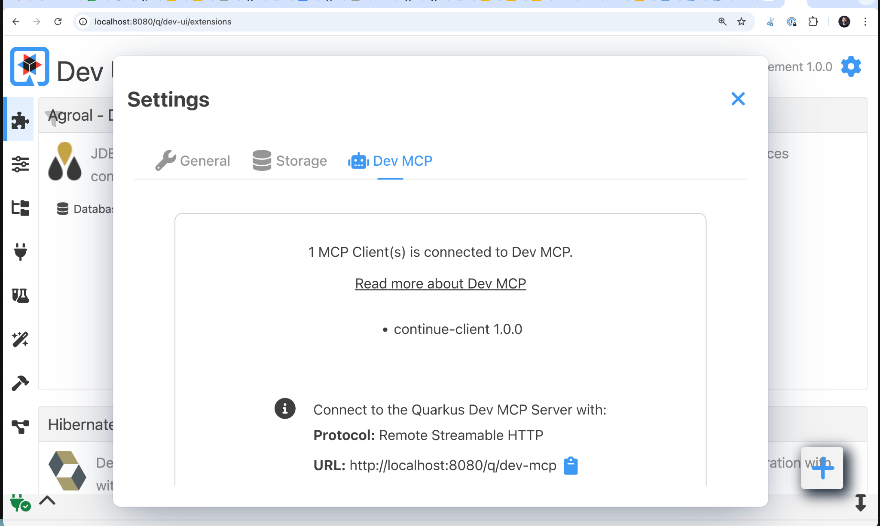
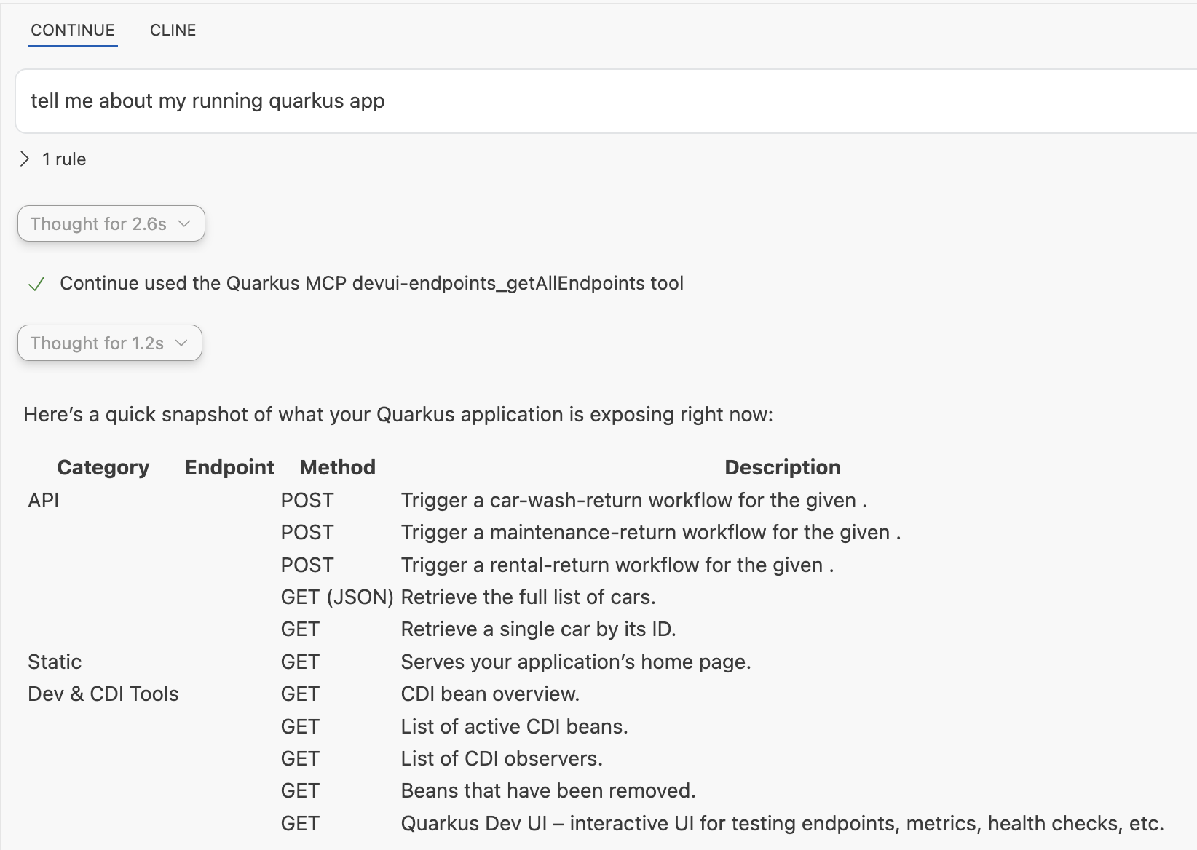

Slide 37
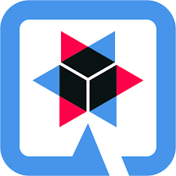

Wrapping it up
There are many options for serving and using models locally
Pick the right model for the right use case
Make sure the model comes from a reputable source (!)
Local code assistants work… ish
You might need to ask for hardware upgrades 😅
Developing local Agentic AI apps with Java is definitely possible (& kind of fun with Quarkus!).
Notes:
Augment the model with custom text, so the generic model is enhanced with documents of our tick

Slide 38

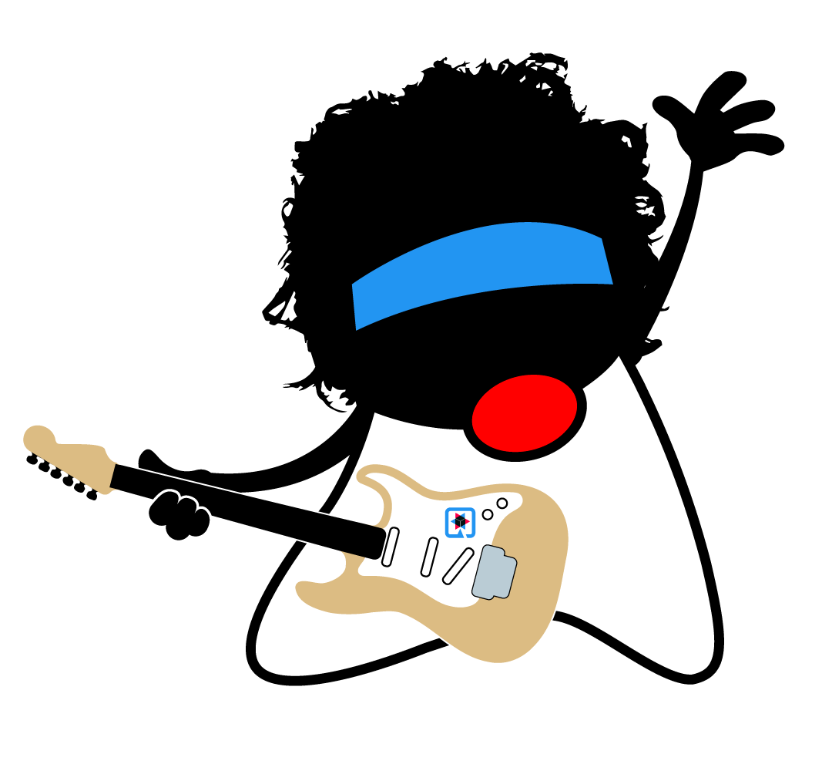


Thank you!
Thank you!
podman-desktop.io
docs.quarkiverse.io/quarkus-langchain4j
github.com/kdubois/netatmo-java-mcp
www.ibm.com/granite
continue.dev
ollama.com
huggingface.co
ibm.com/products/bob
speakerdeck.com/kdubois
@kevindubois.com
slides
youtube.com/@thekevindubois
linkedin.com/in/kevindubois
github.com/kdubois
@kevindubois@mastodon.social

