Slide 1
2025 Sponsorship
Prospectus
EMEA
Opatija | London | Madrid | Copenhagen | Johannesburg | Stockholm | Utrecht | Brussels | Warsaw | Helsinki | Paris | Rome | Riyadh | Darmstadt | Istanbul | Zurich | Dubai

Slide 2
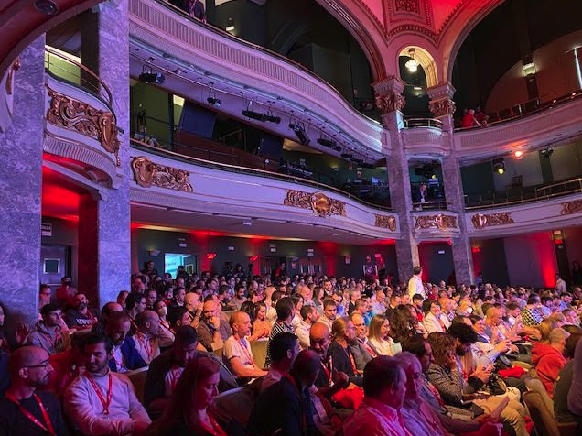
Table of contents
2024 event highlights and attendee demographics | 3
Thank you to our 2024 sponsors | 5
2025 event overview (locations and dates) | 8
Why sponsor? | 9
Sponsorship packages overview | 10
Reserve your sponsorship | 25

Slide 3
Red Hat Summit: Connect took place in 17 cities across EMEA in 2024. We welcomed thousands of customers, partners, community members, and IT professionals to learn and collaborate on technologies from the datacenter and public cloud to the edge and beyond.
2024 in-person event highlights
13,105+
attendees
171
sponsors
83
customer speakers
4M +
social impressions
500+
sessions
and labs
20+
journalists and analysts

Slide 4
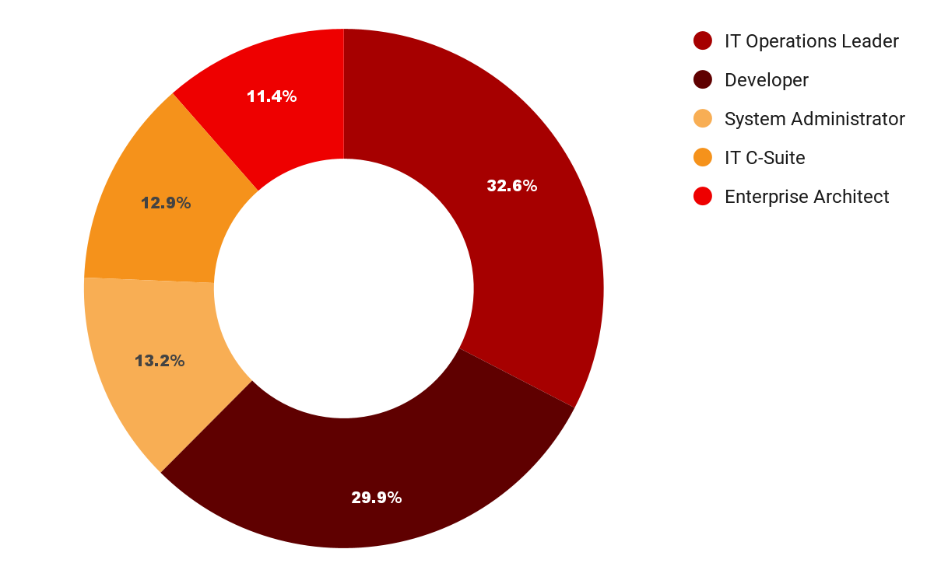
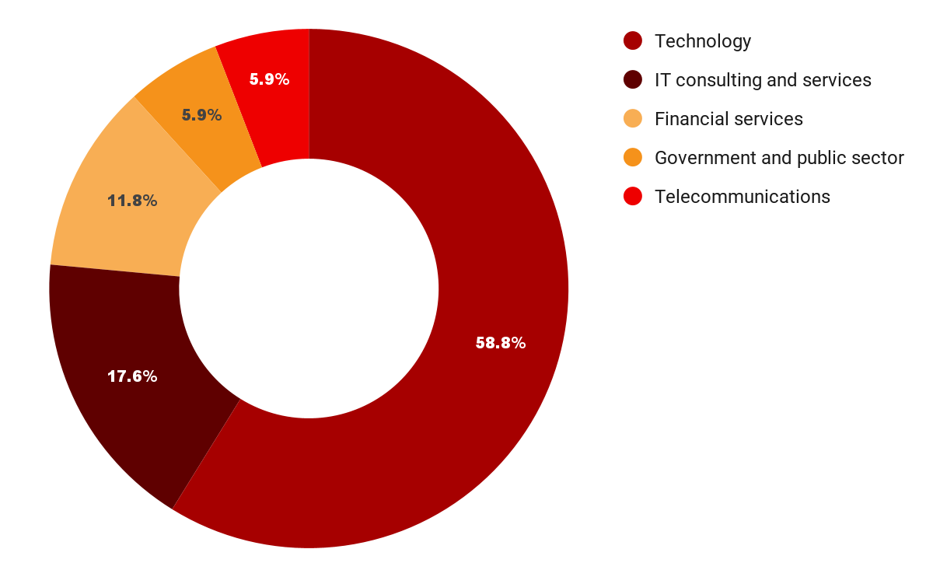
2024 in-person event attendee demographics
Top 5 Job Roles
Top 5 Industries
Note: Highlights and attendee demographics are not projections for Red Hat Summit: Connects 2025 and should be used for reference only.

Slide 5
Support for Red Hat Summit Connects in 2024
included:

Slide 6
Red Hat Summit: Connect 2025
EMEA
Unlock what’s next
This year, a collaborative community of technology professionals will gather across 17 cities in EMEA to unlock what’s next in open source. Join us at Red Hat® Summit: Connect to build new skills, challenge tech complexity, and move your organization forward.
Attendees and partners gain the best knowledge in the industry through:
Technical and business sessions
Presenter-led and self-paced hands-on labs
Customer panels and presentations
Visionary keynotes from industry leaders
Networking opportunities and events
1:1 collaboration with Red Hat subject matter experts

Slide 7
Red Hat Summit: Connect 2025 Overview
Event Structure Opportunities:
Plenary sessions that include an inspirational talk, customer success stories and high-level demos
Moderated panel sessions
Parallel working sessions
Workshops and partner sessions.
Pre-booked exec meetings
Exhibition area
Exclusive invitation only networking
Drinks reception
Business decision makers and influencers
Press activities
Number of Attendees:
Attendance ranges from 200-1200 depending on location.
Target Audiences:
IT decision makers, Directors of the following areas: Innovation, Development, Operations, Architecture, Business, CIOs, CEOs, CTOs.
Partners:
SPs, ISVs, GSI’s, CCSPs,
OEMs and distributors.
(These may vary depending on locations)

Slide 8
Red Hat Summit: Connect 2025
Locations & Dates
EMEA
Brussels
25 Sep 2025
Opatija 7-8 Oct 2025 | London 9 Oct 2025 | Madrid 9 Oct 2025 | Johannesburg 9 Oct 2025
Copenhagen
9 Oct 2025
Utrecht 15 Oct 2025 | Stockholm 16 Oct 2025 | Helsinki 23 Oct 2025 | Warsaw 28 Oct 2025
Paris 6 Nov 2025 | Rome 12 Nov 2025 | Riyadh Nov 2025 | Darmstadt 19 Nov 2025 | Istanbul Nov 2025
 | Zurich 14 Jan 2026 | Dubai 1 April 2026

Slide 9
Why sponsor?
Red Hat Summit: Connect is an exceptional opportunity to build awareness of your brand among technology leaders and practitioners from hundreds of leading organizations.
Share your organization’s brand and messaging with the brightest minds in the open source ecosystem.
Connect with Red Hat customers and prospects, and gain a deeper understanding of their needs and challenges.
Collect new leads to engage with and nurture after the event.
Promote your company’s visibility pre-event, on site, and post-event to Red Hat Summit: Connect’s social media following.
Interested in sponsoring Red Hat Summit: Connect 2025 in EMEA? View our package options!

Slide 10
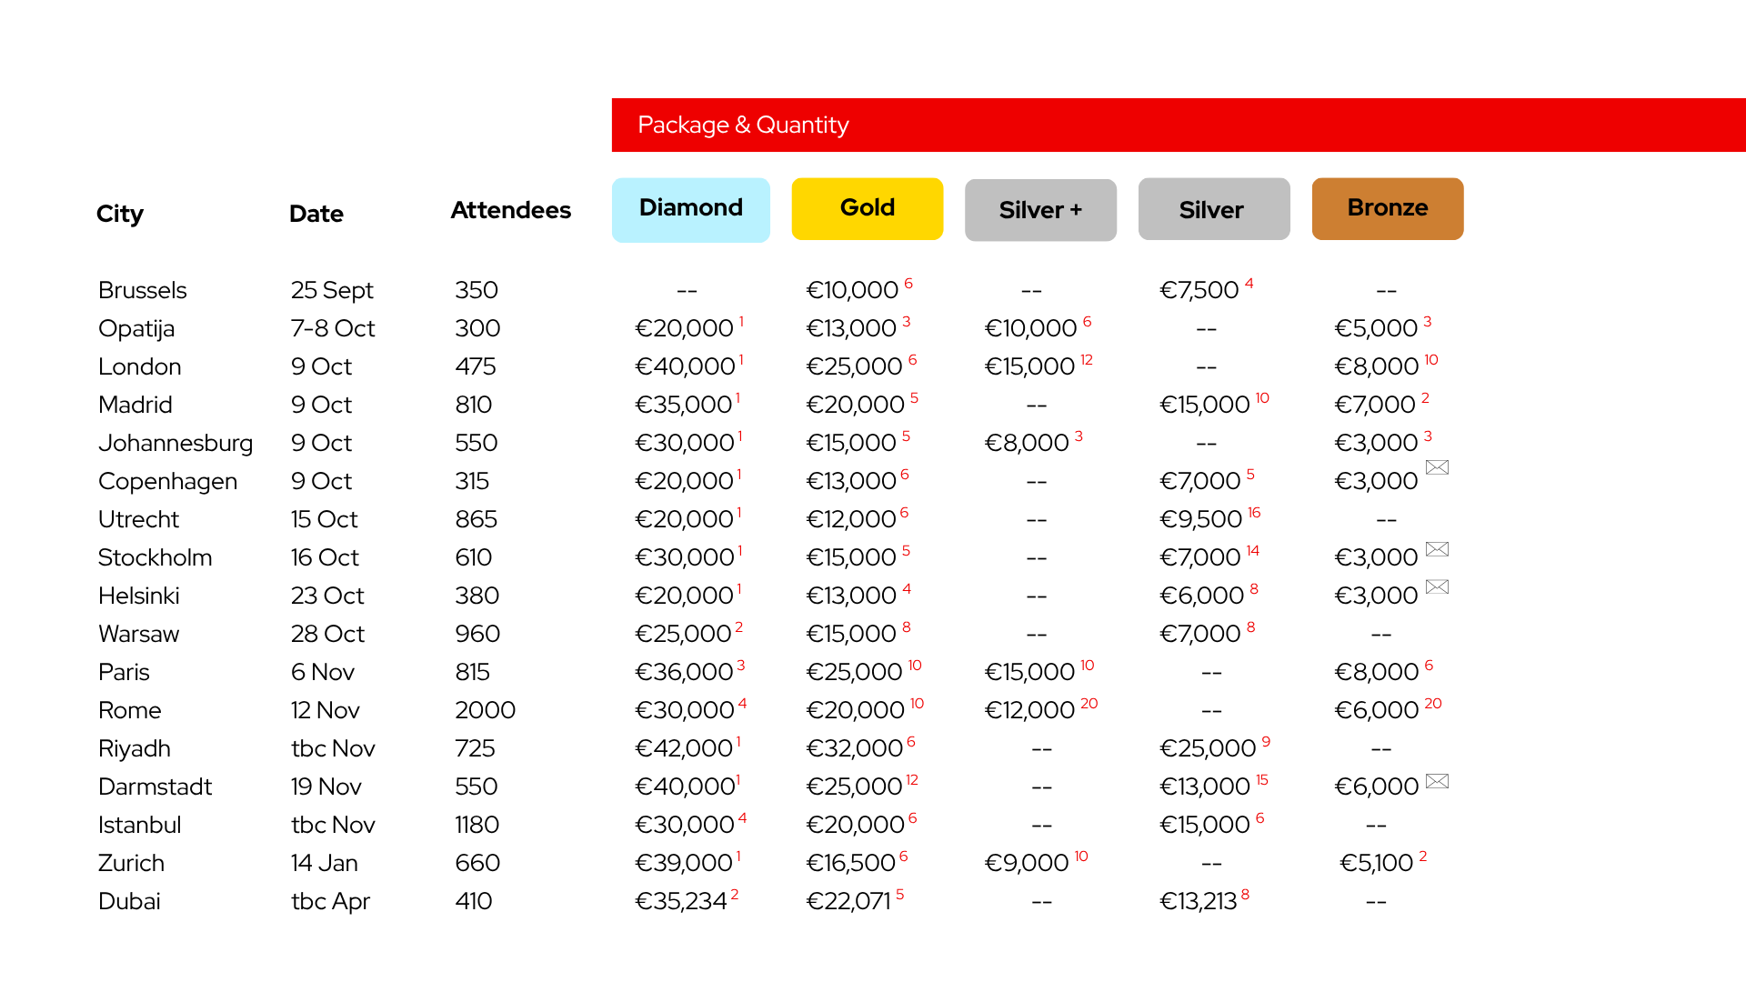
Sponsorship packages overview
Number next to price represents the quantity of packages.
Please contact us as soon as possible to secure your preferred package level to avoid disappointment.
Envelope symbol represents packages which are by invitation only.
All diamond packages are by invitation only.

Slide 11
Diamond
(by invitation only)
Gold
Silver+
Silver
Bronze
Overview of what’s included
Participation in plenary session (must inc. customer use case)
Breakout session
Speaking Opportunity*
Booth - Medium
Booth - Small
Booth - Large
Booth - Medium
Lead capturing
device
Lead capturing
device
Breakout session
4 passes
2 passes
2 invitations to *executive activity
Lead capturing device
Lead capturing device
6 passes
4 passes
Booth - Extra Large
Lead capturing device
8 passes
(*The format may vary depending on locations
Executive Exchange passes available at locations delivering the activity)
Notes:
Helena

Slide 12
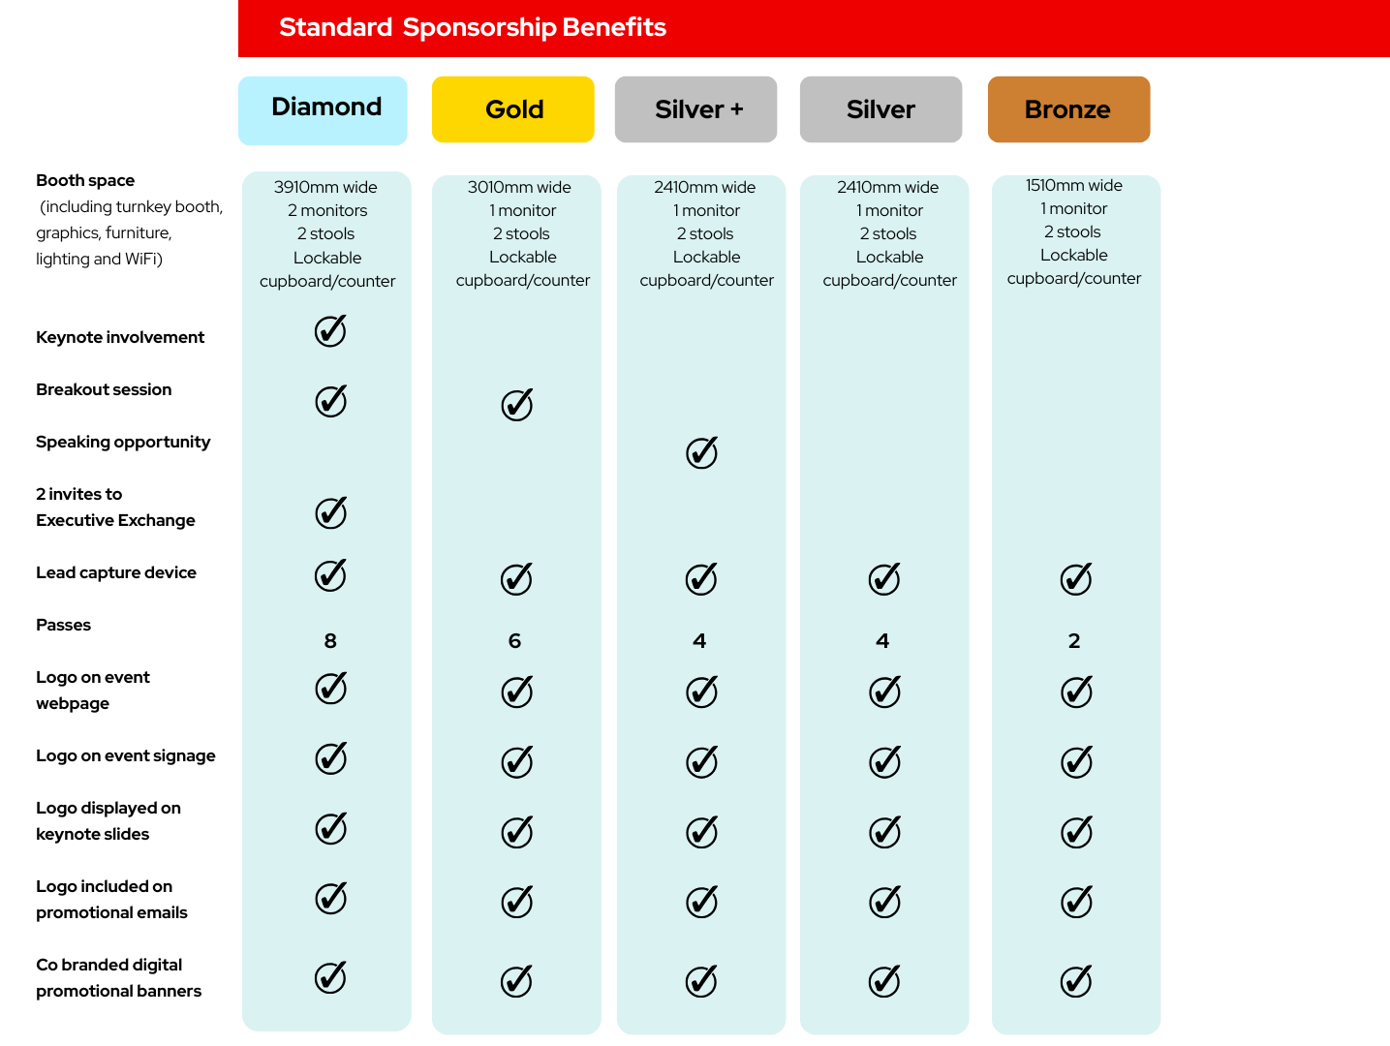
Package Overview
Standard booth packages may vary at location.
All specific details will be provided on the ERC.
All sessions are subject to review and approval by Red Hat.
Keynote session must include a customer use case.
Speaking opportunity format varies at location.
Executive Exchange passes available at locations hosting the activity.
Notes:
Helena

Slide 13
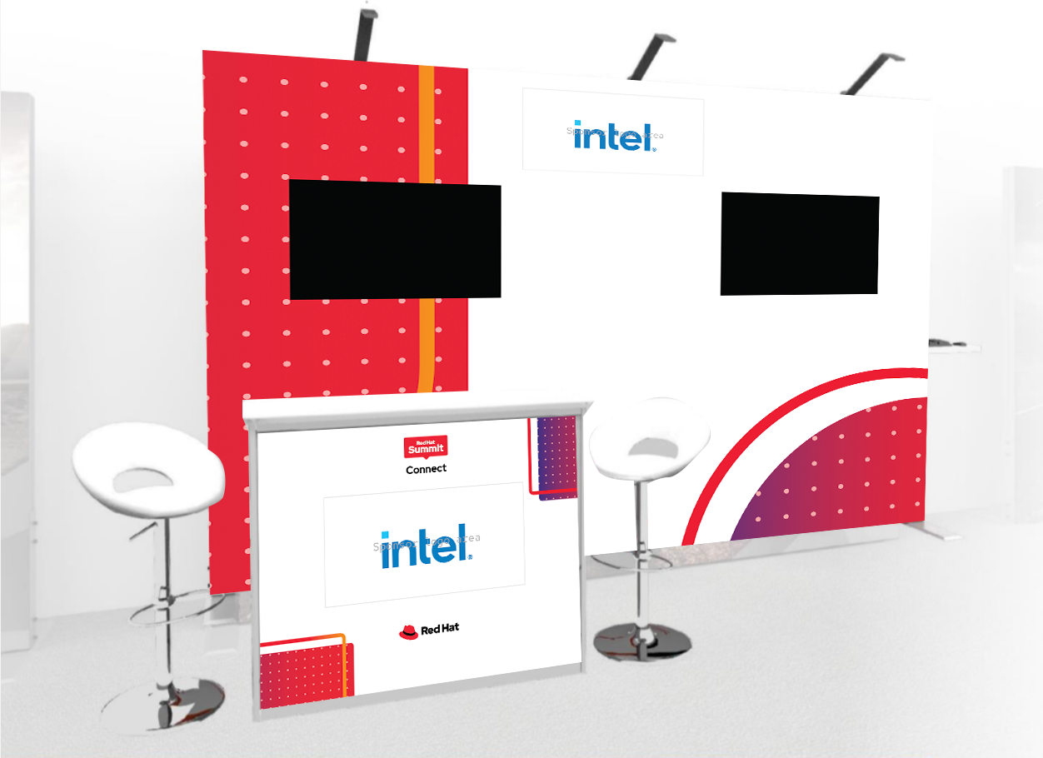
Diamond Package
Networking & Brand Presence
Extra large booth (2 monitors, lockable cupboard, your logo, 2 stools, wifi and electricity)
2 passes to Executive Exchange*
Logo featured during keynote
Logo featured on onsite branding
Logo and 100 word company description featured on event website
Communications
Logo included on event promotional emails
Co branded social banners supplied for your own promotion
Sessions promoted as part of the event agenda
Passes
8 passes (including speakers & booth staff)
2 additional passes for
Executive Exchange*
Speaking Opportunities
Keynote participation (must include a customer)
Breakout session
Leads
Opt in attendees to breakout session
Lead retrieval scanner at booth
3910mm wide 2 monitors with HDMI connection 2 stools Lockable cupboard/counter Logo featured on back wall and cupboard
*at locations where an Executive Exchange is taking place
Example

Slide 14
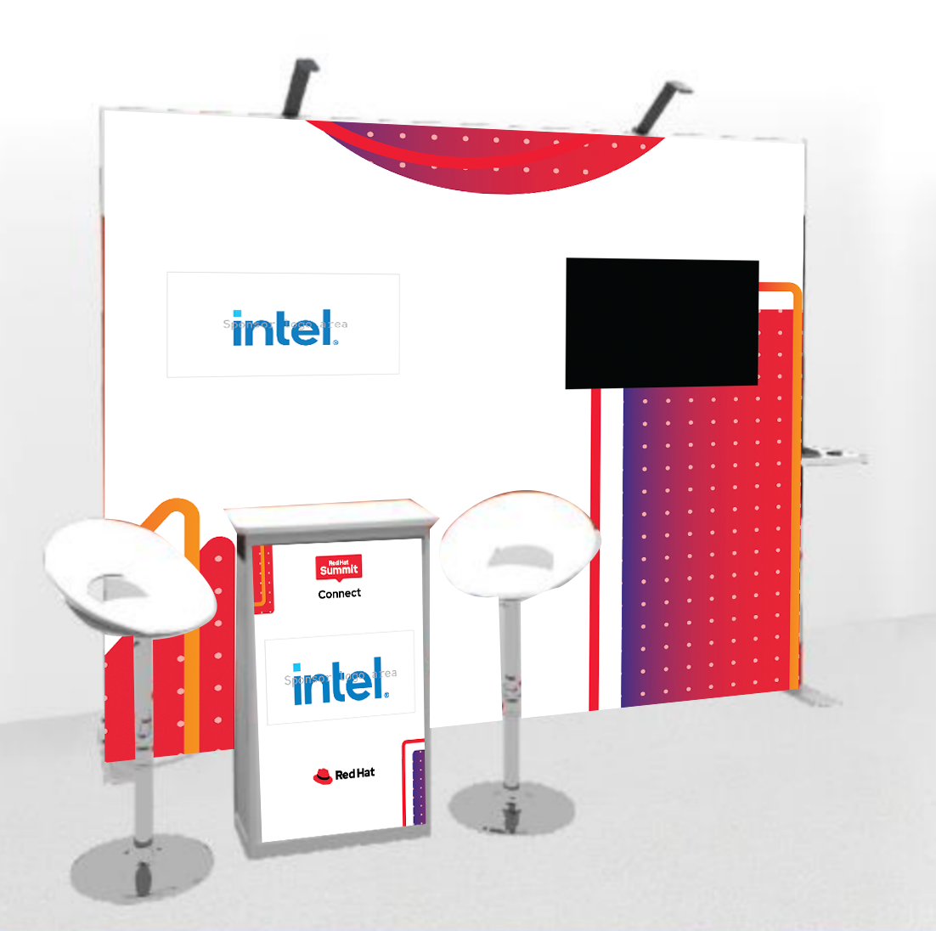
Gold Package
Networking & Brand Presence
Large booth (1 monitor, lockable cupboard, your logo, 2 stools, wifi and electricity)
Logo featured during keynote
Logo featured on onsite branding
Logo and 100 word company description featured on event website
Communications
Logo included on event promotional emails
Co branded social banners supplied for your own promotion
Sessions promoted as part of the event agenda
Passes
6 passes (including speakers & booth staff)
Speaking Opportunities
Breakout session
Leads
Opt in attendees to breakout session
Lead retrieval scanner at booth
3010mm wide 1 monitor with HDMI connection 2 stools Lockable cupboard/counter Logo featured on back wall and cupboard
Not final art

Slide 15
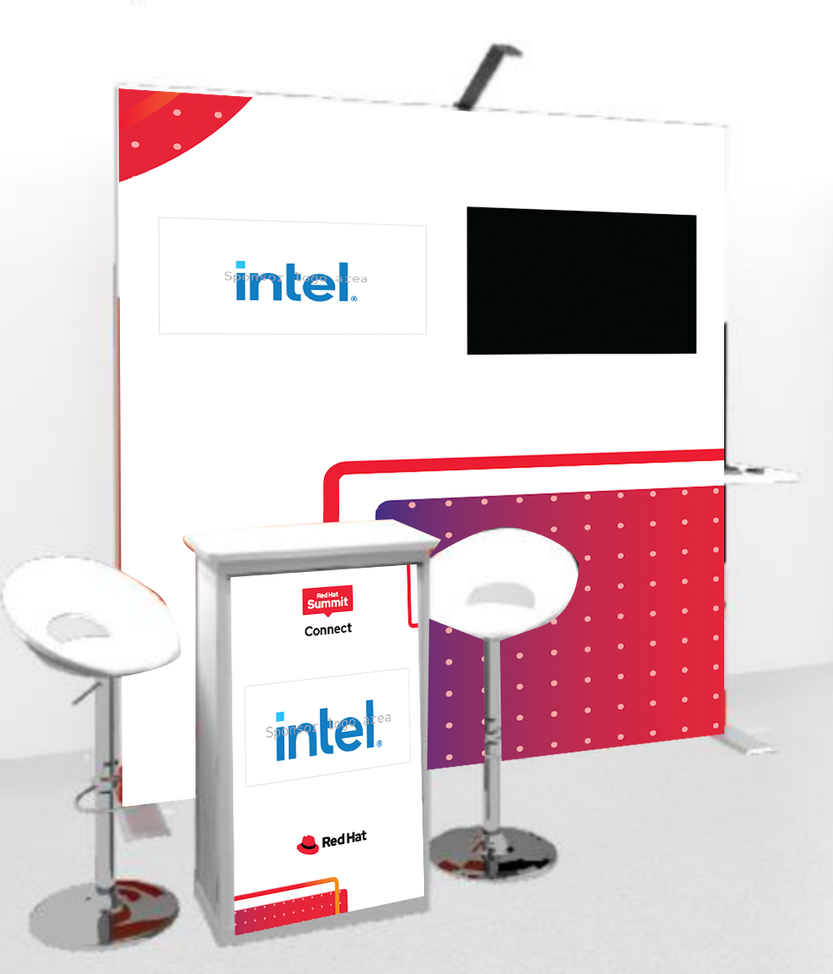
Silver + Package
Networking & Brand Presence
Medium booth (1 monitor, lockable cupboard, your logo, 2 stools, wifi and electricity)
Logo featured during keynote
Logo featured on onsite branding
Logo and 100 word company description featured on event website
Communications
Logo included on event promotional emails
Co branded social banners supplied for your own promotion
Session promoted as part of the event agenda
Passes
4 passes (including speakers & booth staff)
Speaking Opportunity
Breakout session, Panel Discussion or Lightning Talk (format depends on location)
Leads
Opt in attendees to speaking opportunity
Lead retrieval scanner at booth
2410mm wide 1 monitor with HDMI connection 2 stools Lockable cupboard/counter Logo featured on back wall and cupboard
Not final art

Slide 16
Silver Package
Networking & Brand Presence
Medium booth (1 monitor, lockable cupboard, your logo, 2 stools, wifi and electricity)
Logo featured during keynote
Logo featured on onsite branding
Logo and 100 word company description featured on event website
Leads
Lead retrieval scanner at booth
Passes
4 passes (including booth staff)
Communications
Logo included on event promotional emails
Co branded social banners supplied for your own promotion
2410mm wide 1 monitor with HDMI connection 2 stools Lockable cupboard/counter Logo featured on back wall and cupboard
Not final art

Slide 17
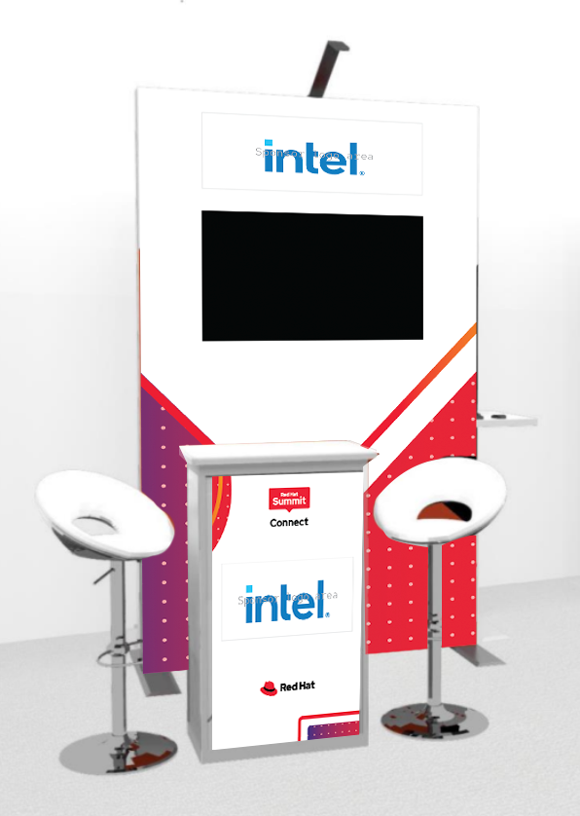
Bronze Package
Networking & Brand Presence
Small booth (1 monitor, lockable cupboard, your logo, 2 stools, wifi and electricity)
Logo featured during keynote
Logo featured on onsite branding
Logo and 100 word company description featured on event website
Leads
Lead retrieval scanner at booth
Passes
2 passes (including booth staff)
Communications
Logo included on event promotional emails
Co branded social banners supplied for your own promotion
1510mm wide 1 monitor with HDMI connection 2 stools Lockable cupboard/counter Logo featured on back wall and cupboard
Not final art

Slide 18
Marketing Promotional Opportunities
Marketing Promotional Opportunities (MPOs) are designed to customise and enhance a sponsor’s participation through unique engagement and increased brand awareness.
A selection of options are listed in the following slides. MPOs are available on a first come, first serve basis. Please note availability depends on the location. The team will ask you if you are interested in purchasing an MPO before contract.

Slide 19
Lunch sponsor 1 available per location
Price on application
Sponsorship includes:
Logo on all lunch tables and buffet stations
Logo on event webpage
2 delegate passes
Networking Reception 1 available per location
Price on application
Sponsorship includes:
Branding of networking reception area/room
Logo on drinks menu
Networking reception sponsor promoted on the agenda
Logo on event page
2 delegate passes
Please note availability depends on the location

Slide 20
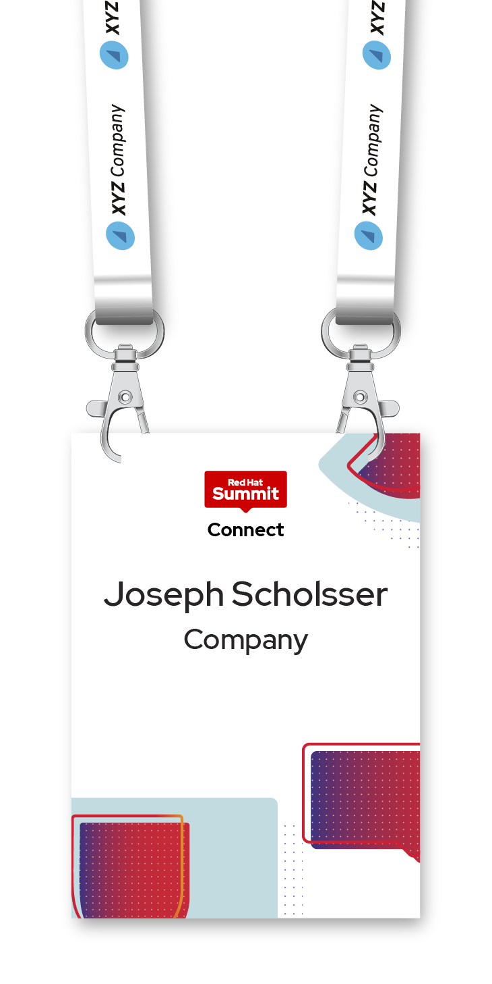
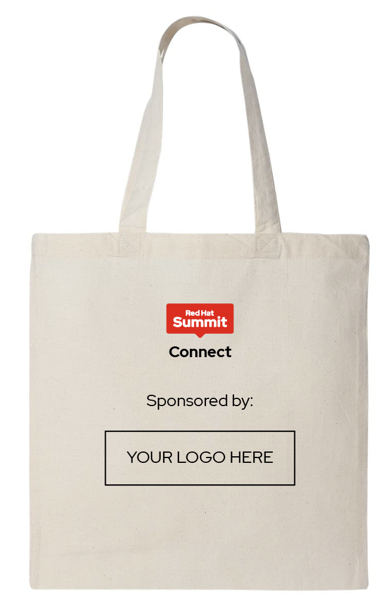
Tote bag sponsor 1 available per location
Price on application
Sponsorship includes:
To be given out to attendees at registration
Bag supplied by sponsor with your choice of design/logo
Logo on event page
2 delegate passes
Lanyard 1 available per location
Price on application
Sponsorship includes:
Co-branded lanyard (each attendee will receive at point of registration)
Logo on event page
2 delegate passes
Please note availability depends on the location

Slide 21
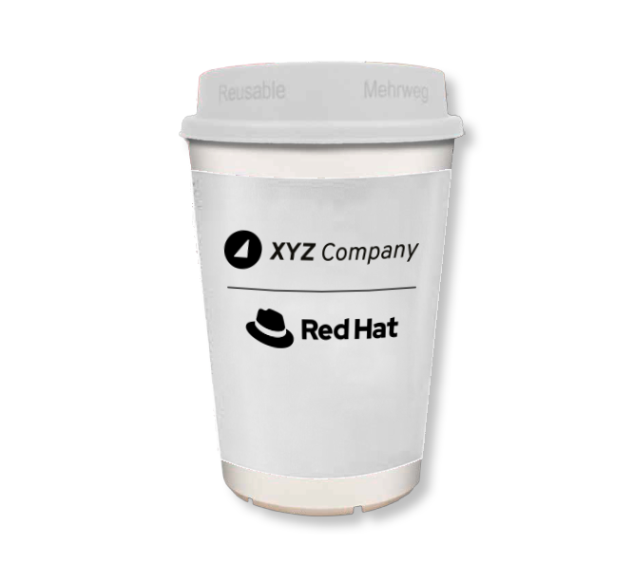
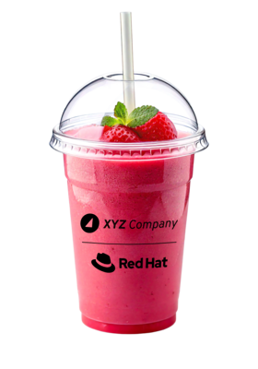
Smoothie bar
Price on application
Sponsorship includes:
Logo branding on the Smoothie station during the event
Logo on the drinks menu
Co-branded logo (with Red Hat) on the cup
Dedicated lead scanner
Logo on event page
2 delegate passes
Barista
Price on application
.
Sponsorship includes:
Logo branding on the barista station during the event
Logo on the drinks menu
Co-branded logo (with Red Hat) on the cup
Dedicated lead scanner
Logo on event page
2 delegate passes
Please note availability depends on the location

Slide 22
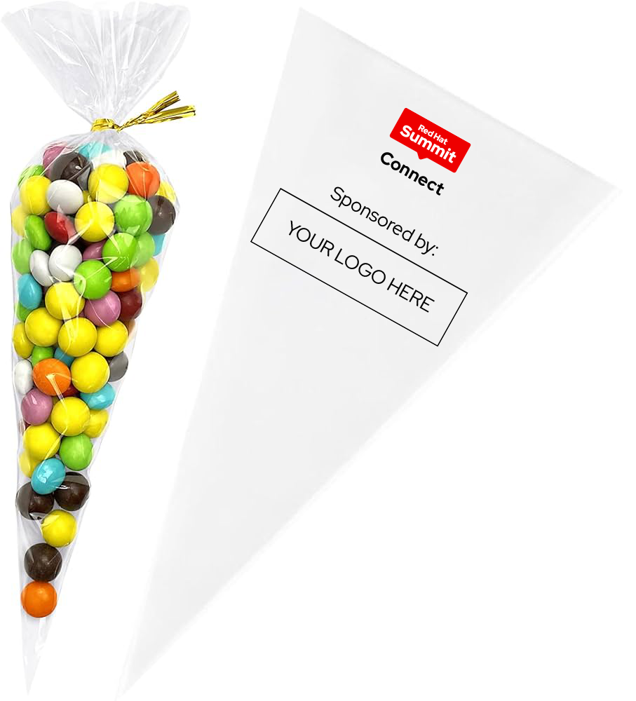
Popcorn machine
Price on application
Sponsorship includes:
Logo branding on popcorn station during the event
Logo on popcorn cones
Dedicated lead scanner
Logo on event webpage
2 delegate passes
Sweet trolley
Price on application
Sponsorship includes:
Logo branding on sweet station during the event
Logo on sweet cones/bags
Dedicated lead scanner
Logo on event webpage
2 delegate passes
Please note availability depends on the location

Slide 23
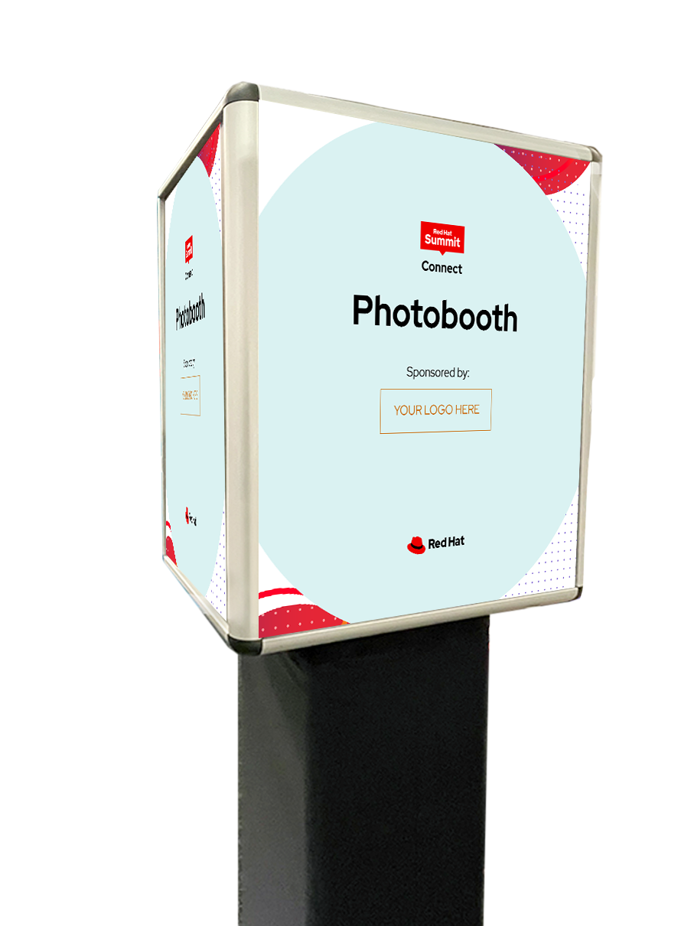
Photobooth
Price on application
Sponsorship includes:
Co branded photo wall with your logo
Sponsor logo on photobooth machine
Design/logo
Photoframe to include your logo
Logo on event page
2 delegate passes
Meeting space
Price on application
Sponsorship includes:
Dedicated access to a meeting space during the event
Co-branded HTML email template to invite your contacts
Logo on event webpage
2 delegate passes
Please note availability depends on the location

Slide 24
Breakout Track
Price on application
Only available to existing sponsors with package level Gold or above
Sponsorship includes:
Dedicated sponsor of a session track
Opportunity for some branding within the room
Listed as track sponsor on the agenda
Logo included on holding slides within track
Leads from all sessions within track
2 additional passes
Please note availability depends on the location

Slide 25
How to reserve your sponsorship
RED HAT SUMMIT: CONNECT EMEA
Every year, many of our top-tier sponsorship packages sell out shortly after the prospectus is released. To avoid missing out, please submit the sponsorship intake form as soon as possible.
Submit your intake form
Once the intake form is submitted, the Red Hat Summit: Connect sponsorship team will be in contact with you within 72 hours to confirm availability and walk you through the next steps of the contract process.
All packages are sold on a first-come, first-served basis. A signed contract is required to secure your sponsorship and be placed in the booth selection queue. Guidelines and due dates are included within the contract and Exhibitor Resource Center (ERC). All items are subject to Red Hat approval.
We’re excited to partner with you and ensure your presence on site meets your organization’s objectives and offers you a successful event experience.
If you have any questions regarding our sponsorship packages or would like more information, please connect with our Sponsorship Team.

Slide 26
Frequently Asked Questions
What happens after I submit the request form?
The Sponsorship Team will check availability and will endeavour to respond to your request within 72 hours. If you are sponsoring 1 -3 cities you will be introduced to the local agency who will deal with your contract and invoice. If you are sponsoring more than 3 cities, the Sponsorship Team will ask whether you wish to contract for each city, locally and individually or whether you wish to contract once.
When is payment due?
Once the contract is signed, an invoice will be generated. Payment is due at least 30 days before the event.
Are there any discounts?
All packages have been priced at market value and reflect the benefits included. Discounts are available to those who wish to sponsor multiple cities, starting at 3% for 3 cities, increasing to 10% for 10 cities.
How do I prepare for the events?
This year, we are pleased to introduce an Exhibitor Resource Center (ERC). This online platform will host all information relating to your sponsorship and also will collect your information (logo, booth artwork, session information).
I would like to know more about a particular event, who do I contact?
Please email emea-event-team@redhat.com.

Slide 27
Thank you
We look forward to partnering with you.

